Slide 2
Jonah (2:1-10)

Slide 3
Jonah (2:1-10)

Slide 4
Jonah (2:1-10)

Slide 5
Jonah (2:1-10)

Slide 6
Jonah (2:1-10)

Slide 7
Prayer in Times of Adversity

Slide 8
Prayer in Times of Adversity

Slide 9
Jonah (2:1-10)

Slide 11
Prayer in Distress

Slide 13
Prayer in Times of Adversity

Slide 14
Jonah (2:1-10)

Slide 16
Several Kinds of Suffering

Slide 21
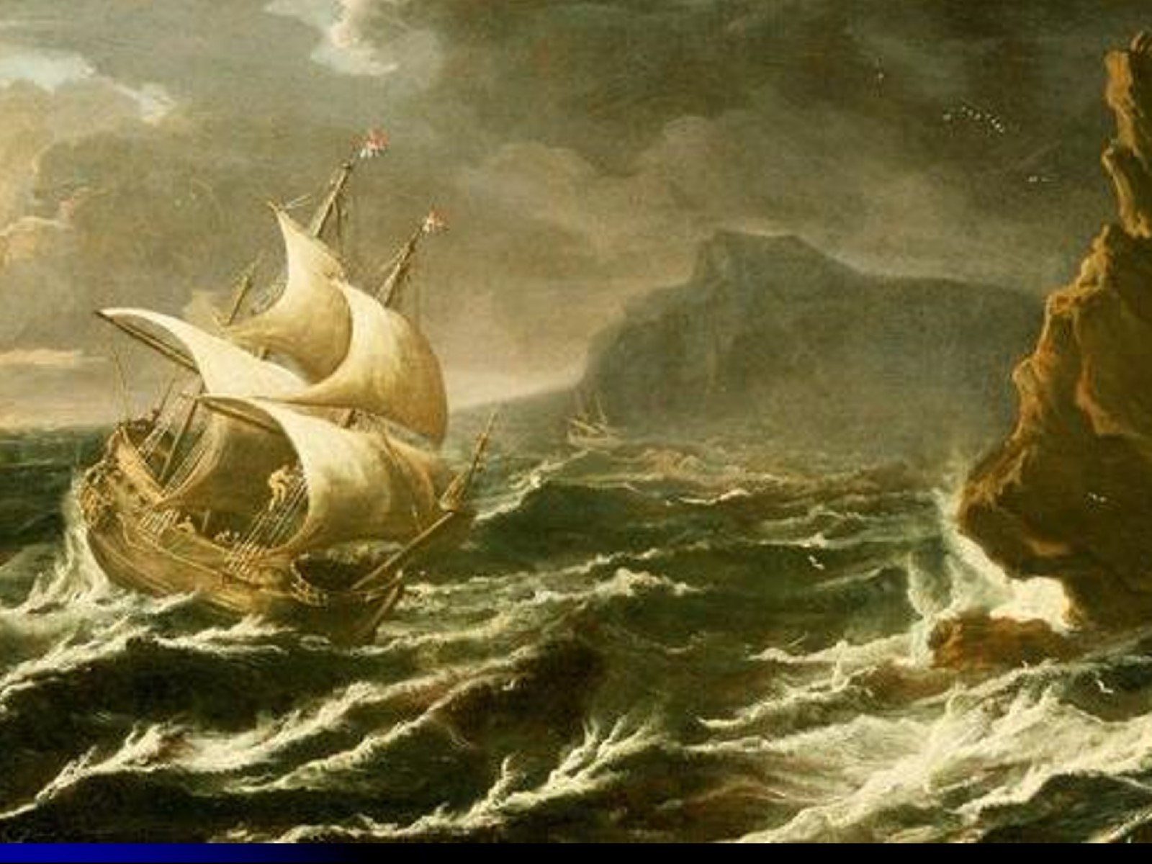

Slide 23
Jonah (2:1-10)

Slide 24
Responses to Discipline

Slide 26
Jonah (2:1-10)

Slide 29
Robert Robinson Come, Thou Fount of Every Blessing

Slide 30
Robert Robinson Come, Thou Fount of Every Blessing

Slide 31
Prayer in Times of Adversity

Slide 32
Jonah (2:1-10)

Slide 33
Making Good of Prayer Vows

Slide 34
Jonah (2:1-10)

Slide 42
Prayer in Times of Adversity

