Slide 1
Lent
Lavish Devotion

Slide 2
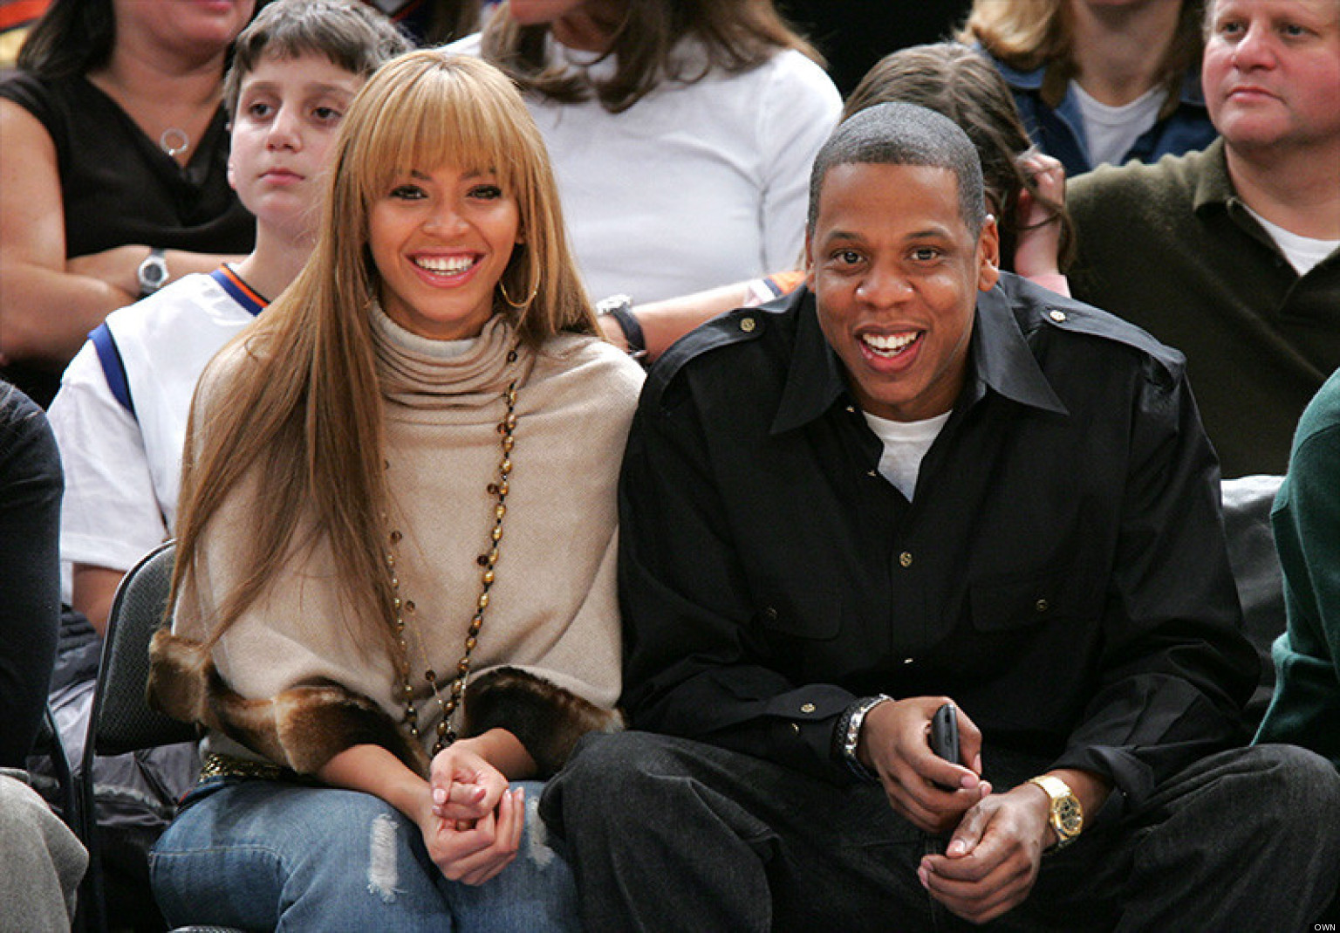

Slide 3
¹ Six days before the Passover, Jesus came to Bethany, where Lazarus lived, whom Jesus had raised from the dead. ² Here a dinner was given in Jesus’ honor. Martha served, while Lazarus was among those reclining at the table with him. ³ Then Mary took about a pint of pure nard, an expensive perfume; she poured it on Jesus’ feet and wiped his feet with her hair. And the house was filled with the fragrance of the perfume.

Slide 4
⁴ But one of his disciples, Judas Iscariot, who was later to betray him, objected, ⁵ “Why wasn’t this perfume sold and the money given to the poor? It was worth a year’s wages.” ⁶ He did not say this because he cared about the poor but because he was a thief; as keeper of the money bag, he used to help himself to what was put into it.

Slide 5
⁷ “Leave her alone,” Jesus replied. “It was intended that she should save this perfume for the day of my burial. ⁸ You will always have the poor among you, but you will not always have me.”
John 12:1-8

Slide 6
A Gathering of Friends

Slide 7
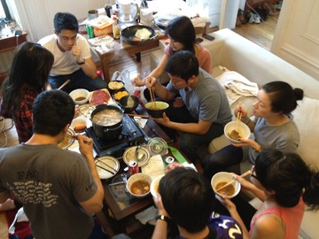

Slide 8
¹ Six days before the Passover, Jesus came to Bethany, where Lazarus lived, whom Jesus had raised from the dead. ² Here a dinner was given in Jesus’ honor. Martha served, while Lazarus was among those reclining at the table with him. ³ Then Mary . . .

Slide 9
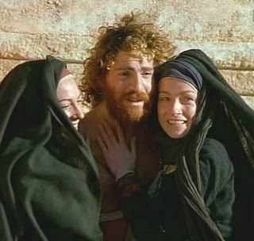

Slide 10
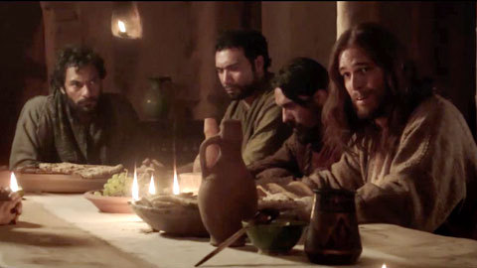

Slide 11
An act of extravagant worship

Slide 13
³ Then Mary took about a pint of pure nard, an expensive perfume; she poured it on Jesus’ feet and wiped his feet with her hair. And the house was filled with the fragrance of the perfume.

Slide 15
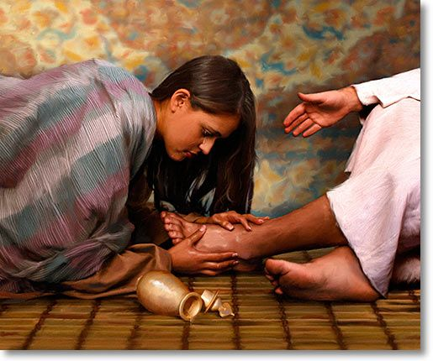

Slide 16
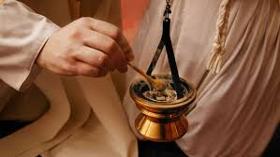

Slide 17
A Teachable Moment

Slide 19
⁴ But one of his disciples, Judas Iscariot, who was later to betray him, objected, ⁵ “Why wasn’t this perfume sold and the money given to the poor? It was worth a year’s wages.” ⁶ He did not say this because he cared about the poor but because he was a thief; as keeper of the money bag, he used to help himself to what was put into it.

Slide 20
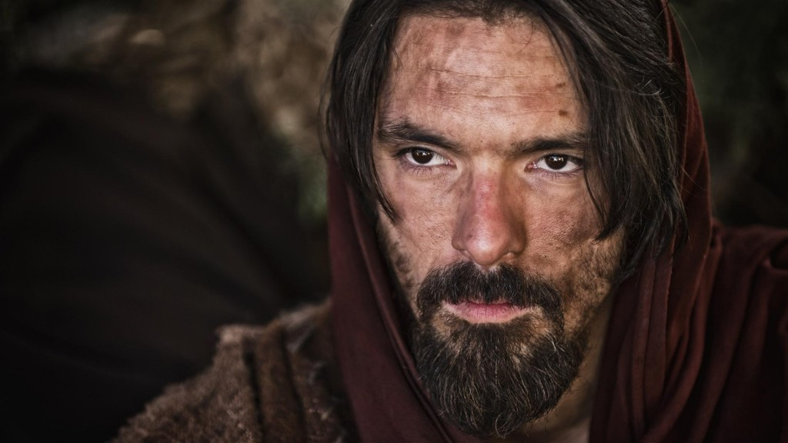

Slide 21
⁷ “Leave her alone,” Jesus replied. “It was intended that she should save this perfume for the day of my burial. ⁸ You will always have the poor among you, but you will not always have me.”

Slide 22
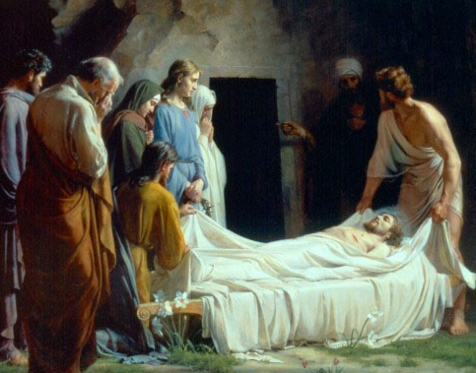

Slide 23
Application

Slide 24
Lavish devotion contrasts critical stinginess. This passage gives permission, so to speak, to honor Jesus in extravagant ways, perhaps even by giving a massive donation to the poor. It warns against mistaking discipline for discipleship. It embraces affection as part of a devotion to Jesus that is nothing less than the costly, precious gift of one's whole self--down to every last strand of hair.
Dr. Matt Skinner

