Slide 1
Jesus
Left Behind

Slide 2
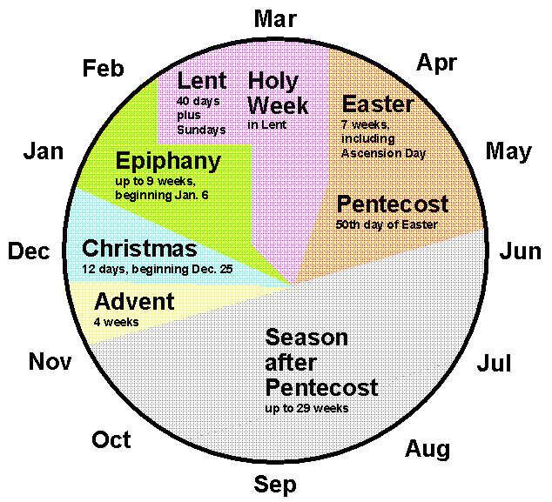

Slide 4
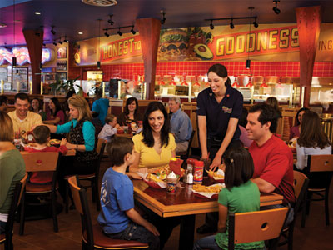

Slide 6
⁴¹ Every year Jesus’ parents went to Jerusalem for the Festival of the Passover. ⁴² When he was twelve years old, they went up to the festival, according to the custom. ⁴³ After the festival was over, while his parents were returning home, the boy Jesus stayed behind in Jerusalem, but they were unaware of it. ⁴⁴ Thinking he was in their company, they traveled on for a day. Then they began looking for him among their relatives and friends. ⁴⁵ When they did not find him, they went back to Jerusalem to look for him.
Luke 2

Slide 7
⁴⁶ After three days they found him in the temple courts, sitting among the teachers, listening to them and asking them questions. ⁴⁷ Everyone who heard him was amazed at his understanding and his answers. ⁴⁸ When his parents saw him, they were astonished. His mother said to him, “Son, why have you treated us like this? Your father and I have been anxiously searching for you.”
Luke 2

Slide 8
⁴⁹ “Why were you searching for me?” he asked. “Didn’t you know I had to be in my Father’s house?” ⁵⁰ But they did not understand what he was saying to them.
⁵¹ Then he went down to Nazareth with them and was obedient to them. But his mother treasured all these things in her heart. ⁵² And Jesus grew in wisdom and stature, and in favor with God and man.
Luke 2

Slide 9
Why is this passage in the Bible?

Slide 11
Why did Jesus’ parents visit Jerusalem?

Slide 12
⁴¹ Every year Jesus’ parents went to Jerusalem for the Festival of the Passover. ⁴² When he was twelve years old, they went up to the festival, according to the custom.
Luke 2

Slide 14
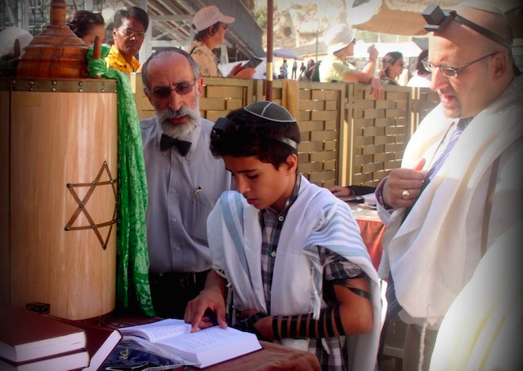

Slide 15
Were Mary & Joseph negligent parents?

Slide 16
⁴³ After the festival was over, while his parents were returning home, the boy Jesus stayed behind in Jerusalem, but they were unaware of it. ⁴⁴ Thinking he was in their company, they traveled on for a day. Then they began looking for him among their relatives and friends. ⁴⁵ When they did not find him, they went back to Jerusalem to look for him. ⁴⁶ After three days they found him in the temple courts, sitting among the teachers, listening to them and asking them questions. ⁴⁷ Everyone who heard him was amazed at his understanding and his answers.

Slide 17
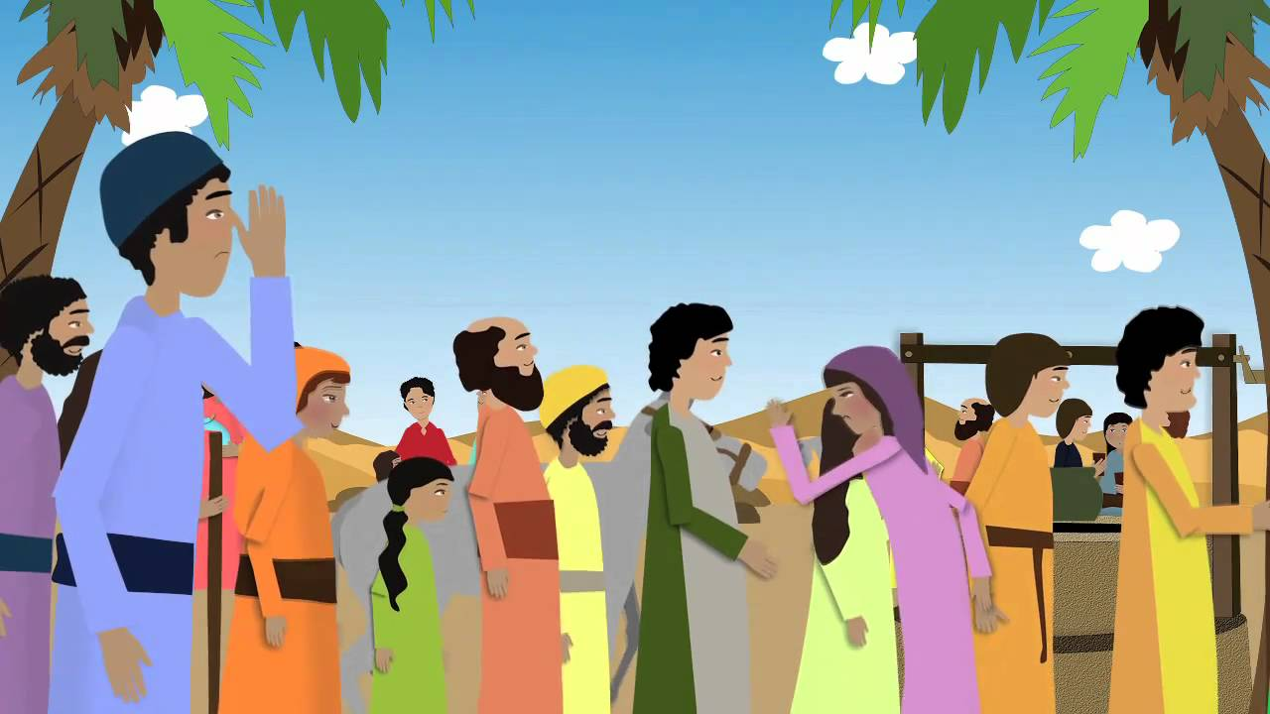

Slide 18
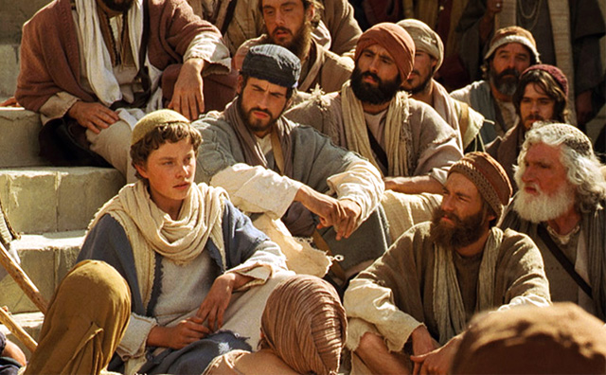

Slide 19
Did Jesus sin against his parents?

Slide 20
⁴⁸ When his parents saw him, they were astonished. His mother said to him, “Son, why have you treated us like this? Your father and I have been anxiously searching for you.”
⁴⁹ “Why were you searching for me?” he asked. “Didn’t you know I had to be in my Father’s house?” ⁵⁰ But they did not understand what he was saying to them.
⁵¹ Then he went down to Nazareth with them and was obedient to them.
Luke 2

Slide 22
What can we learn from this passage?

Slide 23
⁴⁹ “Why were you searching for me?” he asked. “Didn’t you know I had to be in my Father’s house?” ⁵⁰ But they did not understand what he was saying to them.
⁵¹ Then he went down to Nazareth with them and was obedient to them. But his mother treasured all these things in her heart. ⁵² And Jesus grew in wisdom and stature, and in favor with God and man.

Slide 24
In seeking the will of the Father:
Examine your priorities
Treasure Jesus in your heart
Seek to grow in wisdom

