Slide 1
Healthy Church
Living Out Our Vision

Slide 2
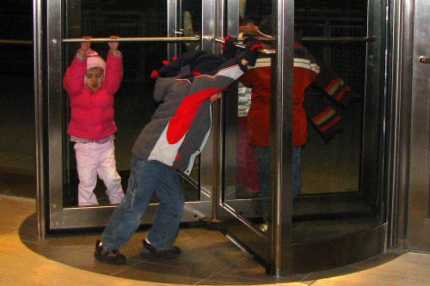

Slide 3
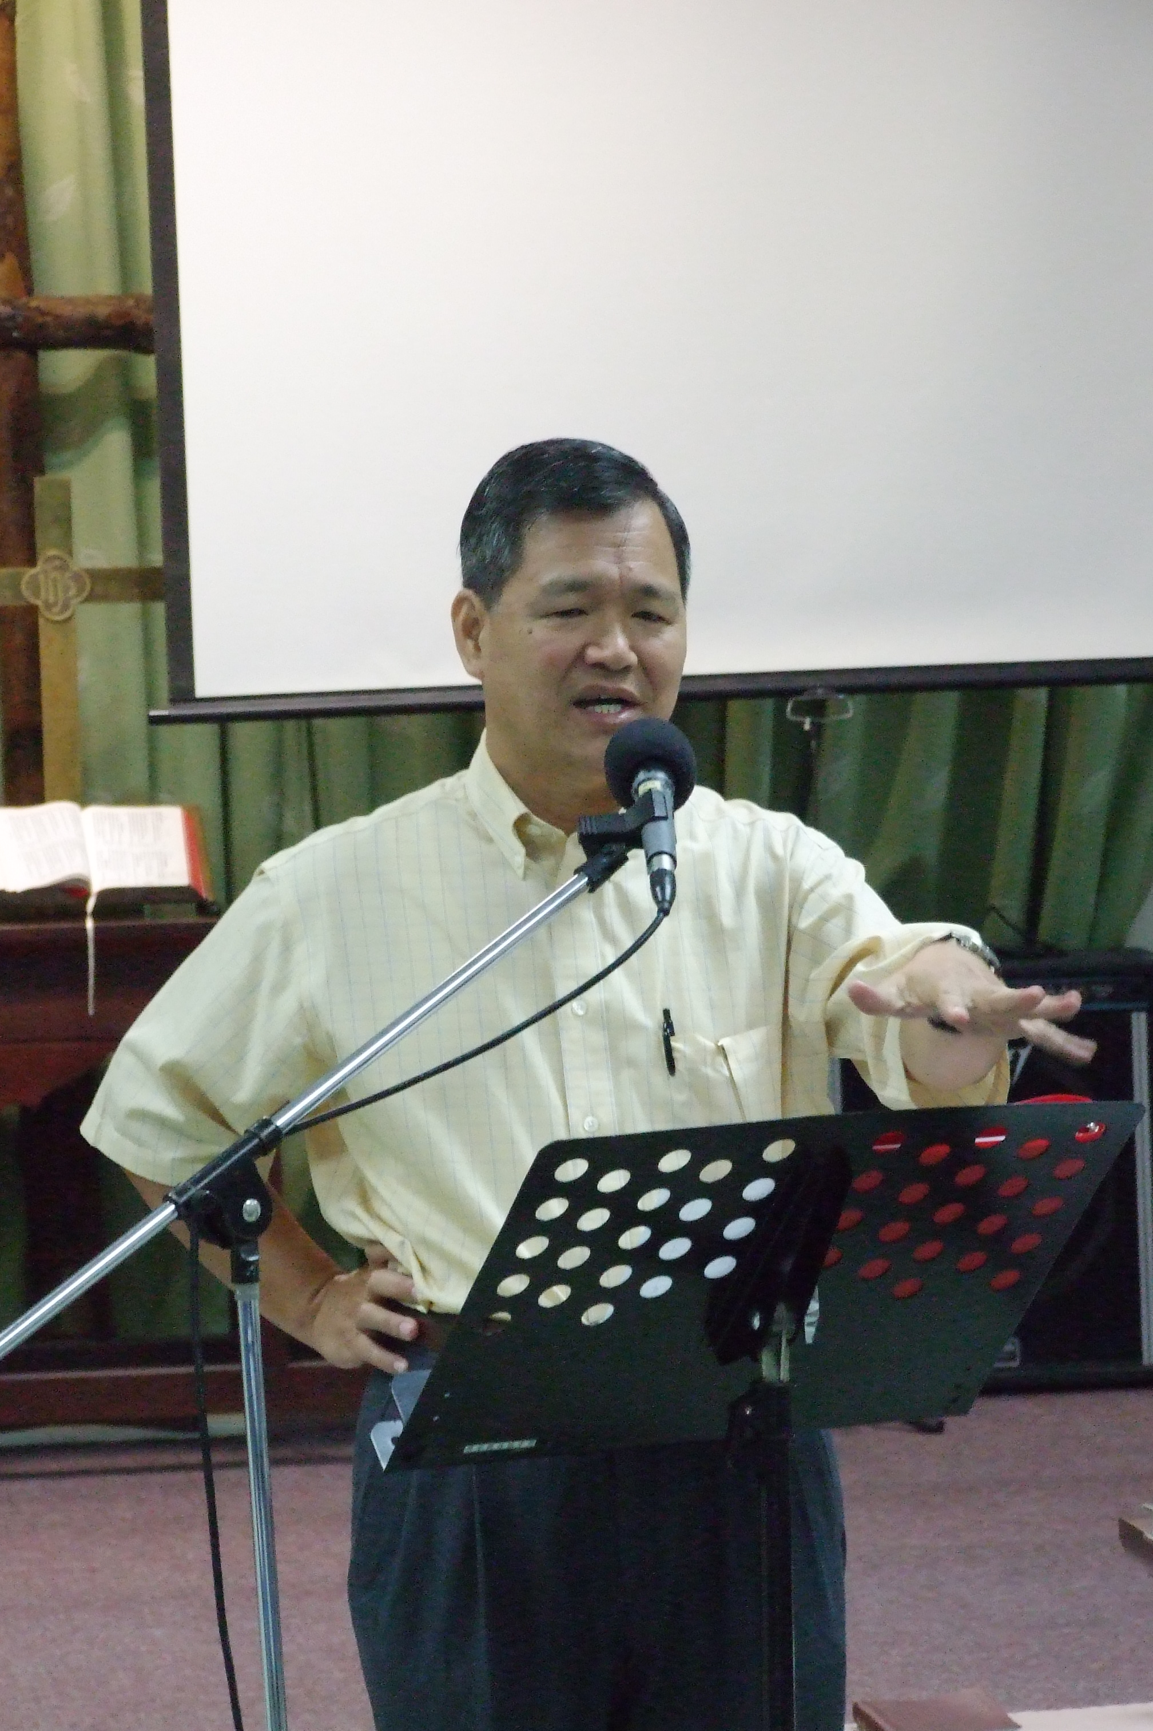

Slide 5
I WILL PROTECT THE UNITY OF MY CHURCH
I WILL SHARE THE RESPONSIBILITY OF MY CHURCH
I WILL SERVE THE MINISTRY OF MY CHURCH
I WILL SUPPORT THE TESTIMONY OF MY CHURCH

Slide 6
I WILL LIVE OUT THE VISION OF MY CHURCH
... by seeking to live as a disciple of Jesus
... by learning about God and the Bible
... by growing in my spiritual walk with the Lord
... by serving according to my spiritual gifts and talents

Slide 7
Chinese Christian Church of Columbia’s vision is to be a Christ-centered community that seeks to make disciples who learn, grow, and serve in the Lord.

Slide 8
Living as a disciple. . .

Slide 9
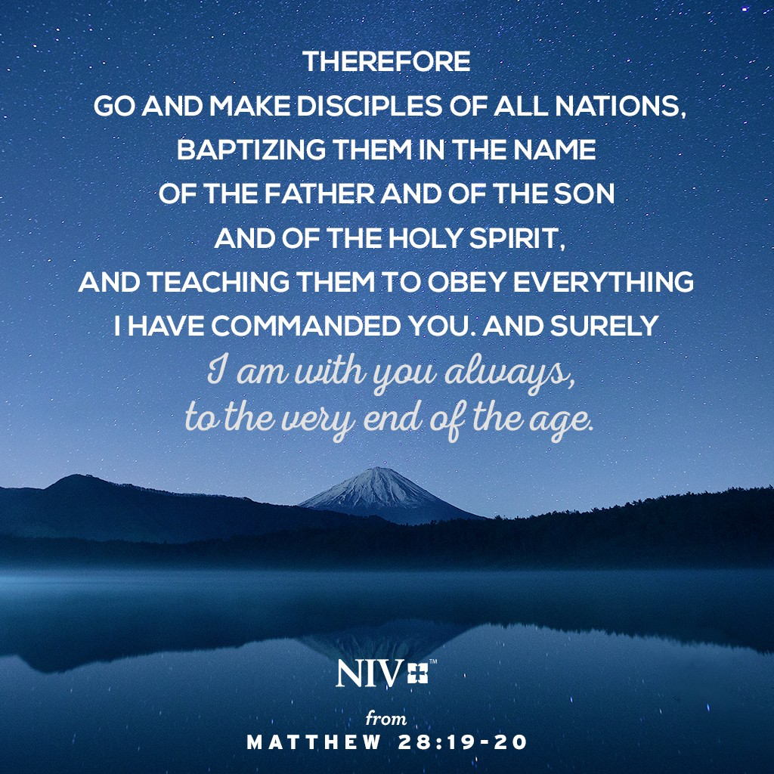

Slide 12
Equipped to serve. . .

Slide 13
¹¹ So Christ himself gave the apostles, the prophets, the evangelists, the pastors and teachers, ¹² to equip his people for works of service, so that the body of Christ may be built up . . .
Ephesians 4:11-12

Slide 14
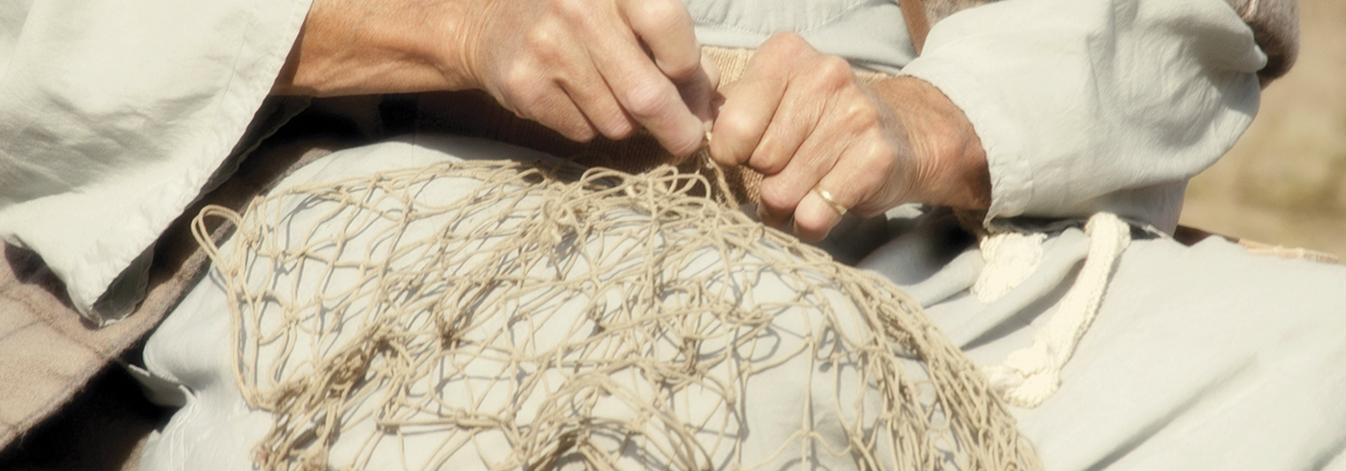
Equip - making someone or something adequate or sufficient for some purpose

Slide 15
Pastor-teachers are to teach the Word to help the rest of the body become adequate or prepared so that they may serve the Lord in accordance with their gifts.
Rev. Steven J. Cole

Slide 19
Called to Unity. . .

Slide 20
¹³ until we all reach unity in the faith and in the knowledge of the Son of God and become mature, attaining to the whole measure of the fullness of Christ.
Ephesians 4:13

Slide 23
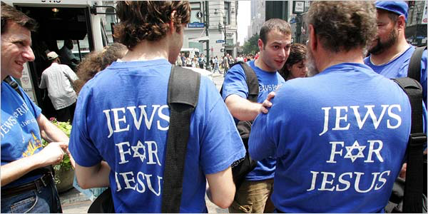

Slide 24
Challenge

Slide 26
