Slide 1
The Lost Son
Part 2

Slide 3
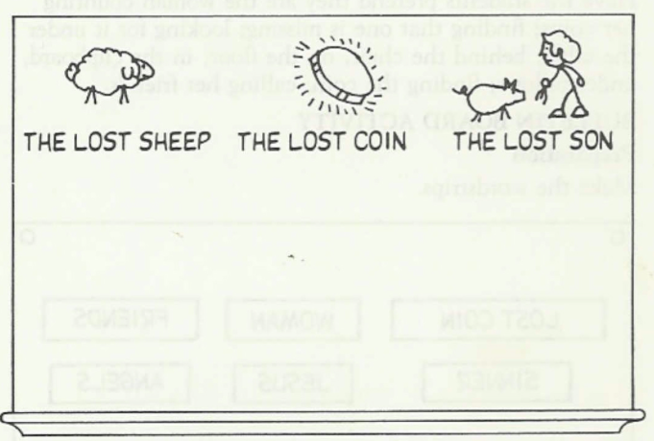

Slide 6
The Lost Son

Slide 7
The Right to Rebel

Slide 8
¹² The younger one said to his father, ‘Father, give me my share of the estate.’ So he divided his property between them.
¹³ “Not long after that, the younger son got together all he had, set off for a distant country and there squandered his wealth in wild living.
Luke 15

Slide 9
Rumspringa

Slide 10
Consequences of Rebellion

Slide 11
¹⁵ So he went and hired himself out to a citizen of that country, who sent him to his fields to feed pigs. ¹⁶ He longed to fill his stomach with the pods that the pigs were eating, but no one gave him anything.

Slide 13
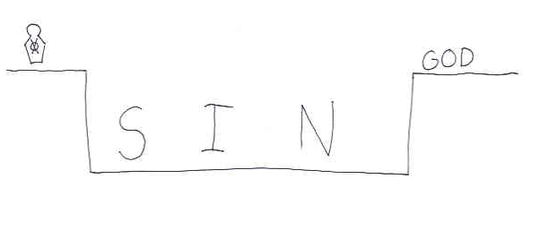

Slide 17
The Waiting Father

Slide 18
²⁰ So he got up and went to his father.
“But while he was still a long way off, his father saw him and was filled with compassion for him; he ran to his son, threw his arms around him and kissed him.

Slide 20
Rejoice with me!

Slide 21
²² “But the father said to his servants, ‘Quick! Bring the best robe and put it on him. Put a ring on his finger and sandals on his feet. ²³ Bring the fattened calf and kill it. Let’s have a feast and celebrate. 24 For this son of mine was dead and is alive again; he was lost and is found.’ So they began to celebrate.

Slide 22
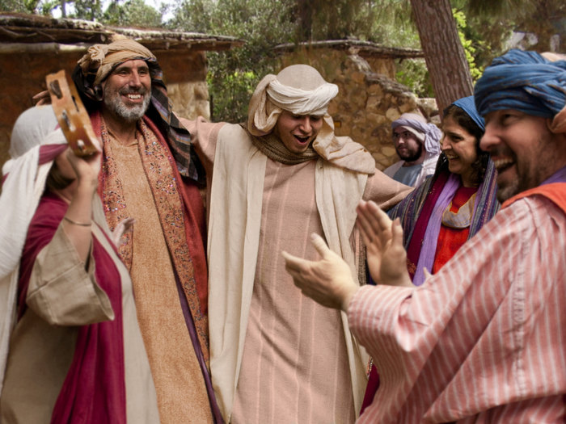

Slide 23
²⁸ “The older brother became angry and refused to go in. So his father went out and pleaded with him. ²⁹ But he answered his father, ‘Look! All these years I’ve been slaving for you and never disobeyed your orders. Yet you never gave me even a young goat so I could celebrate with my friends. . .

Slide 24
Lessons for Disciples

Slide 25
³¹ “‘My son,’ the father said, ‘you are always with me, and everything I have is yours. ³² But we had to celebrate and be glad, because this brother of yours was dead and is alive again; he was lost and is found.’”
Luke 15

