Slide 1
Easter
Gospel of Love

Slide 4
Glorify God by living out the Gospel of Love

Slide 5
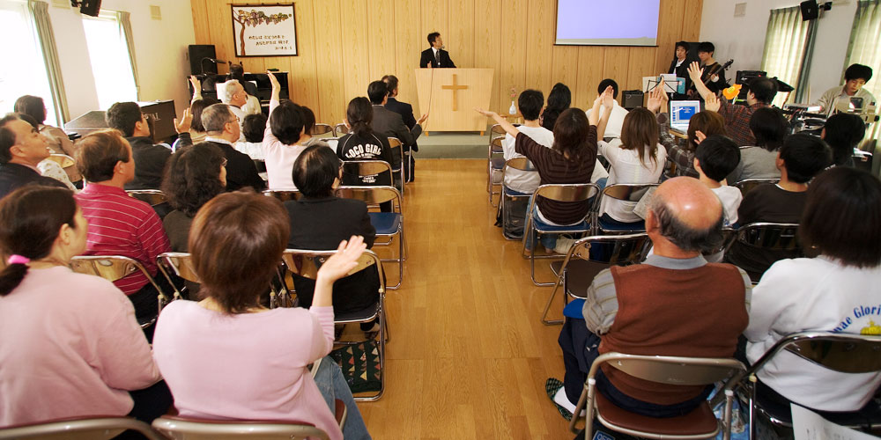

Slide 6
³¹ When he was gone, Jesus said, “Now the Son of Man is glorified and God is glorified in him. ³² If God is glorified in him, God will glorify the Son in himself, and will glorify him at once.
³³ “My children, I will be with you only a little longer. You will look for me, and just as I told the Jews, so I tell you now: Where I am going, you cannot come.

Slide 7
³⁴ “A new command I give you: Love one another. As I have loved you, so you must love one another. ³⁵ By this everyone will know that you are my disciples, if you love one another.”
John 13:31-35

Slide 8
Context

Slide 9
It was just before the Passover Festival. Jesus knew that the hour had come for him to leave this world and go to the Father. Having loved his own who were in the world, he loved them to the end.
John 13:1

Slide 11
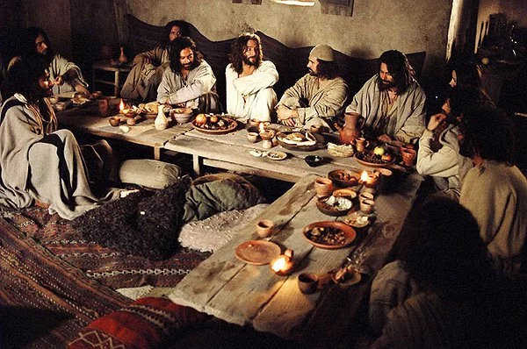

Slide 12
Glorifying God

Slide 13
³¹ When he was gone, Jesus said, “Now the Son of Man is glorified and God is glorified in him. ³² If God is glorified in him, God will glorify the Son in himself, and will glorify him at once.
³³ “My children, I will be with you only a little longer. You will look for me, and just as I told the Jews, so I tell you now: Where I am going, you cannot come.

Slide 14
glorify
to cause to be or treat as being more splendid, excellent, etc., than would normally be considered.
to honor with praise, admiration, or worship; extol.
to make glorious; invest with glory.
to praise the glory of (God), especially as an act of worship.

Slide 15
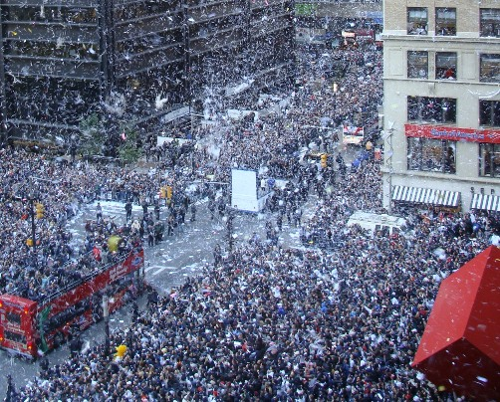

Slide 16
⁴ I have brought you glory on earth by finishing the work you gave me to do. ⁵ And now, Father, glorify me in your presence with the glory I had with you before the world began.
John 17:4-5

Slide 17
³¹ When he was gone, Jesus said, “Now the Son of Man is glorified and God is glorified in him. ³² If God is glorified in him, God will glorify the Son in himself, and will glorify him at once.
³³ “My children, I will be with you only a little longer. You will look for me, and just as I told the Jews, so I tell you now: Where I am going, you cannot come.

Slide 19
Living Out the Glory

Slide 20
As always in John, this glorification of Father and Son is not something between them alone; it does not stop with Christ. The capacity to glorify God extends to Christ's followers and is laid upon believers as a charge -- "My Father is glorified by this, that you bear much fruit and become my disciples" (15:8).
Frank L. Crouch
Moravian Theological Seminary

Slide 21
“A new command I give you: Love one another. As I have loved you, so you must love one another.
John 13:34

Slide 23
“A new command I give you: Love one another. As I have loved you, so you must love one another.
John 13:34

Slide 24
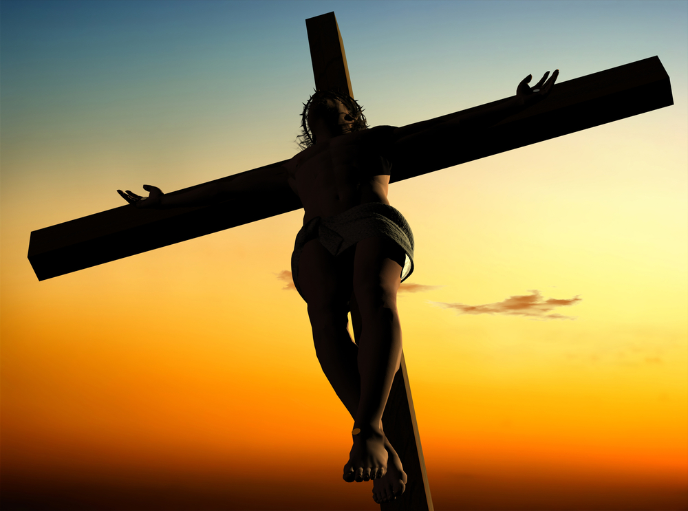

Slide 25
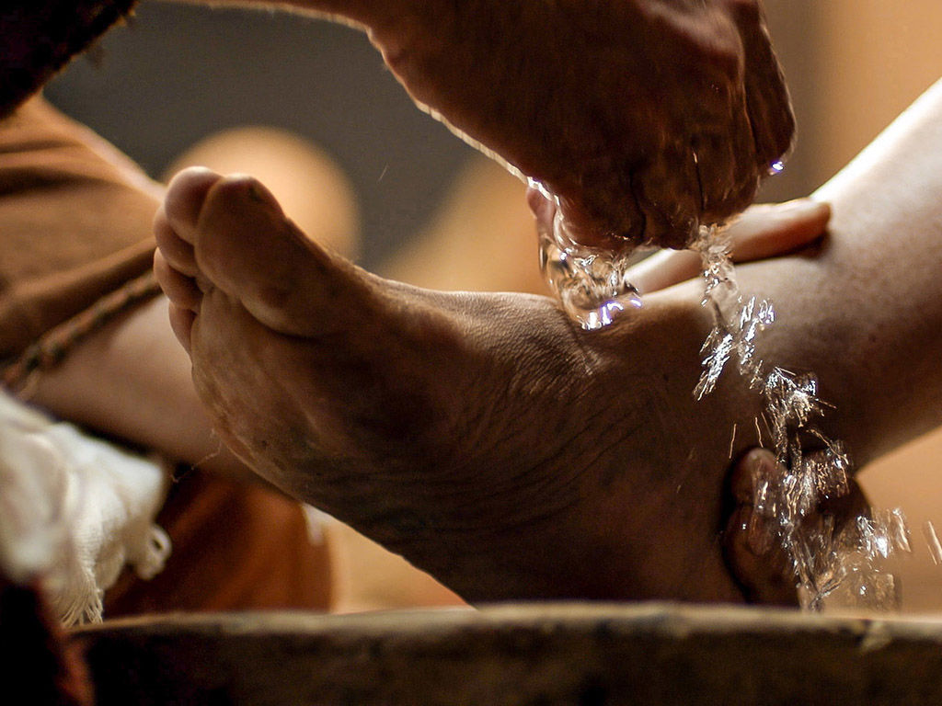

Slide 26
Spreading the Glory

Slide 27
By this everyone will know that you are my disciples, if you love one another.”
John 13:35

Slide 28
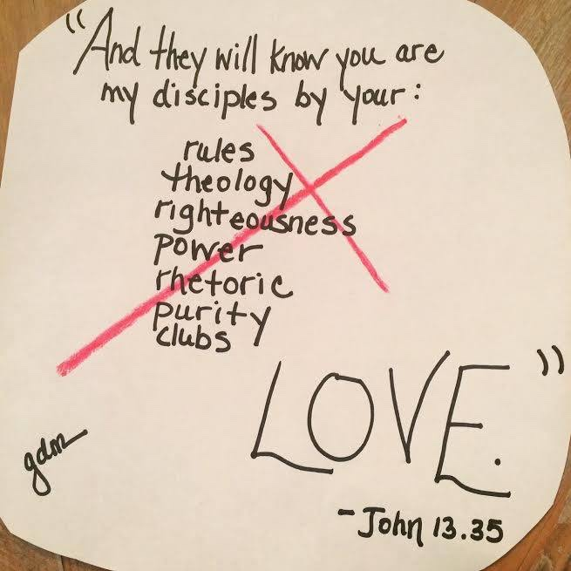

Slide 29
Lessons for Disciples

