Slide 1
Healthy Church
Love One Another

Slide 2
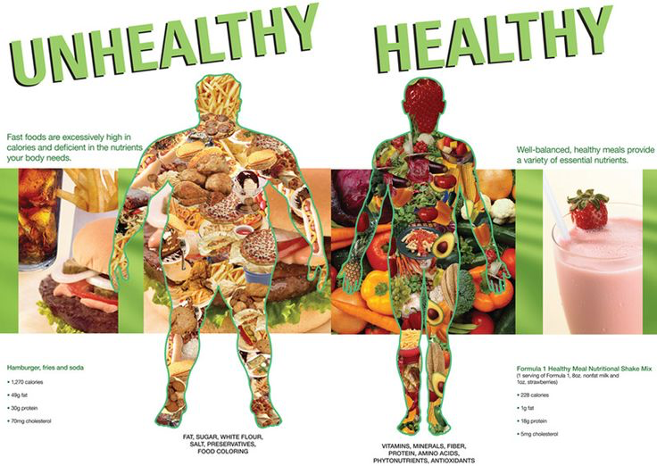

Slide 3
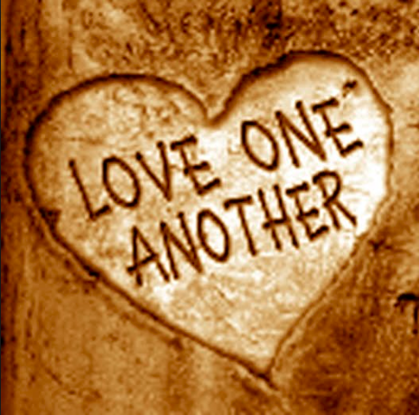

Slide 5
¹⁶ This is how we know what love is: Jesus Christ laid down his life for us. And we ought to lay down our lives for our brothers and sisters. ¹⁷ If anyone has material possessions and sees a brother or sister in need but has no pity on them, how can the love of God be in that person? ¹⁸ Dear children, let us not love with words or speech but with actions and in truth.
1 John 3:16-18

Slide 6
Love is. . .

Slide 8
This is how we know what love is: Jesus Christ laid down his life for us. And we ought to lay down our lives for our brothers and sisters.
1 John 3:16

Slide 11
This is how we know what love is: Jesus Christ laid down his life for us. And we ought to lay down our lives for our brothers and sisters.
1 John 3:16

Slide 13
Love sees. . .

Slide 14
If anyone has material possessions and sees a brother or sister in need but has no pity on them, how can the love of God be in that person?
1 John 3:17

Slide 15
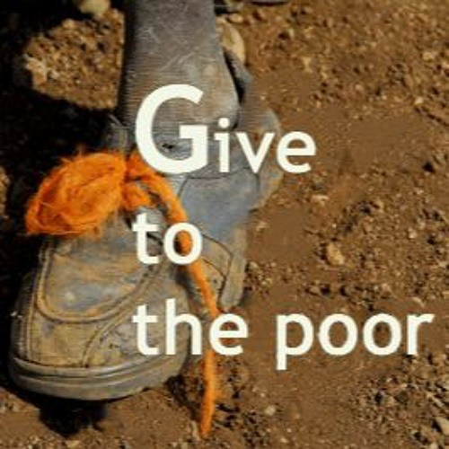

Slide 16
Sacrificial love that models itself after Jesus' example does not enable the destructive behavior of others, but encourages them in actions that lead to love and life, and to healing and wholeness.
Dr. Rodney A. Whitacre

Slide 17
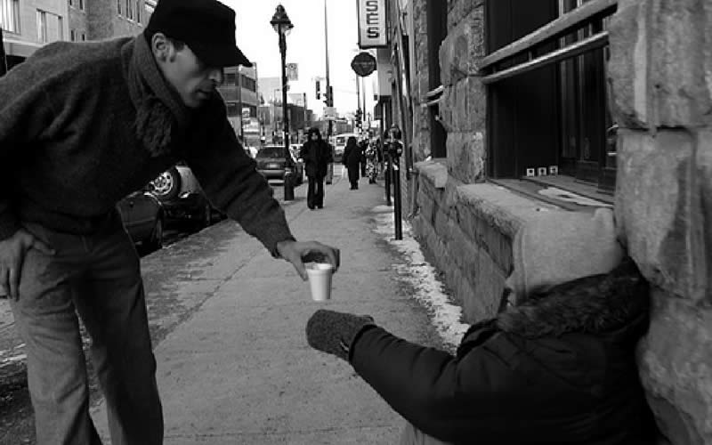

Slide 18
Love acts. . .

Slide 19
Dear children, let us not love with words or speech but with actions and in truth.
1 John 3:18

Slide 20
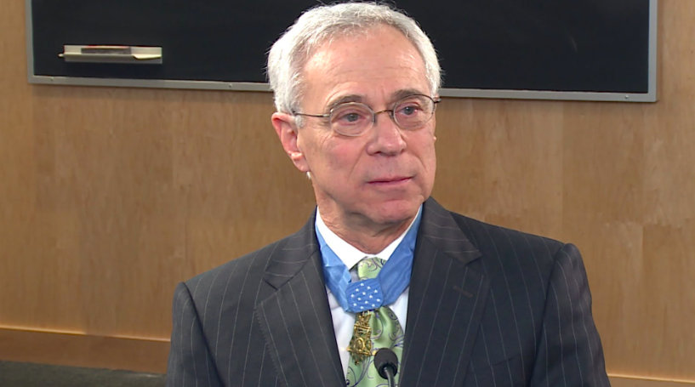
Colonel Jack Jacobs

Slide 21
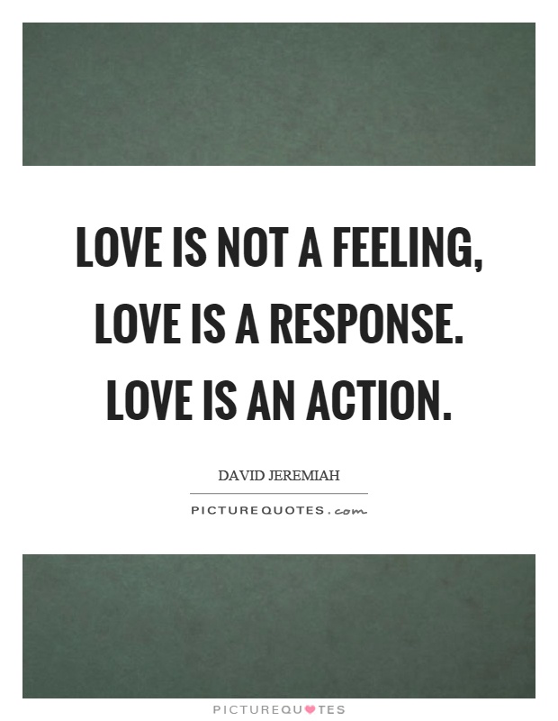

Slide 22
Challenge

Slide 25
