Slide 1
C4 Vision
Make Disciples

Slide 2
The Power of Vision

Slide 3
“To give people the power to share and make the world more open and connected.”
“To organize the world’s information and make it universally accessible and useful.”
“To refresh the world…To inspire moments of optimism and happiness…To create value and make a difference.”

Slide 4
Chinese Christian Church of Columbia’s vision is to be a Christ-centered community that seeks to make disciples who learn, grow, and serve in the Lord.”

Slide 6
Jesus’ Commission

Slide 7
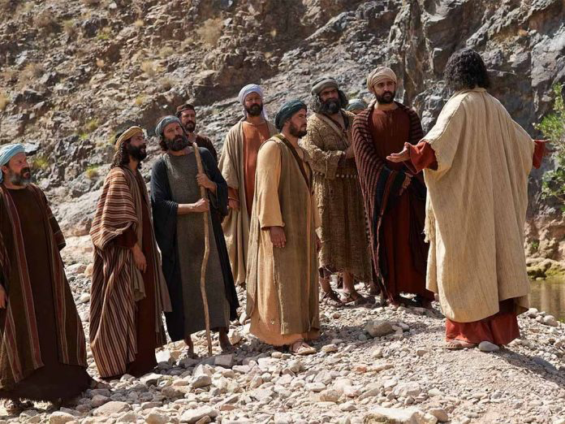

Slide 8
Jeffrey Kranz

Slide 9
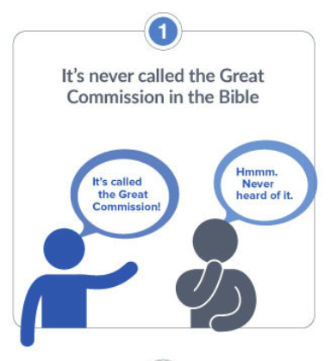

Slide 11
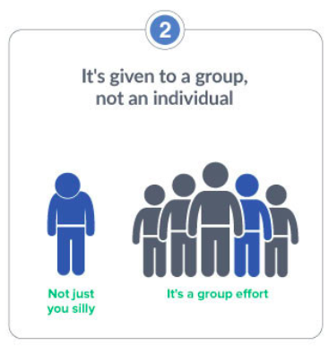

Slide 14
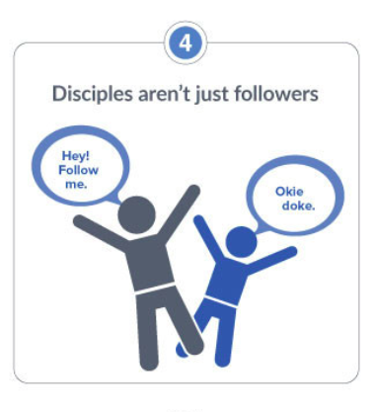

Slide 18
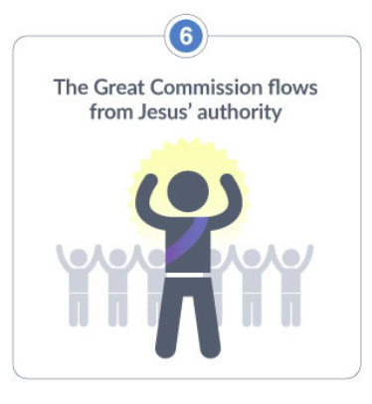

Slide 19
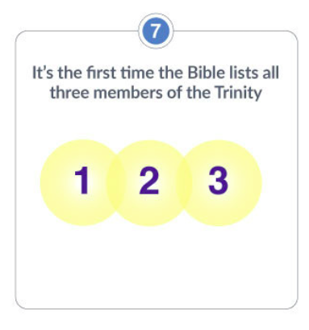

Slide 21
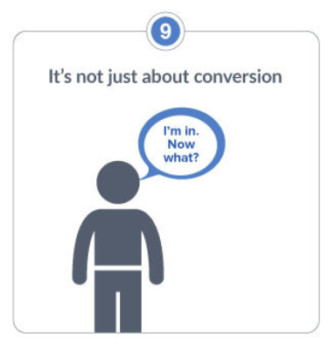

Slide 22
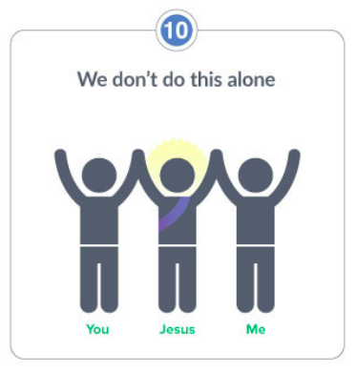

Slide 23
Living it out

