Slide 1
Advent Reflections
Prepare the Way

Slide 2
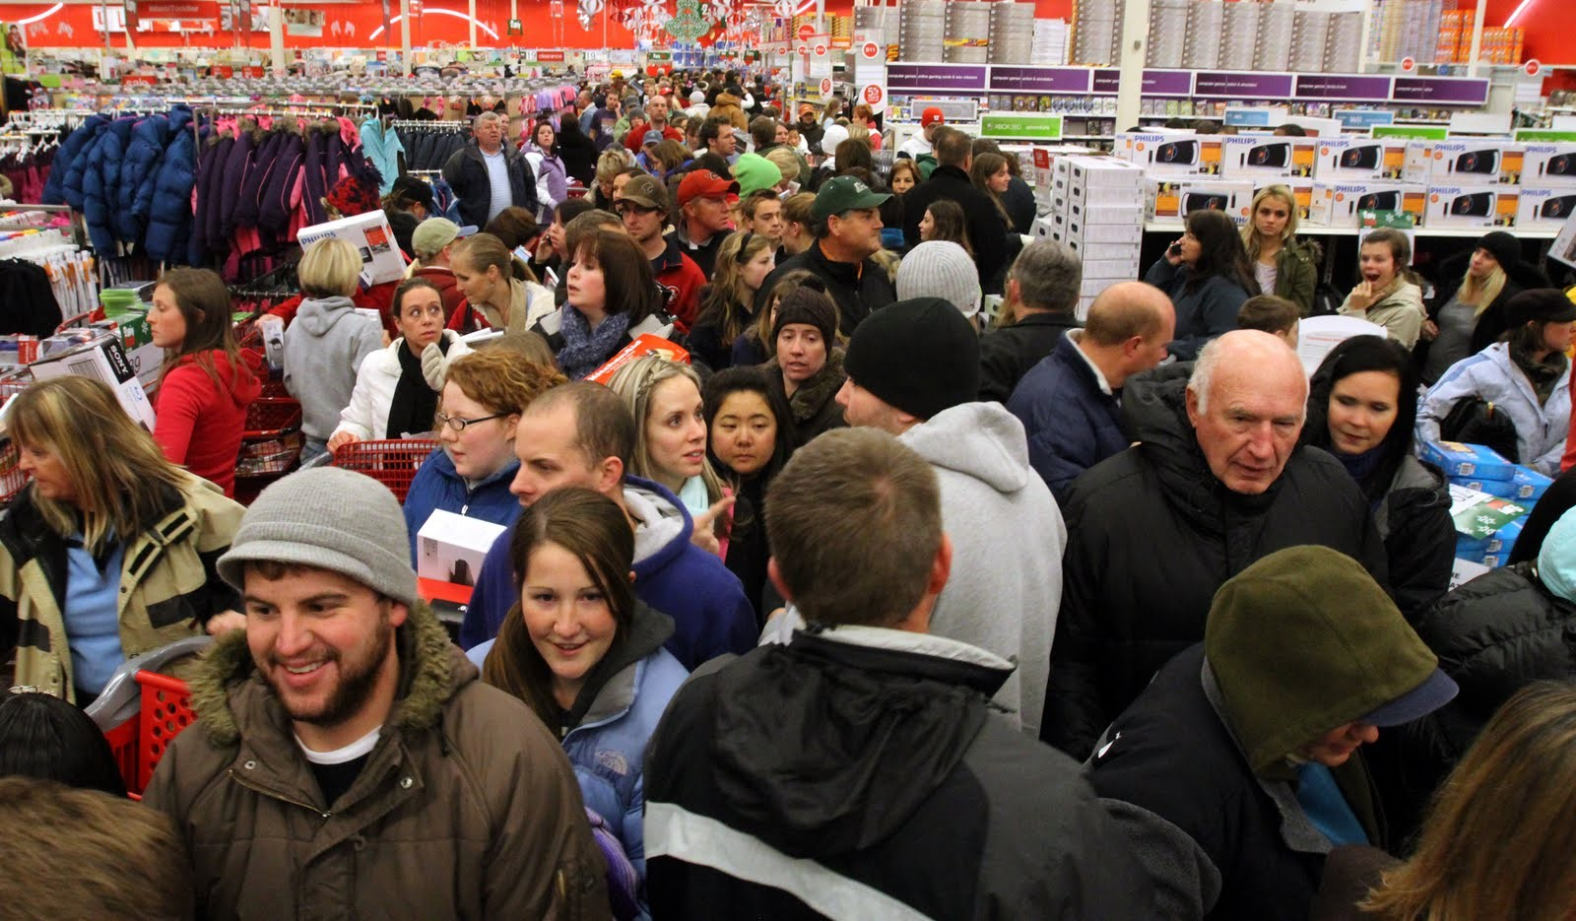

Slide 3
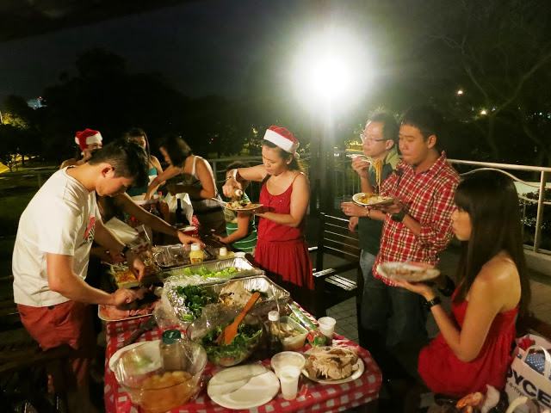

Slide 4
Mark 1:1-8
The beginning of the good news about Jesus the Messiah, the Son of God, as it is written in Isaiah the prophet:
“I will send my messenger ahead of you,
who will prepare your way”—
“a voice of one calling in the wilderness,
‘Prepare the way for the Lord,
make straight paths for him.’”

Slide 5
And so John the Baptist appeared in the wilderness, preaching a baptism of repentance for the forgiveness of sins. The whole Judean countryside and all the people of Jerusalem went out to him. Confessing their sins, they were baptized by him in the Jordan River.

Slide 6
John wore clothing made of camel’s hair, with a leather belt around his waist, and he ate locusts and wild honey. And this was his message: “After me comes the one more powerful than I, the straps of whose sandals I am not worthy to stoop down and untie. I baptize you with water, but he will baptize you with the Holy Spirit.”

Slide 7
Prepare the way for Christ this Christmas

Slide 8
Prepare the Way:
Through His Word

Slide 9
“The beginning of the good news about Jesus the Messiah, the Son of God”
Mark 1:1

Slide 10
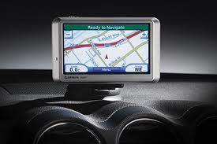

Slide 11
Prepare the Way:
Through Repentance

Slide 12
“And so John the Baptist appeared in the wilderness, preaching a baptism of repentance for the forgiveness of sins. ”
Mark 1:4

Slide 14
Stages of Repentance
Agree
Turn
Persevere

Slide 15
Prepare the Way:
Through Commitment

Slide 16
“Confessing their sins, they were baptized by him in the Jordan River.”
Mark 1:5

Slide 17
“Nothing shapes your life more than the commitments you choose to make.”
Rev. Rick Warren

Slide 18
Fear of Commitment – drift through life
Half-Hearted Commitment – frustration & mediocrity
Worldly Goals – disappointed & bitter
Intentional Commitment – spiritual growth & Christlikeness

Slide 19
Prepare the Way:
Through the Holy Spirit

Slide 20
“I baptize you with water, but he will baptize you with the Holy Spirit.”
Mark 1:8

Slide 21
