Slide 1
Prepare for Christ’s Coming
Matthew 24:36-44

Slide 2
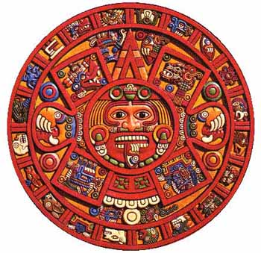

Slide 5
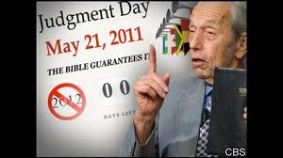

Slide 6
Matthew 24:36-44
³⁶ “But about that day or hour no one knows, not even the angels in heaven, nor the Son, but only the Father. ³⁷ As it was in the days of Noah, so it will be at the coming of the Son of Man. ³⁸ For in the days before the flood, people were eating and drinking, marrying and giving in marriage, up to the day Noah entered the ark;

Slide 7
³⁹ and they knew nothing about what would happen until the flood came and took them all away. That is how it will be at the coming of the Son of Man. ⁴⁰ Two men will be in the field; one will be taken and the other left. ⁴¹ Two women will be grinding with a hand mill; one will be taken and the other left.

Slide 8
⁴² “Therefore keep watch, because you do not know on what day your Lord will come. ⁴³ But understand this: If the owner of the house had known at what time of night the thief was coming, he would have kept watch and would not have let his house be broken into. ⁴⁴ So you also must be ready, because the Son of Man will come at an hour when you do not expect him.

Slide 9
1. Prioritize (vv. 36-39)
³⁶ “But about that day or hour no one knows, not even the angels in heaven, nor the Son,^{[f]}but only the Father.
Notes:
Jesus worked hard in the fields, proclaiming & healing

Slide 11
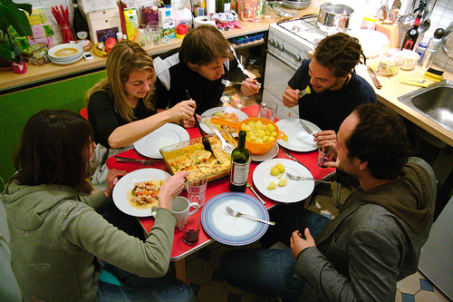
³⁷ As it was in the days of Noah, so it will be at the coming of the Son of Man. ³⁸ For in the days before the flood, people were eating and drinking,

Slide 12
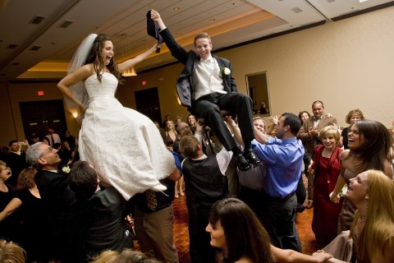
marrying and giving in marriage, up to the day Noah entered the ark;

Slide 13
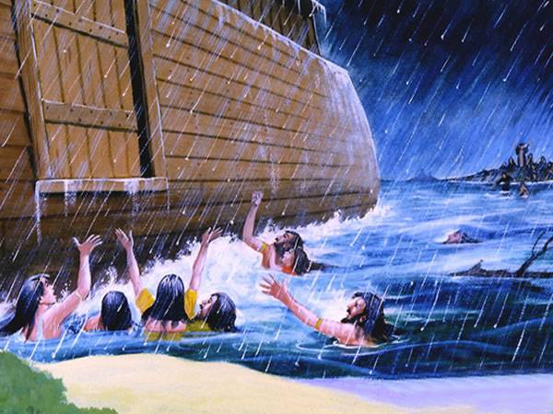
³⁹ and they knew nothing about what would happen until the flood came and took them all away. That is how it will be at the coming of the Son of Man.

Slide 14
As we seek Christ first some matters that we need to prioritize which include:
Salvation – having eternal life (John 3:16)
Sanctification – becoming holy (1 Peter 1:16)
Scripture – the desire to know and apply God’s Word (2 Timothy 3:16)
Supplication – praying to the Almighty God (Ephesians 6:18)
Servanthood – the search to become great by becoming less (Mark 10:45)

Slide 15
2. Prepare (vv. 40-42)
⁴⁰ Two men will be in the field; one will be taken and the other left. ⁴¹ Two women will be grinding with a hand mill; one will be taken and the other left. ⁴² “Therefore keep watch, because you do not know on what day your Lord will come.

Slide 17
How can we be prepared for Christ’s return?
Reflect – on your relationship with God
Repent –in those areas that are displeasing in His sight.
Renew – ask for His strength to help you through the day.

Slide 18
3. Persist
⁴³ But understand this: If the owner of the house had known at what time of night the thief was coming, he would have kept watch and would not have let his house be broken into.

Slide 20
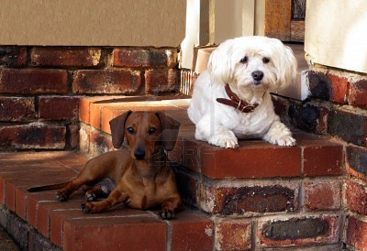

Slide 21
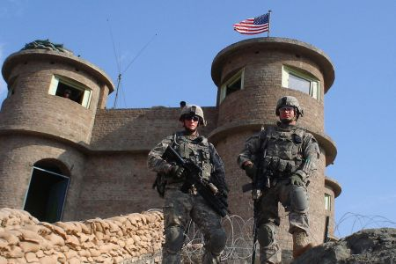

Slide 22
⁴⁴ So you also must be ready, because the Son of Man will come at an hour when you do not expect him.

