Slide 1
Grace to You
Messenger of Grace

Slide 4
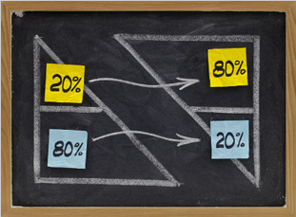

Slide 6
Gift Received

Slide 7
¹⁰ Each of you should use whatever gift you have received to serve others, as faithful stewards of God’s grace in its various forms.
1 Peter 4:10

Slide 8
A spiritual gift is a special ability given by the Holy Spirit to every member of the Body of Christ according to God's grace for use within the context of the Body.

Slide 11
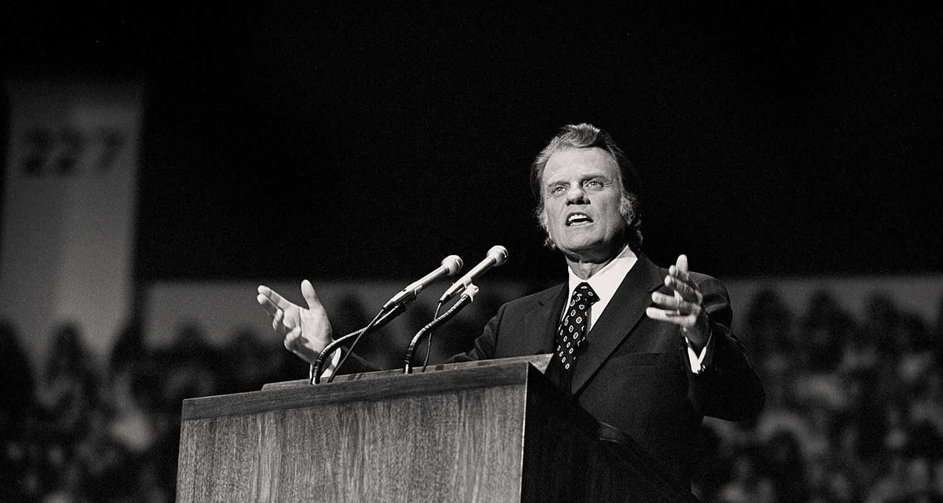

Slide 12
Gift Used

Slide 13
¹⁰ Each of you should use whatever gift you have received to serve others, as faithful stewards of God’s grace in its various forms.
1 Peter 4:10

Slide 15
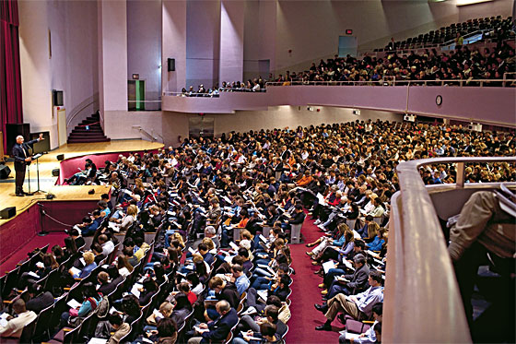

Slide 16
Gift Shared

Slide 17
¹⁰ Each of you should use whatever gift you have received to serve others, as faithful stewards of God’s grace in its various forms.
1 Peter 4:10

Slide 20
Gift Managed

Slide 21
¹⁰ Each of you should use whatever gift you have received to serve others, as faithful stewards of God’s grace in its various forms.
1 Peter 4:10

Slide 23
Lessons for Disciples

