Slide 1
Conformed to Christ’s Image
Motivations for Holy Living

Slide 2
For those God foreknew he also predestined to be conformed to the image of his Son . . .
Romans 8:29

Slide 5
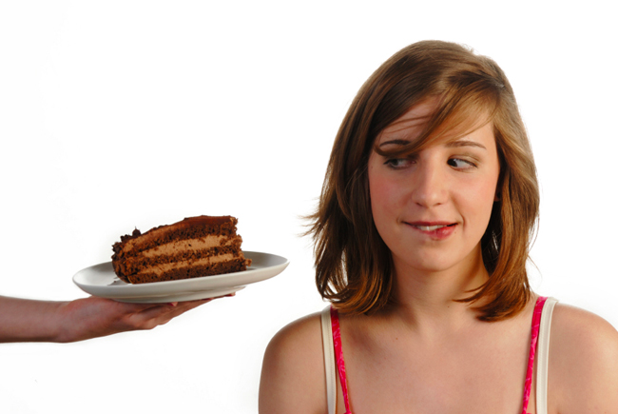

Slide 7
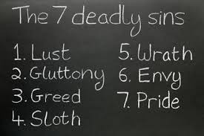

Slide 8
¹⁷ Since you call on a Father who judges each person’s work impartially, live out your time as foreigners here in reverent fear. ¹⁸ For you know that it was not with perishable things such as silver or gold that you were redeemed from the empty way of life handed down to you from your ancestors,
1 Peter 1:17-21

Slide 9
¹⁹ but with the precious blood of Christ, a lamb without blemish or defect. ²⁰ He was chosen before the creation of the world, but was revealed in these last times for your sake. ²¹ Through him you believe in God, who raised him from the dead and glorified him, and so your faith and hope are in God.
1 Peter 1:17-21

Slide 11
¹⁵ But just as he who called you is holy, so be holy in all you do; ¹⁶ for it is written: “Be holy, because I am holy.”
1 Peter 1:15-16

Slide 12
Holiness has the root idea in the Old Testament of being separated from what is defective and evil and separated for God . . .
Dr. John Piper

Slide 14
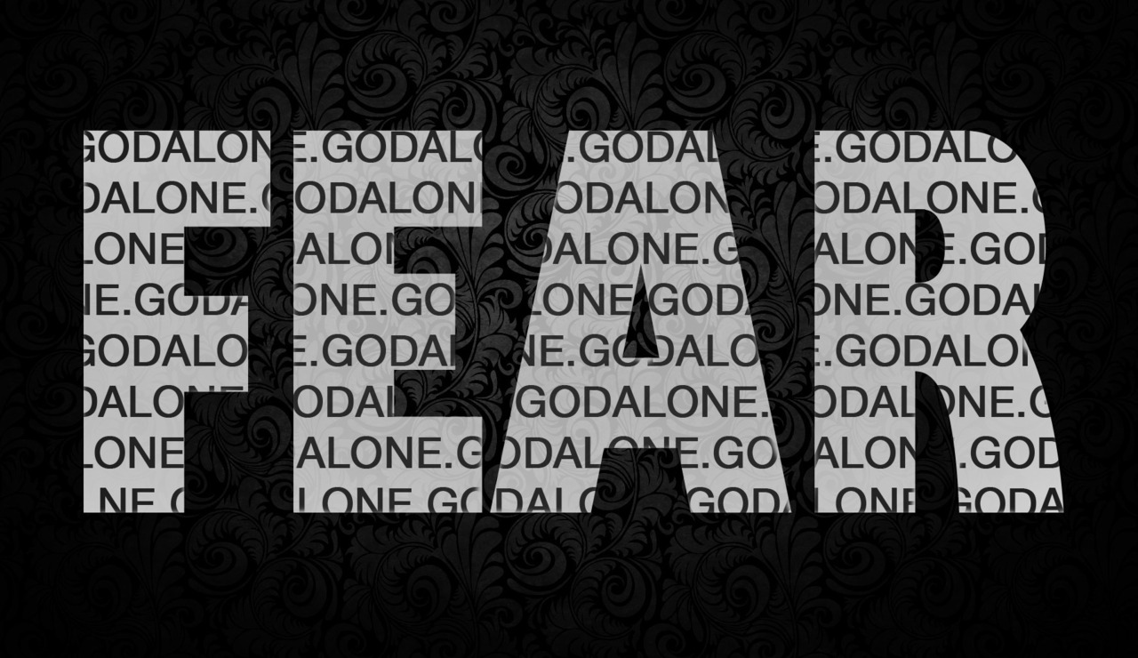

Slide 15
¹⁷ Since you call on a Father who judges each person’s work impartially, live out your time as foreigners here in reverent fear.
1 Peter 1:17

Slide 17
Believers are not to be scared of God. We have no reason to be scared of Him. We have His promise that nothing can separate us from His love. . .
GotQuestions.org

Slide 19
¹⁸ For you know that it was not with perishable things such as silver or gold that you were redeemed from the empty way of life handed down to you from your ancestors,
1 Peter 1:18

Slide 21
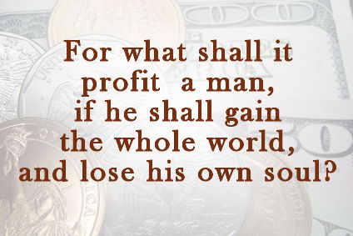

Slide 24
¹⁹ but with the precious blood of Christ, a lamb without blemish or defect. ²⁰ He was chosen before the creation of the world, but was revealed in these last times for your sake.
1 Peter 1:17-20

Slide 27
²¹ Through him you believe in God, who raised him from the dead and glorified him, and so your faith and hope are in God.
1 Peter 1:21

Slide 29
