Slide 1
Journey to the Cross
Mountain Experience

Slide 4
Renew our walk with God through various spiritual practices

Slide 6
²⁸ About eight days after Jesus said this, he took Peter, John and James with him and went up onto a mountain to pray. ²⁹ As he was praying, the appearance of his face changed, and his clothes became as bright as a flash of lightning. ³⁰ Two men, Moses and Elijah, appeared in glorious splendor, talking with Jesus. ³¹ They spoke about his departure, which he was about to bring to fulfillment at Jerusalem.

Slide 7
³² Peter and his companions were very sleepy, but when they became fully awake, they saw his glory and the two men standing with him. ³³ As the men were leaving Jesus, Peter said to him, “Master, it is good for us to be here. Let us put up three shelters—one for you, one for Moses and one for Elijah.” (He did not know what he was saying.)

Slide 8
³⁴ While he was speaking, a cloud appeared and covered them, and they were afraid as they entered the cloud. ³⁵ A voice came from the cloud, saying, “This is my Son, whom I have chosen; listen to him.” ³⁶ When the voice had spoken, they found that Jesus was alone. The disciples kept this to themselves and did not tell anyone at that time what they had seen.
Luke 9:28-36

Slide 9
Renew our orientation of Jesus’ person

Slide 10
²⁸ About eight days after Jesus said this, he took Peter, John and James with him and went up onto a mountain to pray.

Slide 13
²⁸ About eight days after Jesus said this, he took Peter, John and James with him and went up onto a mountain to pray.

Slide 14
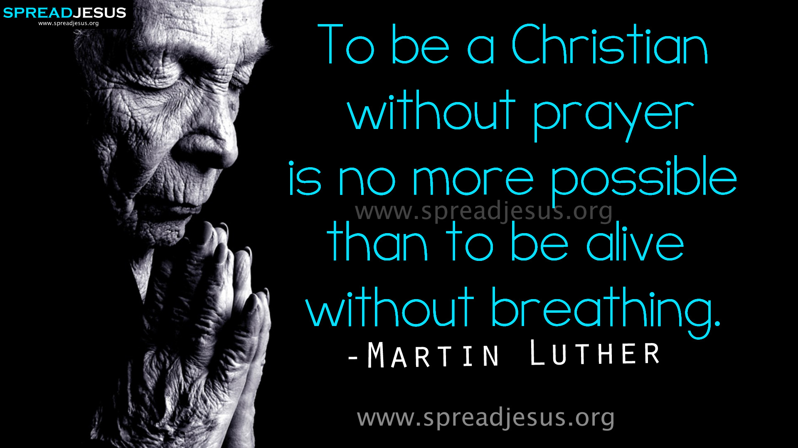

Slide 15
²⁹ As he was praying, the appearance of his face changed, and his clothes became as bright as a flash of lightning. ³⁰ Two men, Moses and Elijah, appeared in glorious splendor, talking with Jesus. ³¹ They spoke about his departure, which he was about to bring to fulfillment at Jerusalem.

Slide 16
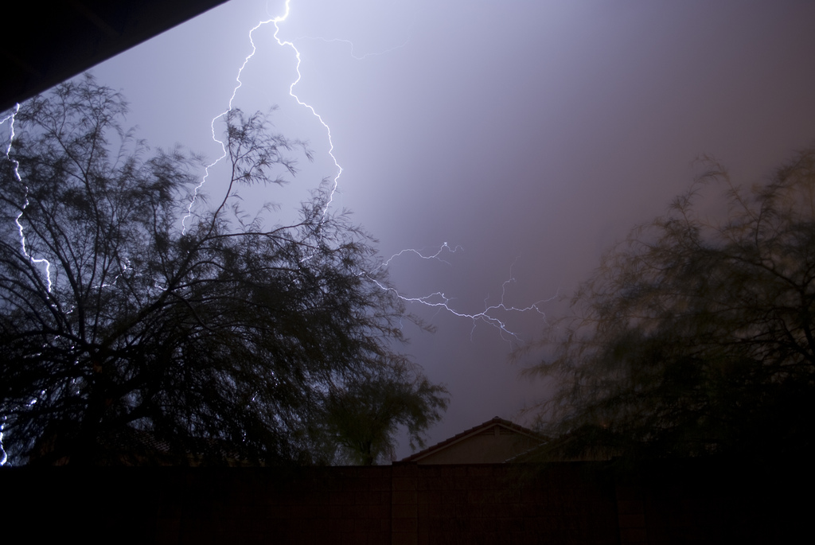

Slide 17
²⁹ As he was praying, the appearance of his face changed, and his clothes became as bright as a flash of lightning. ³⁰ Two men, Moses and Elijah, appeared in glorious splendor, talking with Jesus. ³¹ They spoke about his departure, which he was about to bring to fulfillment at Jerusalem.

Slide 18
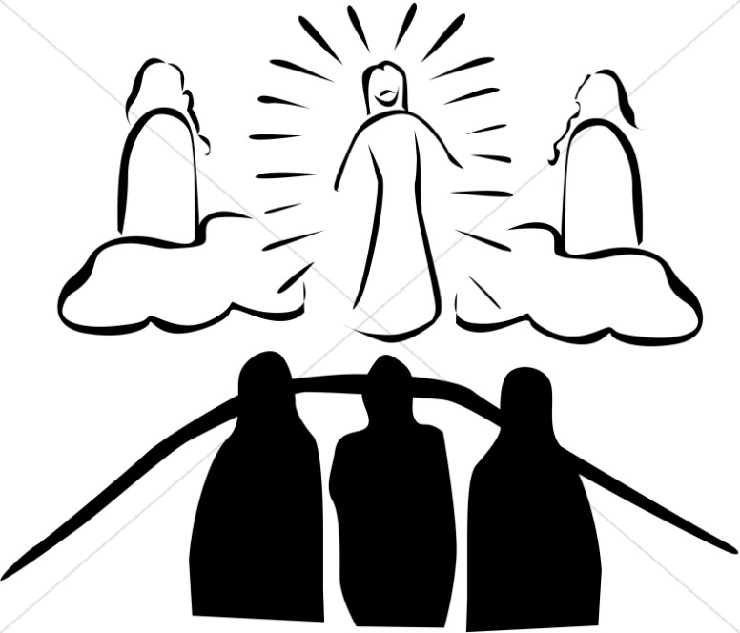

Slide 19
We can almost picture Moses and Elijah asking, “Are You really going to do it?”
Moses might say, “I offered to be judged in the place of the people, but God wouldn’t have it. Can You go through with this, Jesus?”
Elijah might add, “I was persecuted terribly by Ahab and Jezebel, and I hated it – sometimes I went into a deep spiritual depression. Can You go through with this, Jesus?”
Rev. David Guzik

Slide 20
³² Peter and his companions were very sleepy, but when they became fully awake, they saw his glory and the two men standing with him. ³³ As the men were leaving Jesus, Peter said to him, “Master, it is good for us to be here. Let us put up three shelters—one for you, one for Moses and one for Elijah.” (He did not know what he was saying.)

Slide 21
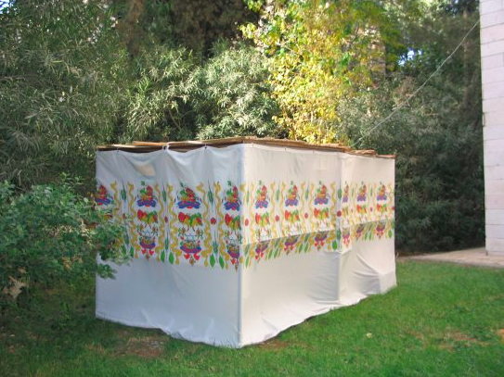

Slide 22
³⁴ While he was speaking, a cloud appeared and covered them, and they were afraid as they entered the cloud. ³⁵ A voice came from the cloud, saying, “This is my Son, whom I have chosen; listen to him.” ³⁶ When the voice had spoken, they found that Jesus was alone. The disciples kept this to themselves and did not tell anyone at that time what they had seen.
Luke 9:28-36

Slide 23
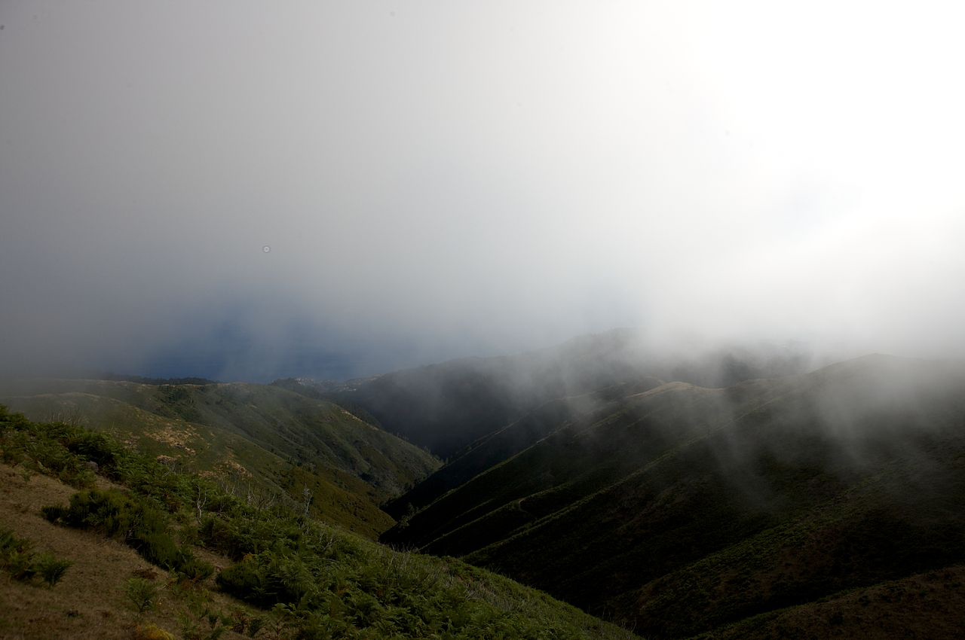

Slide 24
Lesson for disciples

Slide 25
Renew our orientation of Jesus’ person

