Slide 1
Romans
Our Hope

Slide 2
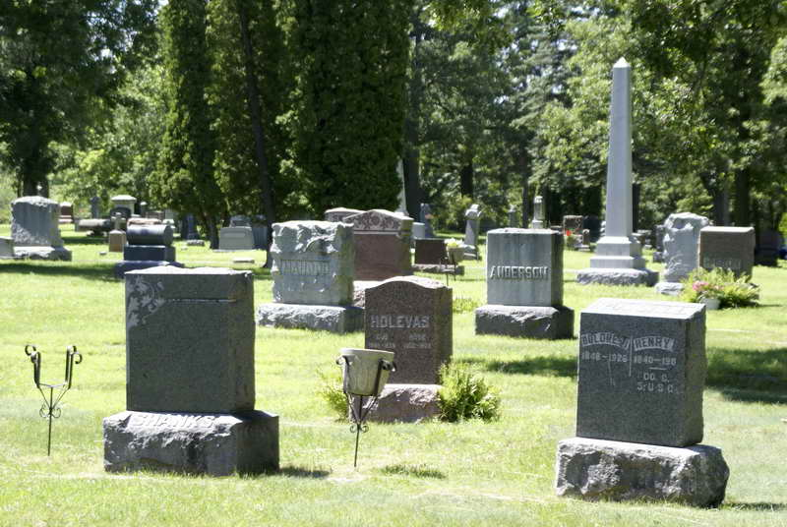
Grief. . .

Slide 3
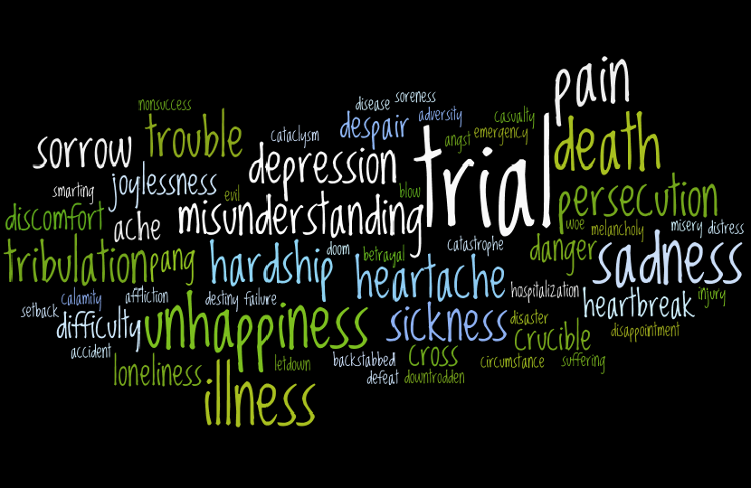

Slide 4
And we boast in the hope of the glory of God. Not only so, but we also glory in our sufferings, because we know that suffering produces perseverance; perseverance, character; and character, hope. And hope does not put us to shame, because God’s love has been poured out into our hearts through the Holy Spirit, who has been given to us.
Romans 5:2-5 NIV

Slide 5
Definitions
Boast:
Hope:
Glory:

Slide 6
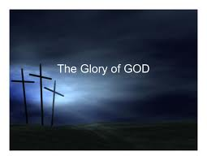
Hope in God’s Glory

Slide 7
Hope through Suffering
Suffering is a normal part of a consistent Christian life.
God uses suffering to accomplish His purposes.
We rejoice in the midst of suffering, not in suffering.
Suffering includes all the difficulties of life.
Dr. Douglas Moo

Slide 8
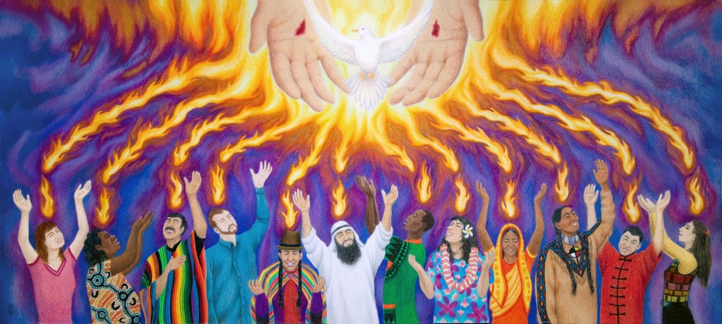
Hope through the Holy Spirit

Slide 9
Embrace trials as a means of growth resulting in hope.

Slide 10
Theology of Glory
Theology of the Cross

