Slide 1
Forgive
Overcoming Evil

Slide 6
¹⁷ Do not repay anyone evil for evil. Be careful to do what is right in the eyes of everyone. ¹⁸ If it is possible, as far as it depends on you, live at peace with everyone. ¹⁹ Do not take revenge, my dear friends, but leave room for God’s wrath, for it is written: “It is mine to avenge; I will repay,” says the Lord.

Slide 7
²⁰ On the contrary:
“If your enemy is hungry, feed him; if he is thirsty, give him something to drink.
In doing this, you will heap burning coals on his head.”
²¹ Do not be overcome by evil, but overcome evil with good.
Romans 12:17-21

Slide 8
Right Action

Slide 9
¹⁷ Do not repay anyone evil for evil. Be careful to do what is right in the eyes of everyone. ¹⁸ If it is possible, as far as it depends on you, live at peace with everyone.

Slide 11
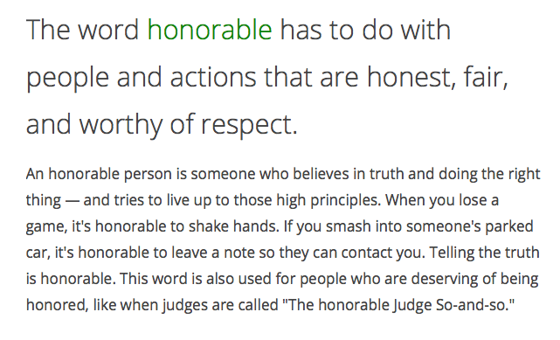

Slide 12
Non-Action

Slide 13
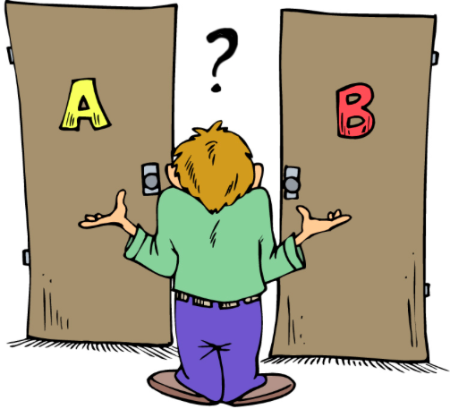

Slide 14
¹⁷ Do not repay anyone evil for evil. Be careful to do what is right in the eyes of everyone. ¹⁸ If it is possible, as far as it depends on you, live at peace with everyone. ¹⁹ Do not take revenge, my dear friends. . .

Slide 17
God’s Action

Slide 18
¹⁹ Do not take revenge, my dear friends, but leave room for God’s wrath, for it is written: “It is mine to avenge; I will repay,” says the Lord.

Slide 19
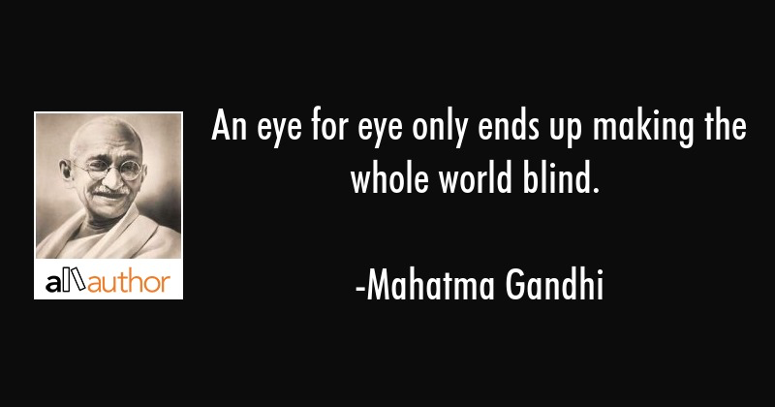

Slide 20
Surprising Action

Slide 21
²⁰ On the contrary:
“If your enemy is hungry, feed him; if he is thirsty, give him something to drink.
In doing this, you will heap burning coals on his head.”

Slide 22
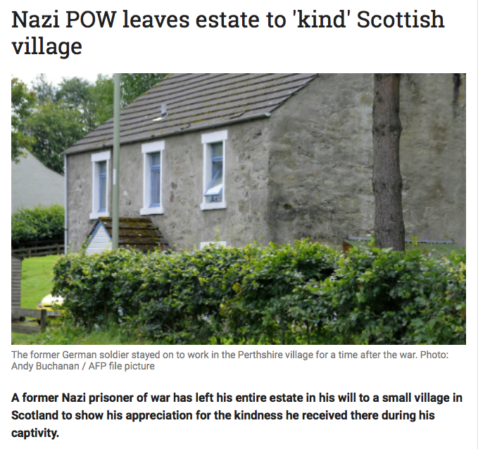

Slide 23
Lessons for disciples

Slide 24
Is there someone you need to forgive, and bless?
Is there someone hurting, whom you can come along side?
Are you living in harmony with others?
Can you help someone made in God’s image?

Slide 25
