Slide 1
Romans
Paul’s Prayer

Slide 2
Scot McKnight
The biggest problem with prayer—the dirty secret in the prayer lives of so many Christians—is that we don’t pray. We read books about prayer. We study the prayers in the Bible. We avoid prayer by falling for the notion . . . that we are simply perhaps not one of those who “have influence with the throne.

Slide 3
Romans 10
¹ Brothers and sisters, my heart’s desire and prayer to God for the Israelites is that they may be saved. ² For I can testify about them that they are zealous for God, but their zeal is not based on knowledge

Slide 4
³ Since they did not know the righteousness of God and sought to establish their own, they did not submit to God’s righteousness. ⁴ Christ is the culmination of the law so that there may be righteousness for everyone who believes.

Slide 5
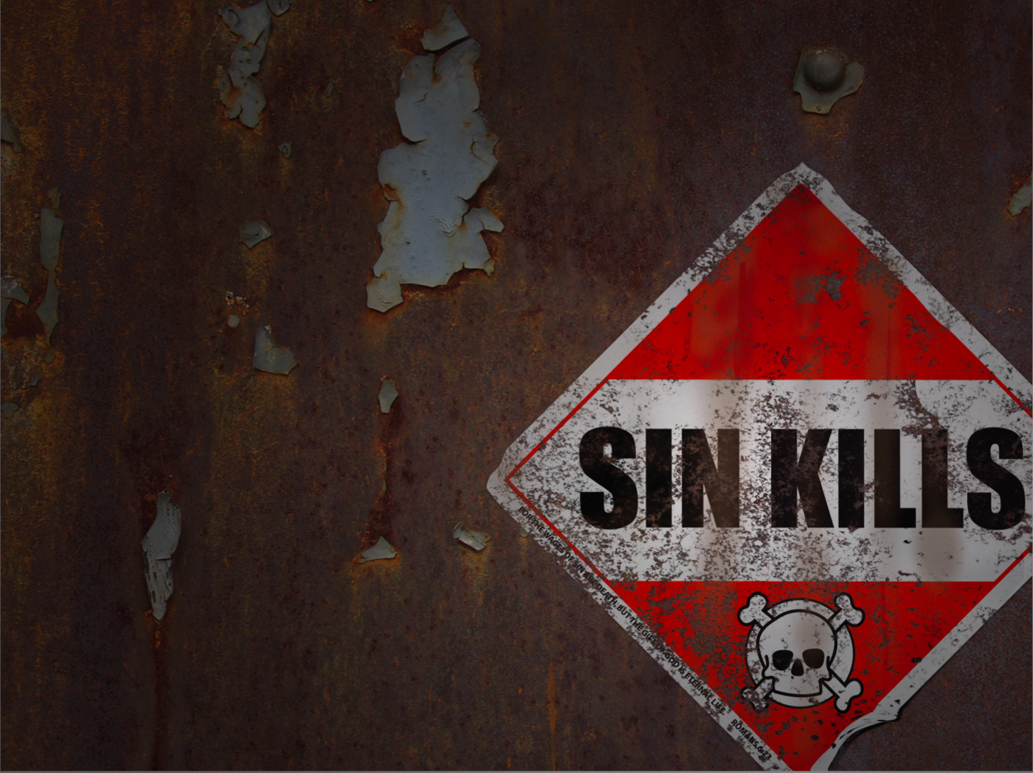
He realized their condition

Slide 6
He had a burden to pray

Slide 7
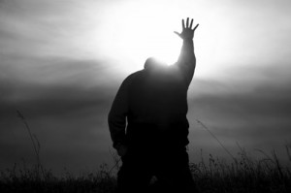
He understood that prayer makes a difference

Slide 8
“God is still on the throne, and prayer changes things.”
Dr. Noah Hutchings

