Slide 1
Missions Sunday
The ABC’s of Praying for Missionaries

Slide 2
Acceptance
“Pray that I may be rescued from the unbelievers in Judea and that my service in Jerusalem may be acceptable to the saints there.” Romans 15:31

Slide 3
Boldness
“Pray also for me, that whenever I speak, words may be given me so that I will fearlessly make known the mystery of the gospel.” Ephesians 6:19

Slide 4
Clarity
“Pray that I may proclaim it clearly, as I should.” Colossians 4:4

Slide 5
Deliverance
“Pray that I may be rescued from the unbelievers in Judea and that my service in Jerusalem may be acceptable to the saints there.” Romans 15:31

Slide 6
Extension
“And pray for us, too, that God may open a door for our message, so that we may proclaim the mystery of Christ, for which I am in chains.” Colossians 4:3

Slide 7
Fruitfulness
“Finally, brothers, pray for us that the message of the Lord may spread rapidly and be honored, just as it was with you.” 2 Thessalonians 3:1

Slide 8
Guidance
“For this reason, since the day we heard about you, we have not stopped praying for you. We continually ask God to fill you with the knowledge of his will through all the wisdom and understanding that the Spirit gives.” Colossians 1:9

Slide 9
Hope
“May the God of hope fill you with all joy and peace as you trust in him, so that you may overflow with hope by the power of the Holy Spirit.” Romans 15:13

Slide 10
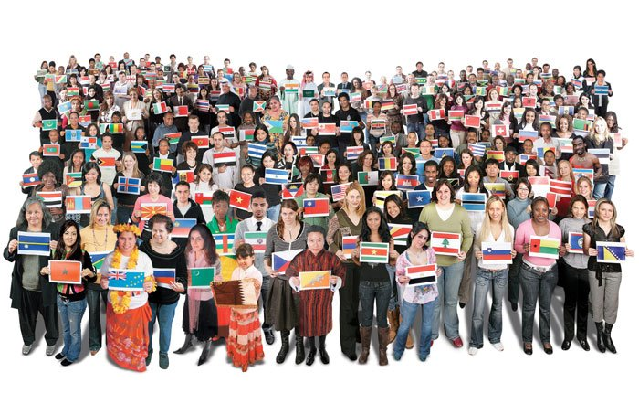
All Peoples & Nations. . .

