Slide 1
Advent
Preparing for Jesus

Slide 3
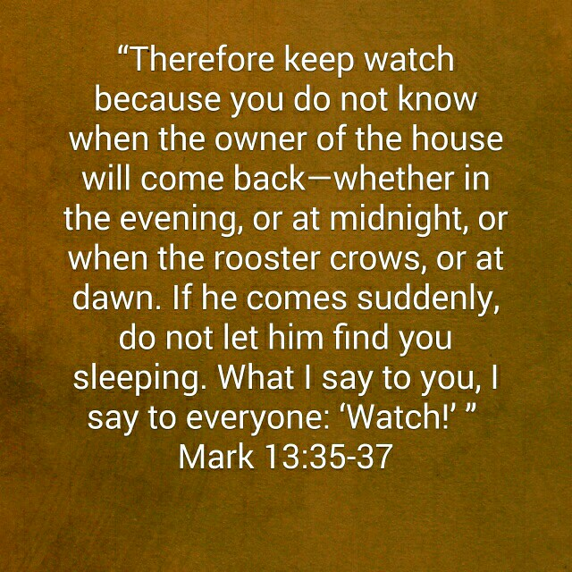

Slide 4
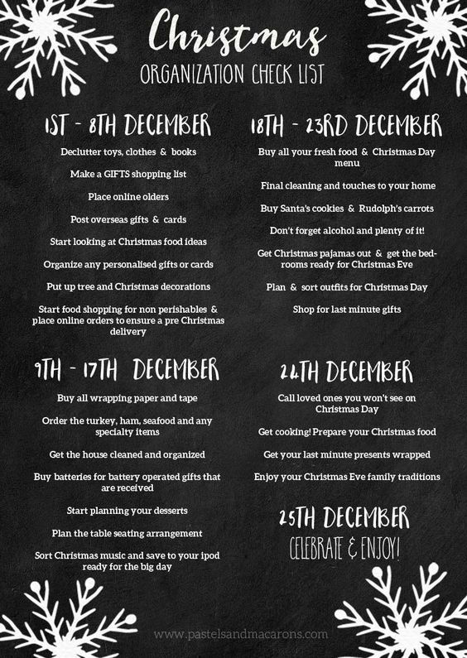

Slide 5
¹ The beginning of the good news about Jesus the Messiah, the Son of God, ² as it is written in Isaiah the prophet:
“I will send my messenger ahead of you,
who will prepare your way”—
³ “a voice of one calling in the wilderness,
‘Prepare the way for the Lord,
make straight paths for him.’”
⁴ And so John the Baptist appeared in the wilderness, preaching a baptism of repentance for the forgiveness of sins.

Slide 6
⁵ The whole Judean countryside and all the people of Jerusalem went out to him. Confessing their sins, they were baptized by him in the Jordan River. ⁶ John wore clothing made of camel’s hair, with a leather belt around his waist, and he ate locusts and wild honey. ⁷ And this was his message: “After me comes the one more powerful than I, the straps of whose sandals I am not worthy to stoop down and untie. ⁸ I baptize you with water, but he will baptize you with the Holy Spirit.”
Mark 1:1-8

Slide 7
Prophecy Given

Slide 8
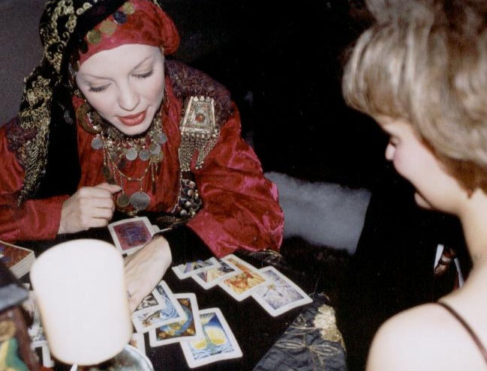
Anyone who does these things is detestable to the Lord.
Deuteronomy 18:12

Slide 9
¹ The beginning of the good news about Jesus the Messiah, the Son of God, ² as it is written in Isaiah the prophet:
“I will send my messenger ahead of you,
who will prepare your way”—
³ “a voice of one calling in the wilderness,
‘Prepare the way for the Lord,
make straight paths for him.’”

Slide 11
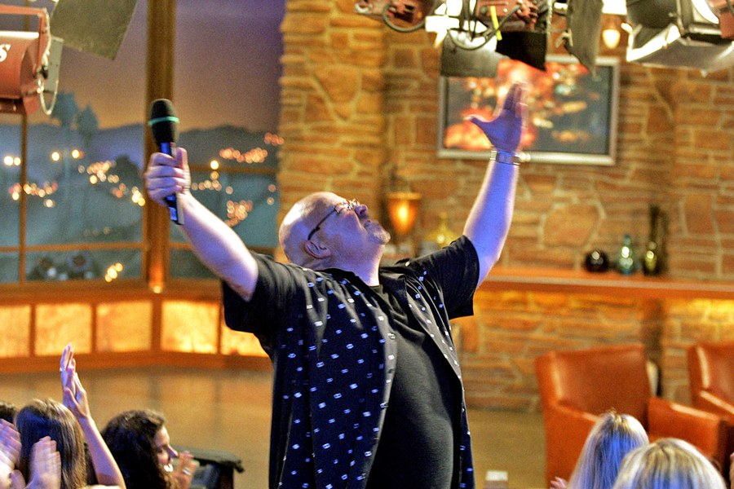
Richard Lundblade

Slide 12
Prophecy Fulfilled

Slide 13
But any prophet who falsely claims to speak in my name or who speaks in the name of another god must die.
Deuteronomy 18:20

Slide 14
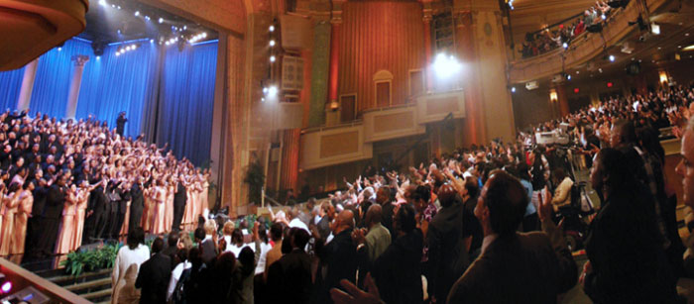

Slide 15
⁴ And so John the Baptist appeared in the wilderness, preaching a baptism of repentance for the forgiveness of sins. . .
⁶ John wore clothing made of camel’s hair, with a leather belt around his waist, and he ate locusts and wild honey. ⁷ And this was his message: “After me comes the one more powerful than I, the straps of whose sandals I am not worthy to stoop down and untie. ⁸ I baptize you with water, but he will baptize you with the Holy Spirit.”

Slide 16
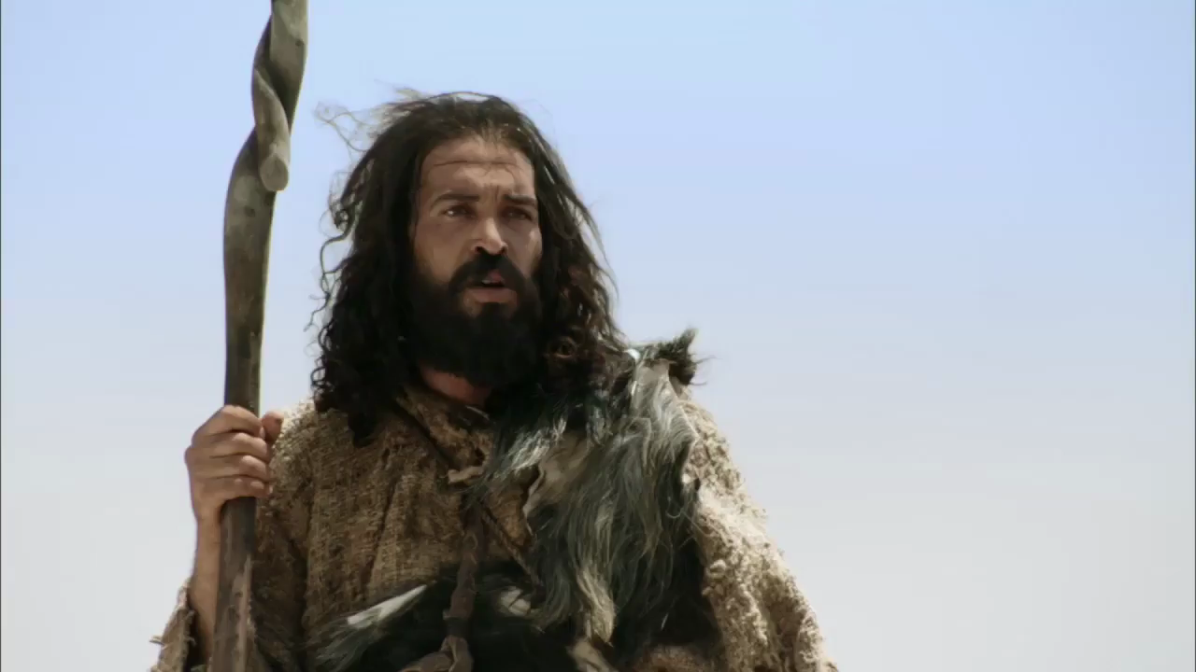

Slide 18
Prophecy Received

Slide 19
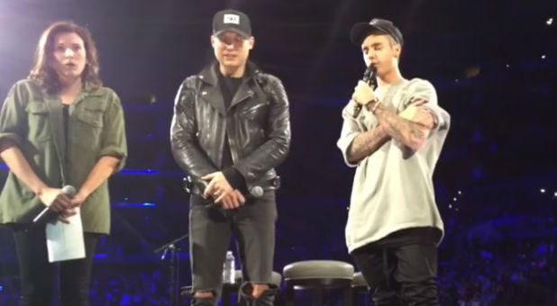

Slide 20
⁵ The whole Judean countryside and all the people of Jerusalem went out to him. Confessing their sins, they were baptized by him in the Jordan River.

Slide 21
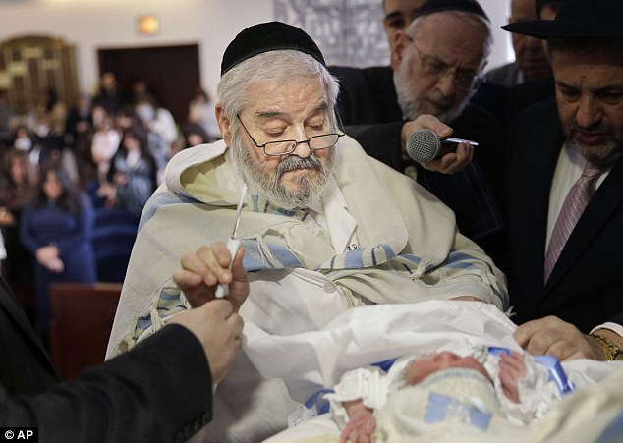

Slide 22
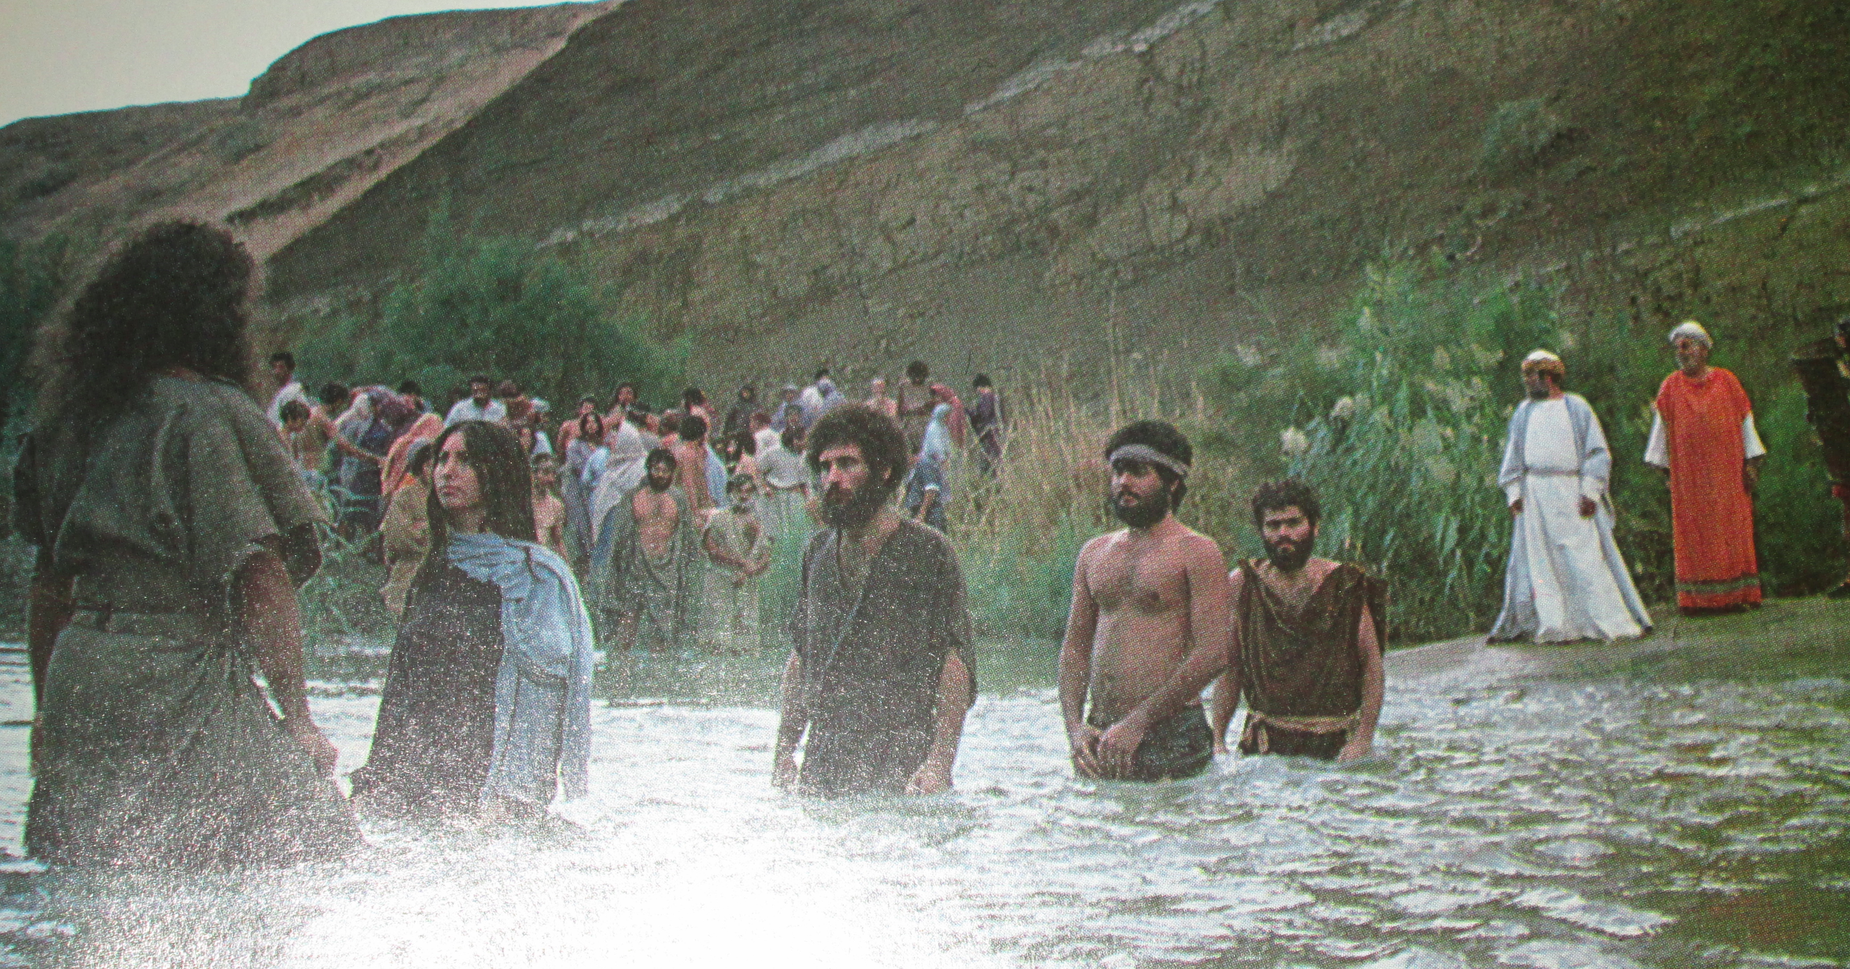

Slide 23
Apply

Slide 24
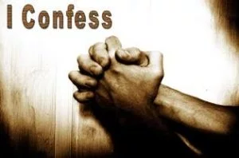
Confess Your Sins

Slide 25
Live Out Your Baptism

