Slide 1
Means of Spiritual Growth
The Word

Slide 2
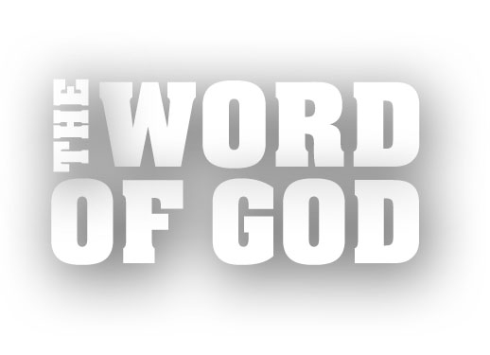

Slide 3
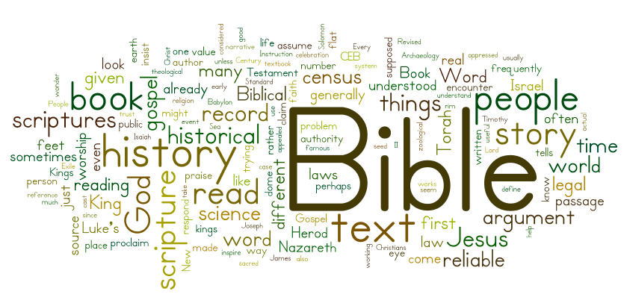

Slide 4
¹ Blessed are those whose ways are blameless, who walk according
to the law of the Lord. ² Blessed are those who keep his statutes and seek him with all their heart— ³ they do no wrong but follow his ways.
Psalm 119:1-3

Slide 5
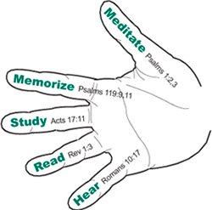

Slide 6
Hear
So faith comes from hearing, and hearing through the word of Christ.
Romans 10:17 ESV

Slide 7
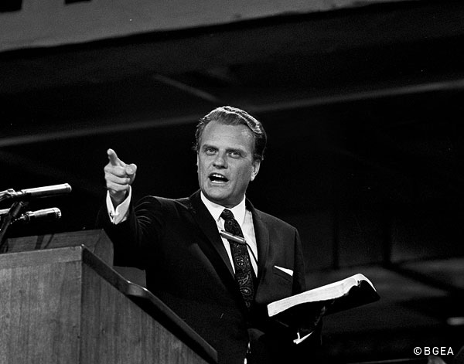

Slide 8
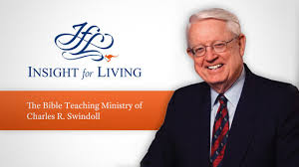

Slide 10
Read
Blessed is the one who reads aloud the words of this prophecy, and blessed are those who hear it and take to heart what is written in it, because the time is near.
Revelation 1:3

Slide 11
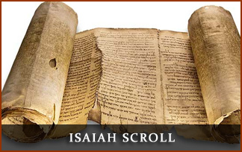

Slide 12
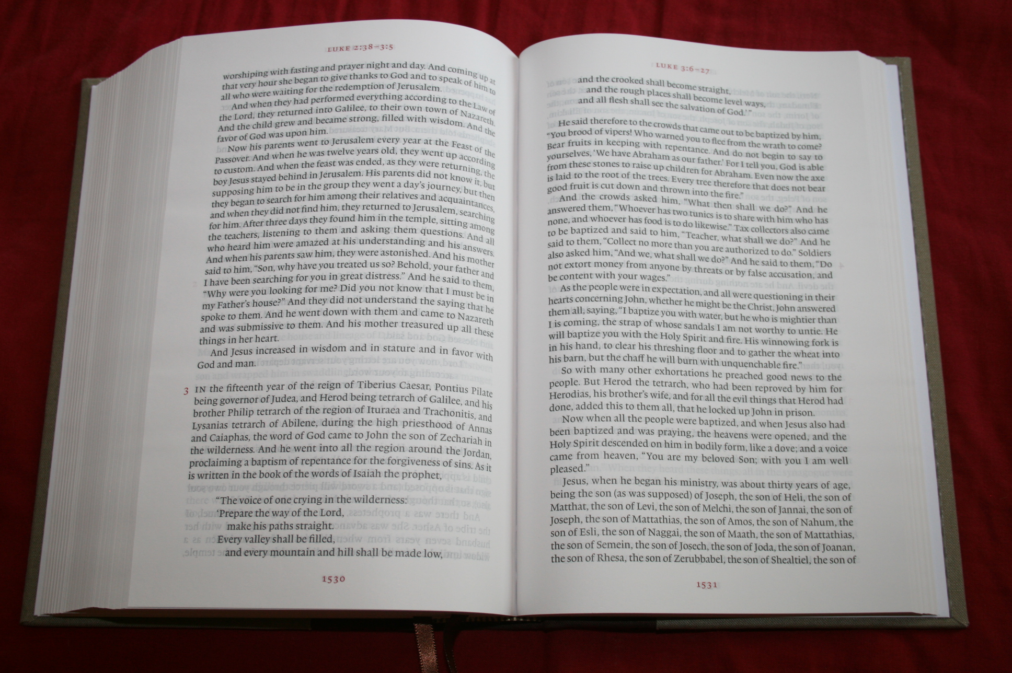

Slide 13
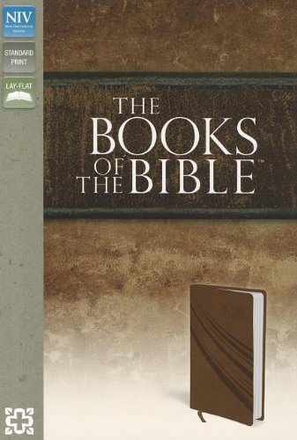

Slide 14
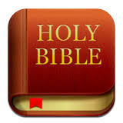

Slide 16
Study
Now these Jews were more noble than those in Thessalonica; they received the word with all eagerness, examining the Scriptures daily to see if these things were so.
Acts 17:11

Slide 17
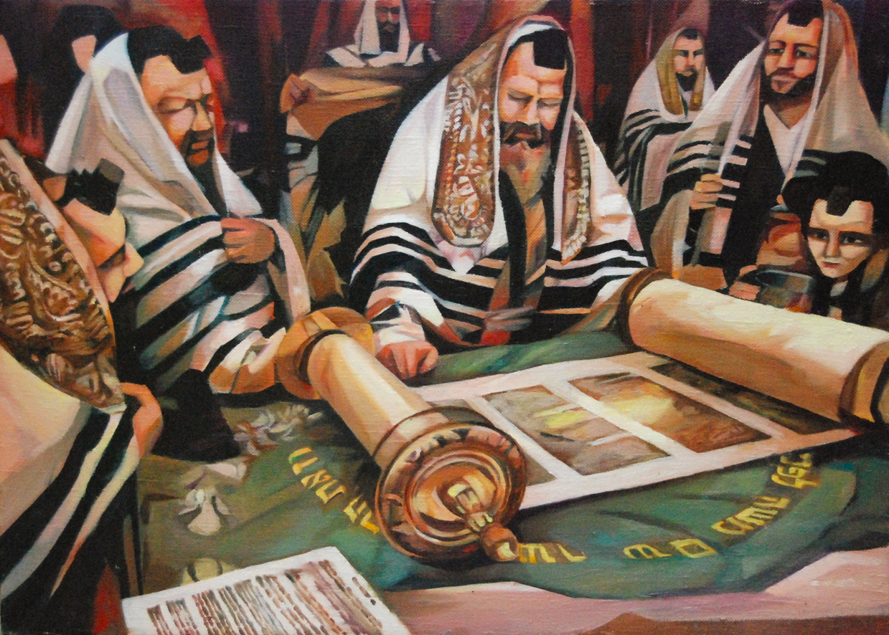

Slide 19
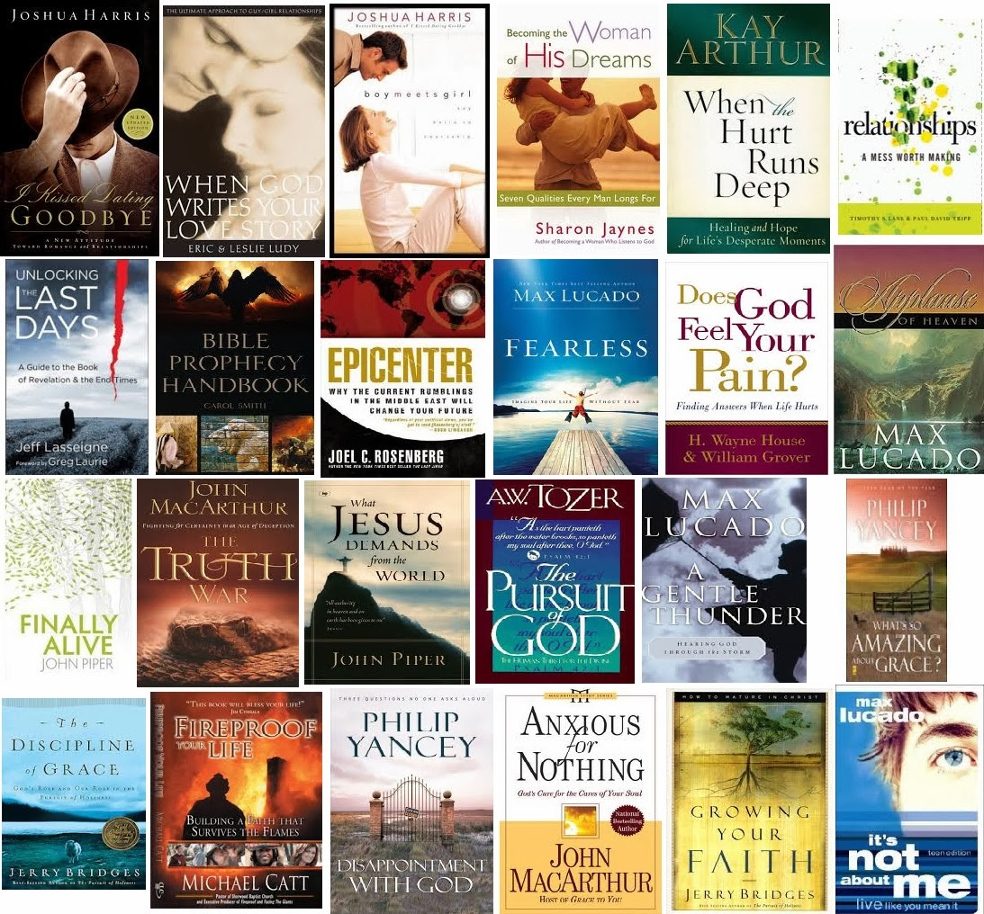

Slide 20
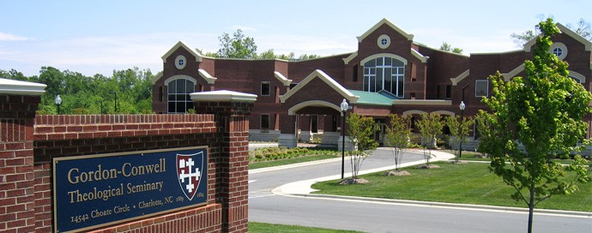

Slide 21
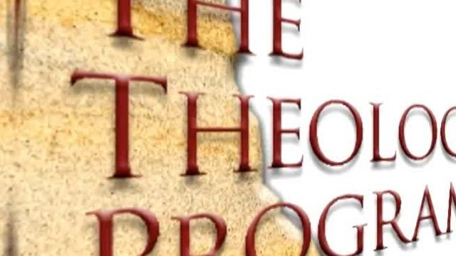

Slide 23
Memorize
⁹ How can a young man keep his way pure? By guarding it according to your word. . .
¹¹ I have stored up your word in my heart, that I might not sin against you.
Psalm 119:9, 11

Slide 24
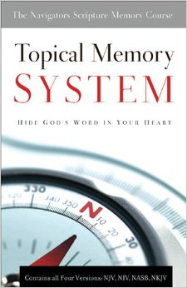

Slide 27
Meditate
² But his delight is in the law of the Lord, and on his law he meditates day and night.
³ He is like a tree planted by streams of water that yields its fruit in its season, and its leaf does not wither. In all that he does, he prospers.
Psalm 1:2-3

Slide 28
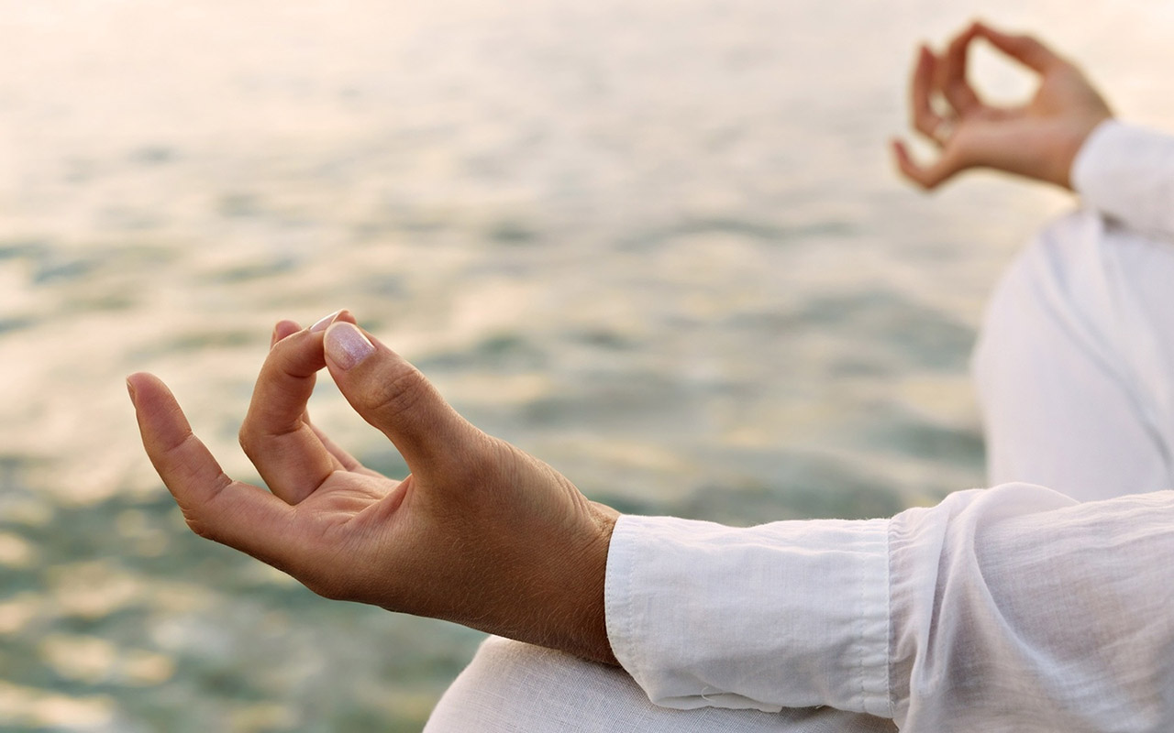

Slide 29
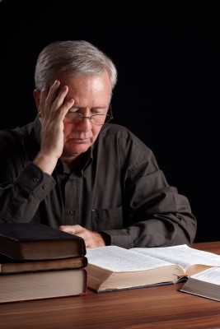

Slide 31
