Slide 1
Christmas
Its Purpose

Slide 2
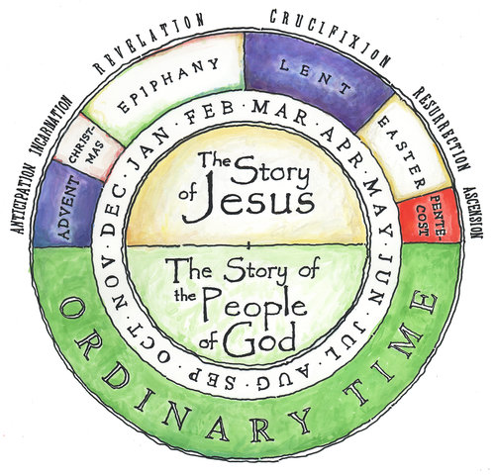

Slide 3
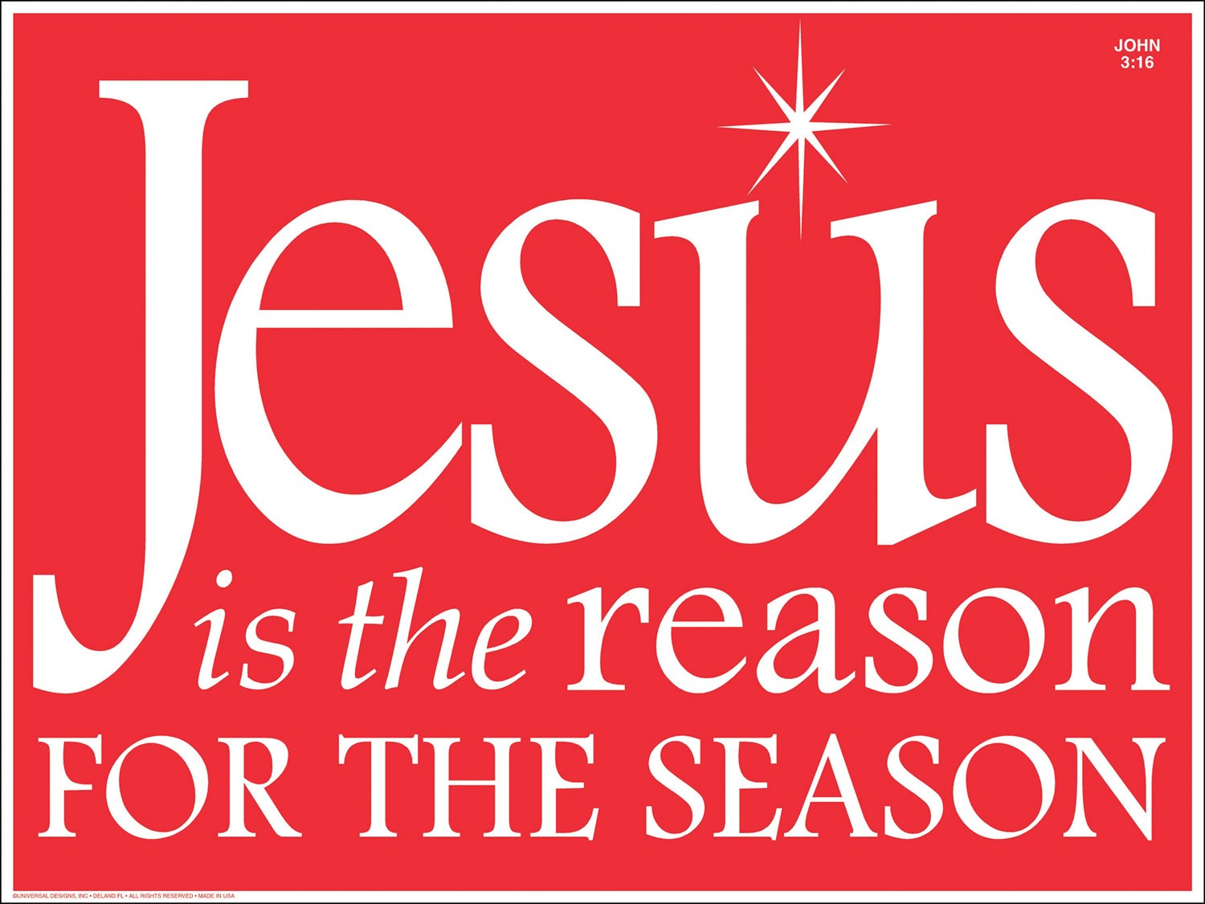

Slide 4
⁴ But when the set time had fully come, God sent his Son, born of a woman, born under the law, ⁵ to redeem those under the law, that we might receive adoption to sonship. ⁶ Because you are his sons, God sent the Spirit of his Son into our hearts, the Spirit who calls out, “Abba, Father.” ⁷ So you are no longer a slave, but God’s child; and since you are his child, God has made you also an heir.
Galatians 4:4-7

Slide 5
The Time Had Come

Slide 6
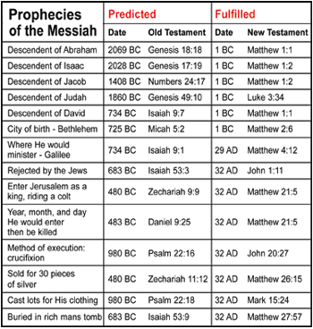

Slide 8
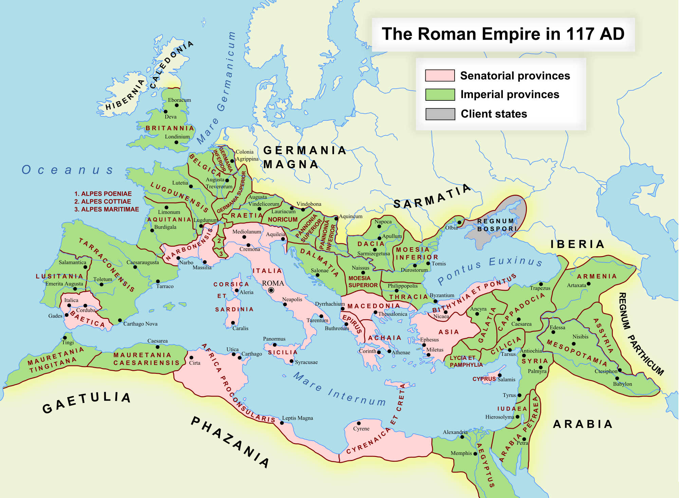

Slide 10
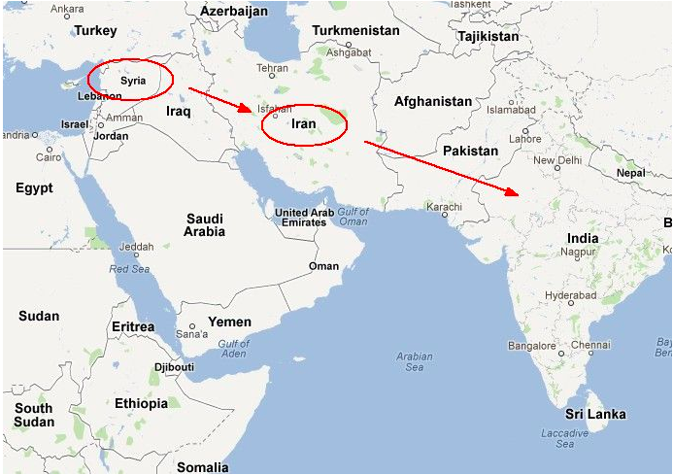

Slide 11
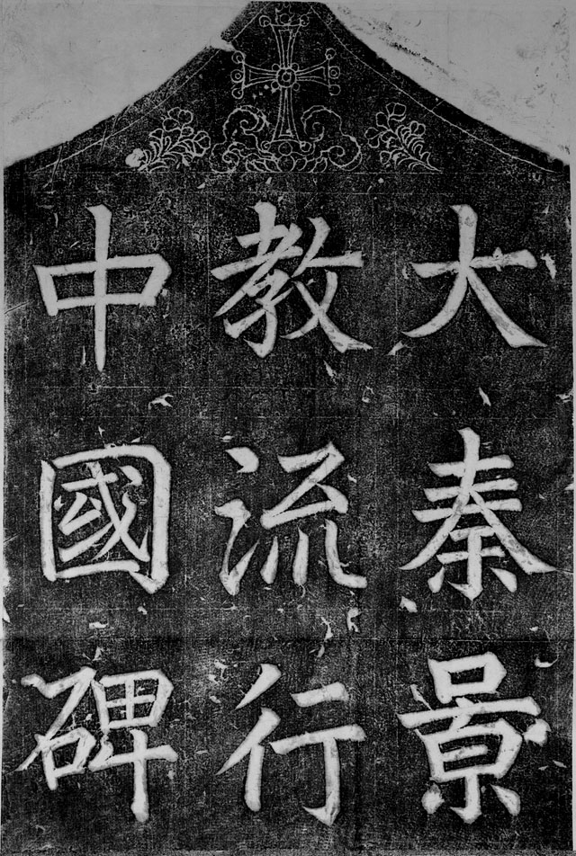
Tang Chinese stele erected 781 AD that documents 150 years of history of early Christianity in China.

Slide 13
Redemption Achieved

Slide 14
⁴ But when the set time had fully come, God sent his Son, born of a woman, born under the law, ⁵ to redeem those under the law, that we might receive adoption to sonship.

Slide 15
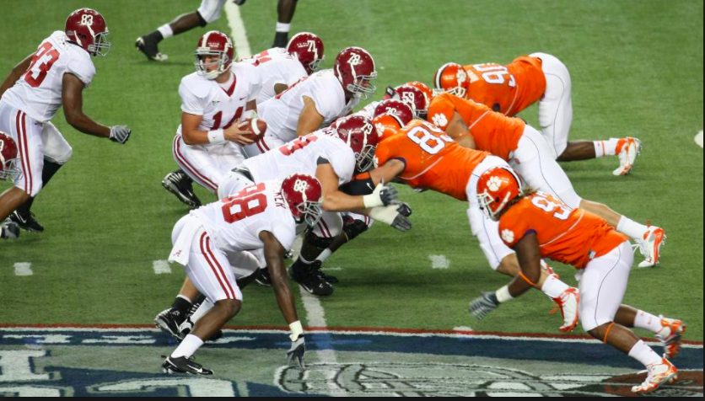

Slide 17
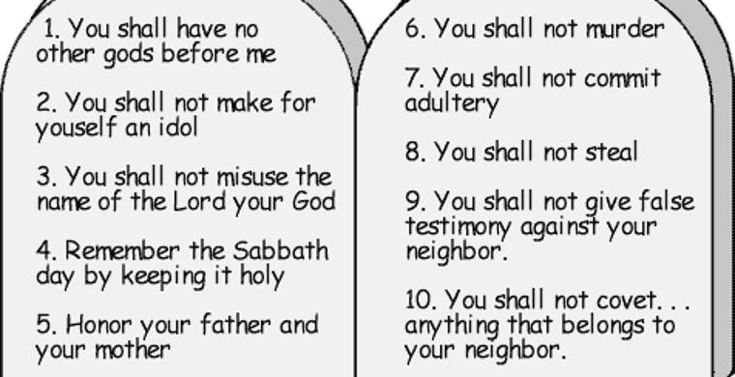

Slide 19
Adoption Received

Slide 20
⁴ But when the set time had fully come, God sent his Son, born of a woman, born under the law, ⁵ to redeem those under the law, that we might receive adoption to sonship. ⁶ Because you are his sons, God sent the Spirit of his Son into our hearts, the Spirit who calls out, “Abba, Father.” ⁷ So you are no longer a slave, but God’s child; and since you are his child, God has made you also an heir.
Galatians 4:4-7

Slide 23
Apply

Slide 24
Rest in the knowledge that God is in control

Slide 26
Relish (greatly enjoy) your relationship with Abba

