Slide 1
Conformed to Christ’s Image
Pursuing Godliness

Slide 7
For those God foreknew he also predestined to be conformed to the image of his Son . . .
Romans 8:29

Slide 8
Have nothing to do with irreverent, silly myths. Rather train yourself for godliness; for while bodily training is of some value, godliness is of value in every way, as it holds promise for the present life and also for the life to come.
1 Timothy 4:7-8

Slide 9
Have nothing to do with irreverent, silly myths. Rather train yourself for godliness; for while bodily training is of some value, godliness is of value in every way, as it holds promise for the present life and also for the life to come.
1 Timothy 4:7-8

Slide 12
Have nothing to do with irreverent, silly myths. Rather train yourself for godliness; for while bodily training is of some value, godliness is of value in every way, as it holds promise for the present life and also for the life to come.
1 Timothy 4:7-8

Slide 13
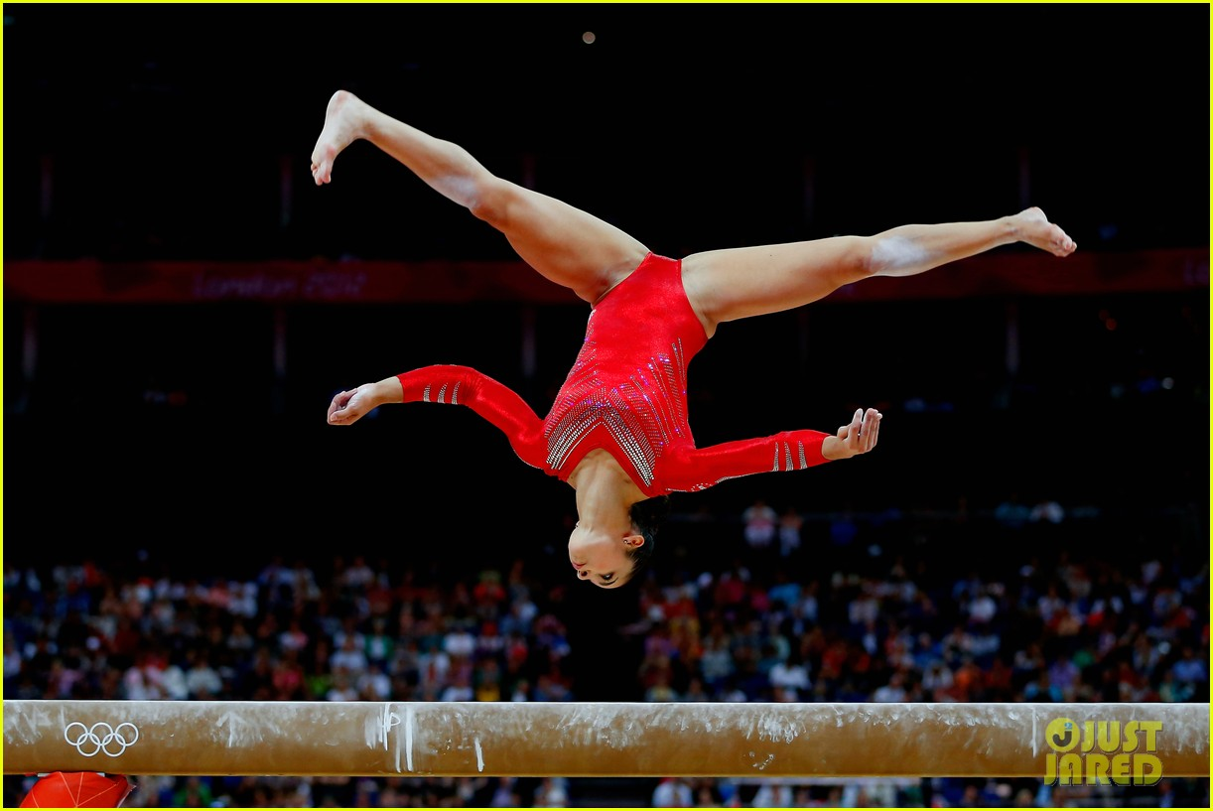

Slide 14
“Those who would be godly must train themselves to be godly; it requires a constant exercise.”
Matthew Henry

Slide 15
Have nothing to do with irreverent, silly myths. Rather train yourself for godliness; for while bodily training is of some value, godliness is of value in every way, as it holds promise for the present life and also for the life to come.
1 Timothy 4:7-8

Slide 17
Godliness - devotion to God which results in a life that is pleasing to Him.”
Jerry Bridges

Slide 18
Have nothing to do with irreverent, silly myths. Rather train yourself for godliness; for while bodily training is of some value, godliness is of value in every way, as it holds promise for the present life and also for the life to come.
1 Timothy 4:7-8

Slide 20
Have nothing to do with irreverent, silly myths. Rather train yourself for godliness; for while bodily training is of some value, godliness is of value in every way, as it holds promise for the present life and also for the life to come.
1 Timothy 4:7-8

Slide 22
Have nothing to do with irreverent, silly myths. Rather train yourself for godliness; for while bodily training is of some value, godliness is of value in every way, as it holds promise for the present life and also for the life to come.
1 Timothy 4:7-8

Slide 24
Application
Examine Your Values

Slide 26
Application
Pursue Godliness

