Slide 1
Renew
An Offering of Worship

Slide 5
While a lot of people who make New Year's resolutions generally find them hard to keep, research shows that making resolutions can be useful. People who make resolutions are 10 times more likely to attain their goals than people who don't make any.
Deborah Serani, PsyD

Slide 6
¹ Therefore, I urge you, brothers and sisters, in view of God’s mercy, to offer your bodies as a living sacrifice, holy and pleasing to God—this is your true and proper worship. ² Do not conform to the pattern of this world, but be transformed by the renewing of your mind. Then you will be able to test and approve what God’s will is—his good, pleasing and perfect will.
Romans 12:1-2

Slide 7
An urgent plea

Slide 8
Therefore, I urge you, brothers and sisters, in view of God’s mercy, to offer your bodies as a living sacrifice, holy and pleasing to God—this is your true and proper worship.

Slide 10
Therefore, I urge you, brothers and sisters, in view of God’s mercy, to offer your bodies as a living sacrifice, holy and pleasing to God—this is your true and proper worship.

Slide 11
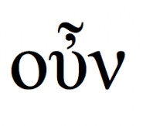

Slide 12
For I am not ashamed of the gospel. . . (Rm. 1:16)
For the wages of sin is death. . . (Rm. 6:23)
But God demonstrates His own love for us. . . (Rm. 5:8)
God works for the good of those who love him (Rm. 8:28)
Everyone who calls on the name of the Lord will be saved. (Rm. 10:13)

Slide 13
A thank offering

Slide 14
Therefore, I urge you, brothers and sisters, in view of God’s mercy, to offer your bodies as a living sacrifice, holy and pleasing to God—this is your true and proper worship.

Slide 15
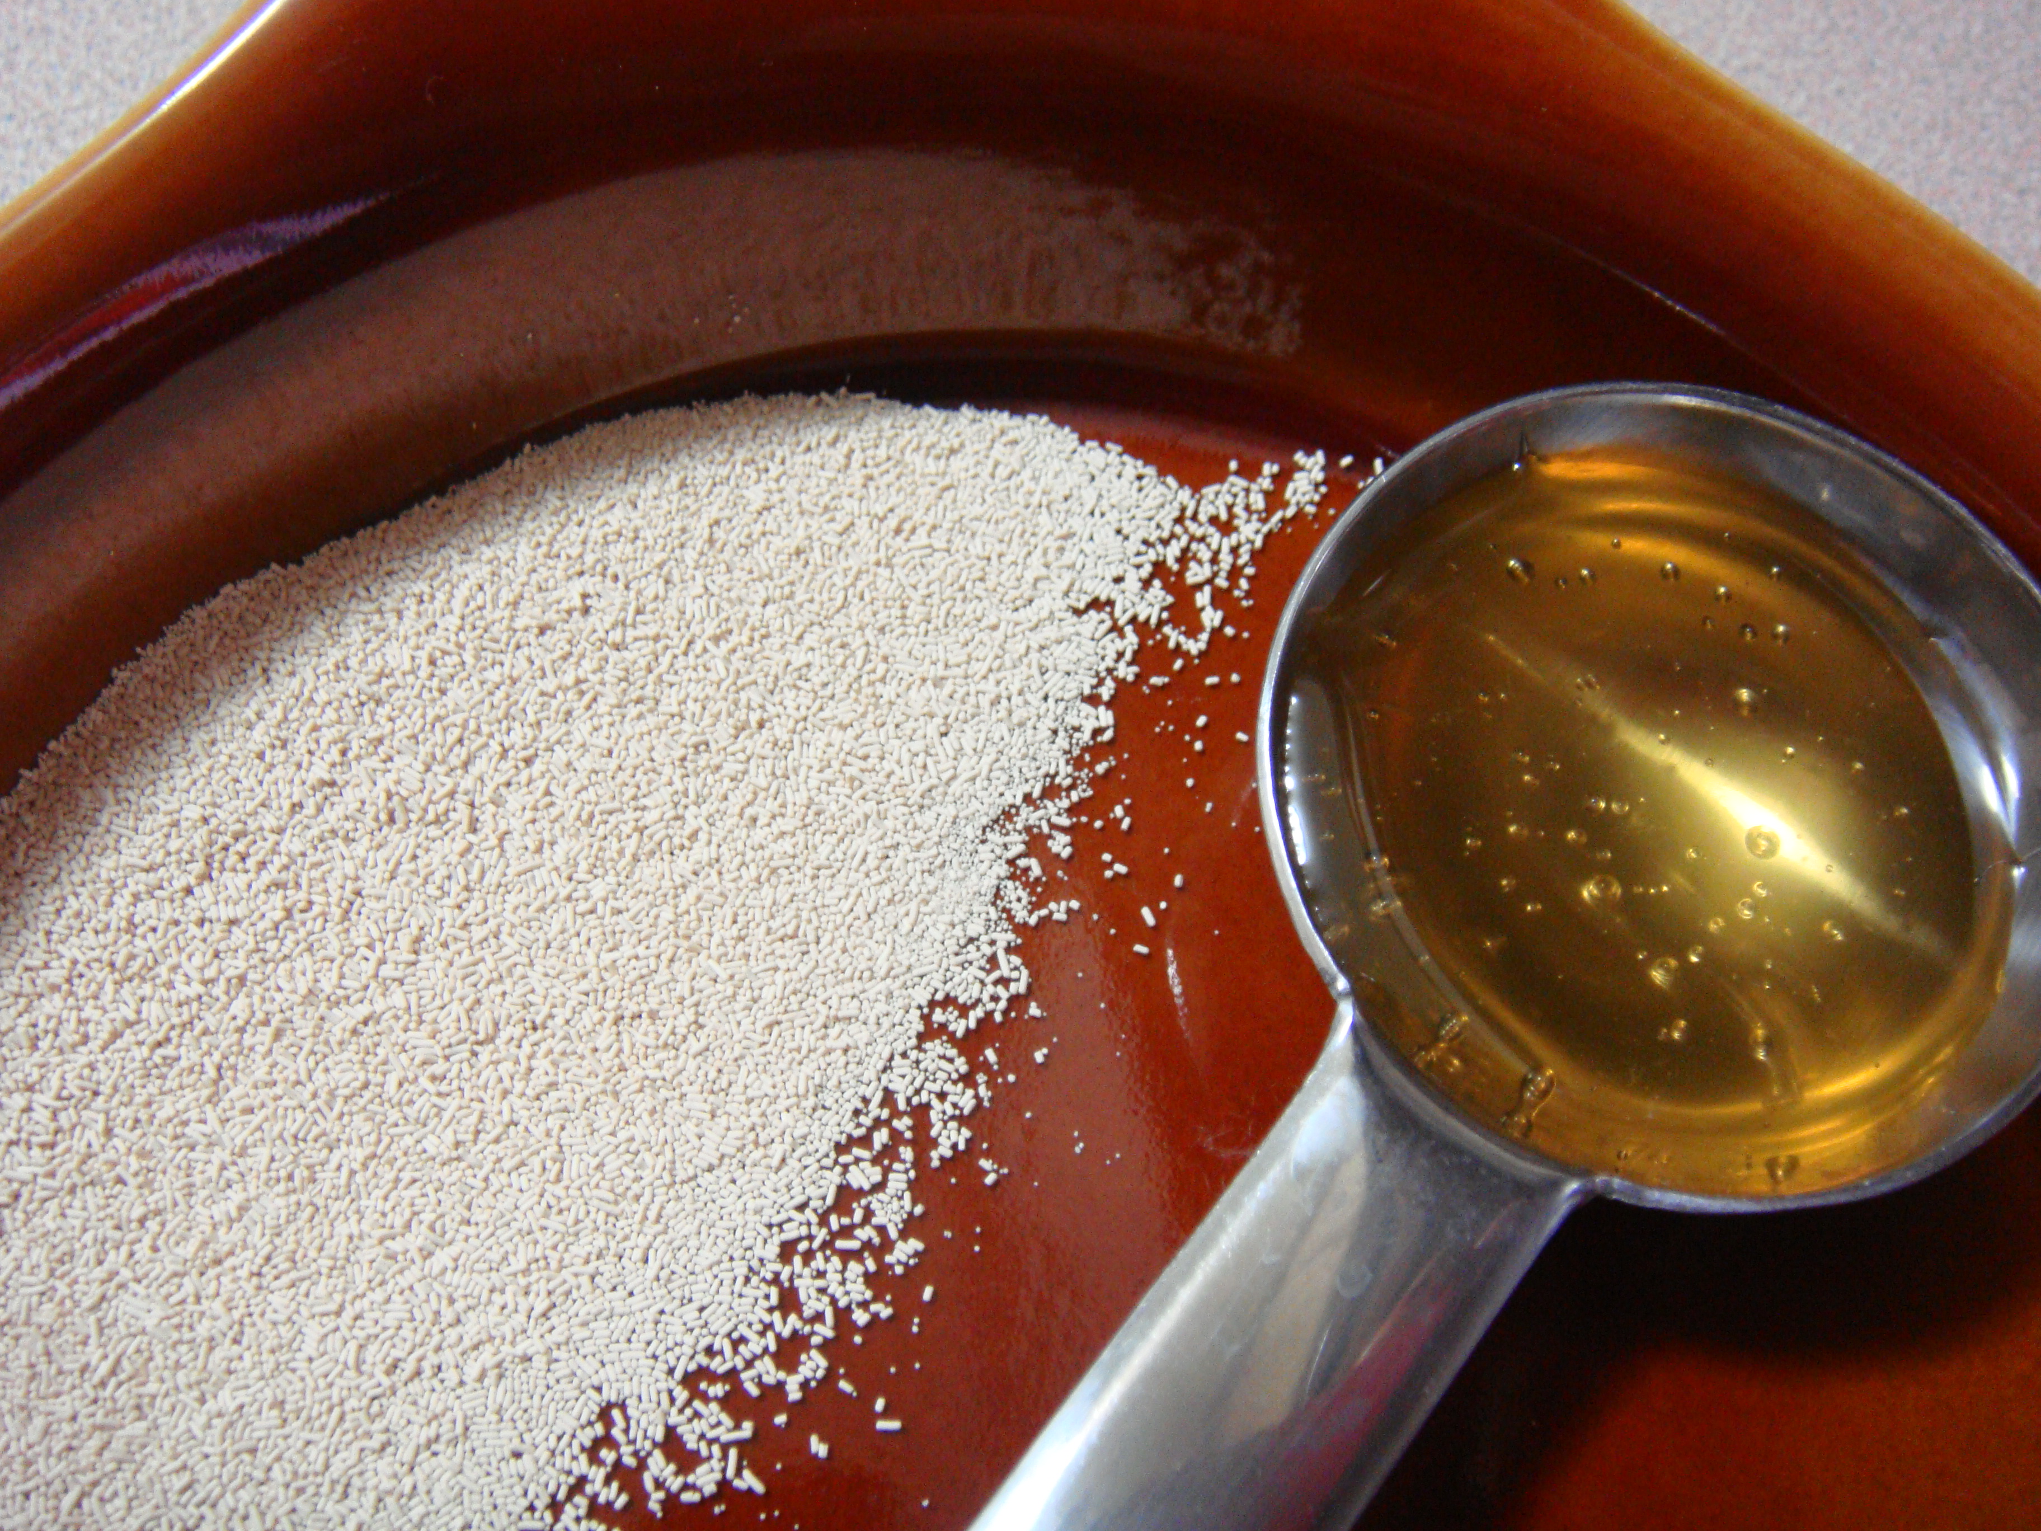

Slide 18
A holy offering

Slide 19
Therefore, I urge you, brothers and sisters, in view of God’s mercy, to offer your bodies as a living sacrifice, holy and pleasing to God—this is your true and proper worship.

Slide 21
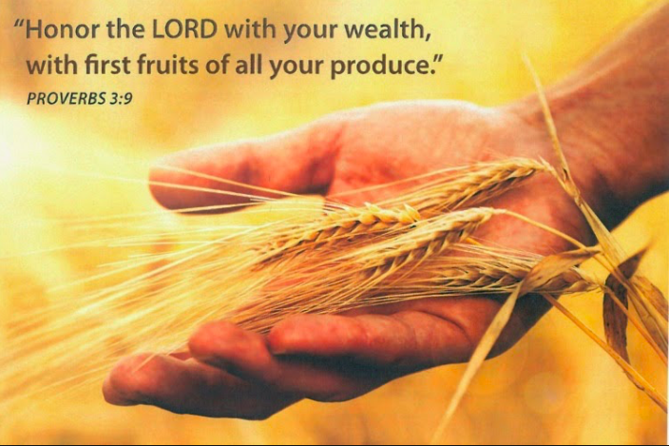

Slide 23
Lessons for disciples

Slide 24
Present yourself an offering to God
Ask God to empower your life
Consider how you may grow closer to God

