Slide 1
Resolutions
Changing Habits

Slide 2
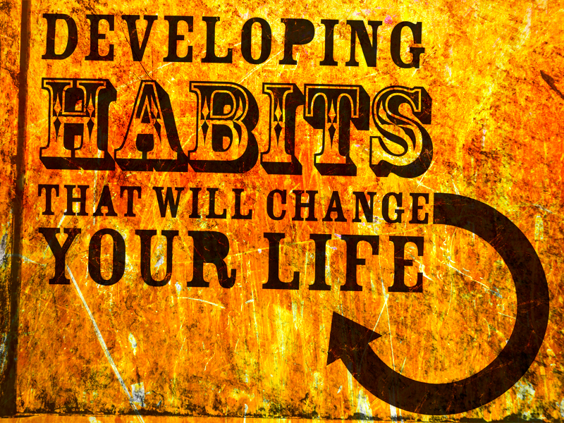

Slide 3
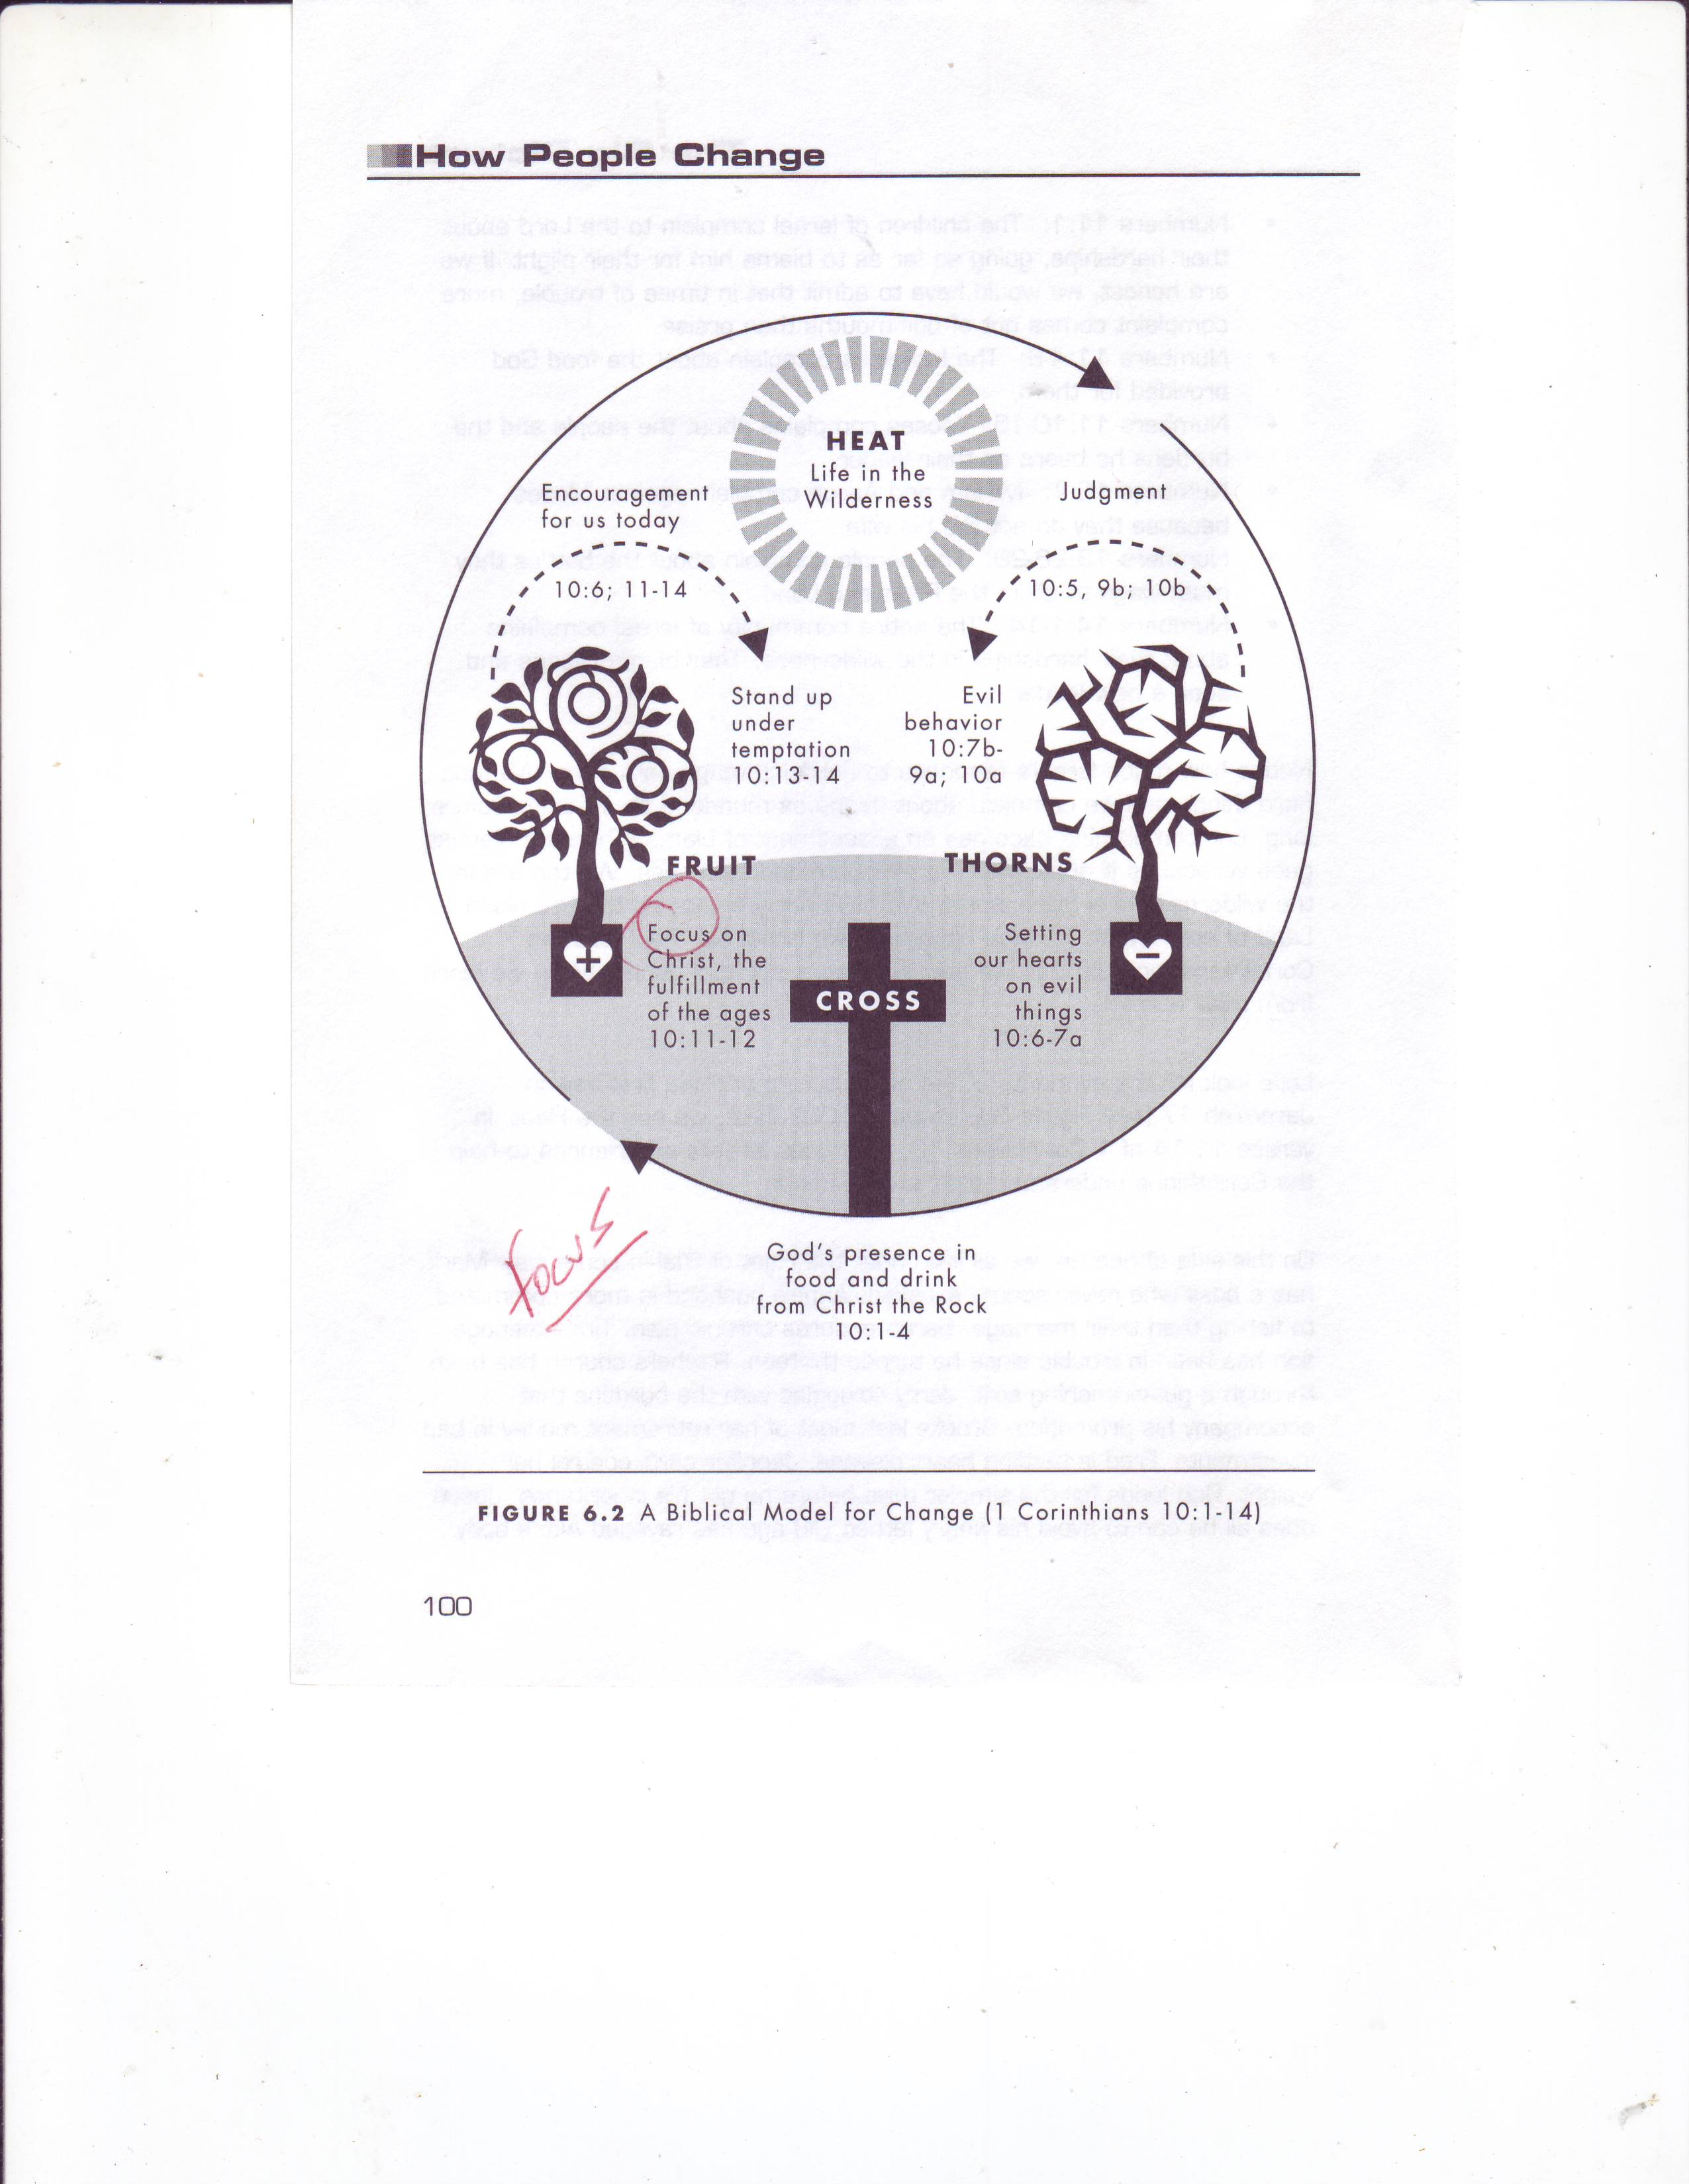

Slide 4
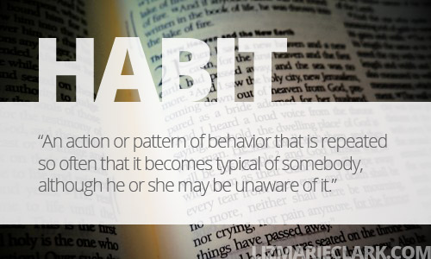

Slide 6
Change entails stopping old behaviors and acquiring new ones.

Slide 7
Let the thief no longer steal, but rather let him labor, doing honest work with his own hands, so that he may have something to share with anyone in need.
Ephesians 4:28

Slide 8
Stop

Slide 9
Let the thief no longer steal, but rather let him labor, doing honest work with his own hands, so that he may have something to share with anyone in need.
Ephesians 4:28

Slide 13
Redirect

Slide 14
Let the thief no longer steal, but rather let him labor, doing honest work with his own hands, so that he may have something to share with anyone in need.
Ephesians 4:28

Slide 15
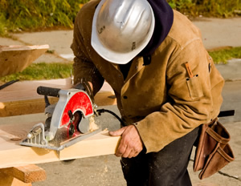

Slide 18
Live It Out

Slide 19
Let the thief no longer steal, but rather let him labor, doing honest work with his own hands, so that he may have something to share with anyone in need.
Ephesians 4:28

Slide 22
Change entails stopping old behaviors and acquiring new ones.

Slide 23
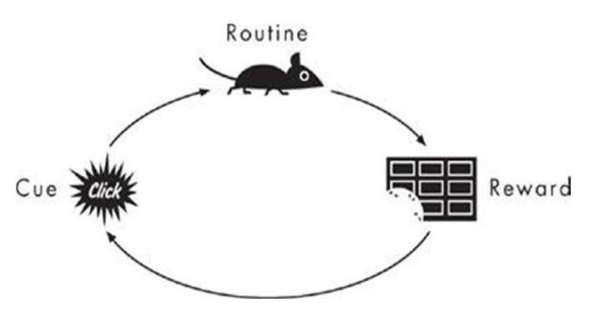

Slide 24
