Slide 1
Resolutions
Foundations

Slide 3
STATISTIC BRAIN

Slide 4
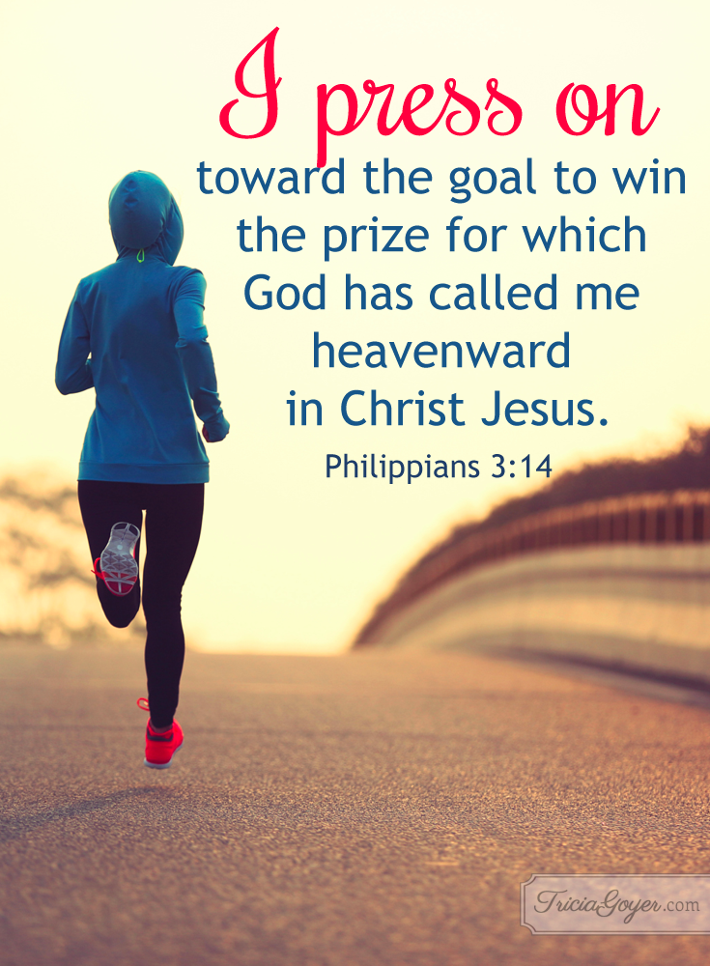

Slide 5
Lay a strong spiritual foundation in your life.

Slide 7
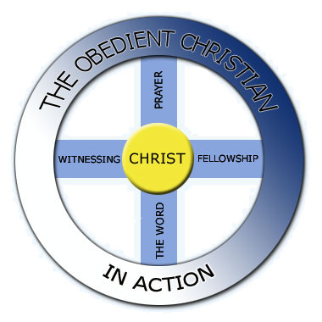

Slide 8
Christ the Center
I have been crucified with Christ and I no longer live, but Christ lives in me. The life I now live in the body, I live by faith in the Son of God, who loved me and gave himself for me.
Galatians 2:20

Slide 9
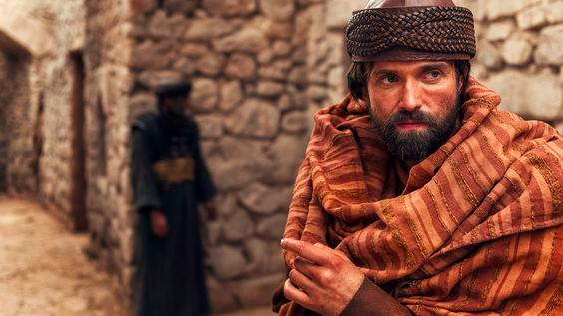
Emmett J. Scanlan as Saul/the apostle Paul from "A.D: The Bible Continues"

Slide 10
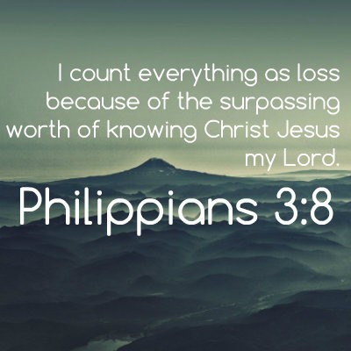

Slide 11
The Obedient Christian in Action
Whoever has my commands and keeps them is the one who loves me. The one who loves me will be loved by my Father, and I too will love them and show myself to them.”
John 14:21

Slide 12
When you purposefully choose to walk in God's way, it shows in your outward lifestyle.

Slide 14
The Word
All Scripture is God-breathed and is useful for teaching, rebuking, correcting and training in righteousness,
2 Timothy 3:16

Slide 15
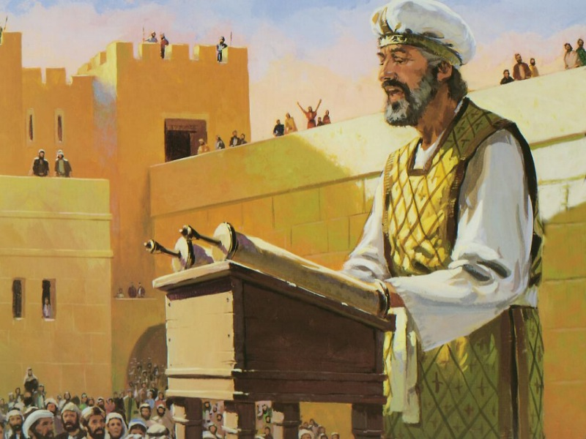

Slide 17
Prayer
Do not be anxious about anything, but in every situation, by prayer and petition, with thanksgiving, present your requests to God. And the peace of God, which transcends all understanding, will guard your hearts and your minds in Christ Jesus.
Philippians 4:6-7

Slide 19
¹² As she kept on praying to the Lord, Eli observed her mouth. ¹³ Hannah was praying in her heart, and her lips were moving but her voice was not heard. Eli thought she was drunk ¹⁴ and said to her, “How long are you going to stay drunk? Put away your wine.”
¹⁵ “Not so, my lord,” Hannah replied, “I am a woman who is deeply troubled. I have not been drinking wine or beer; I was pouring out my soul to the Lord.
1 Samuel 1:12-15

Slide 20
Fellowship
And let us consider how we may spur one another on toward love and good deeds, not giving up meeting together, as some are in the habit of doing, but encouraging one another—and all the more as you see the Day approaching.
Hebrews 10:24-25

Slide 21
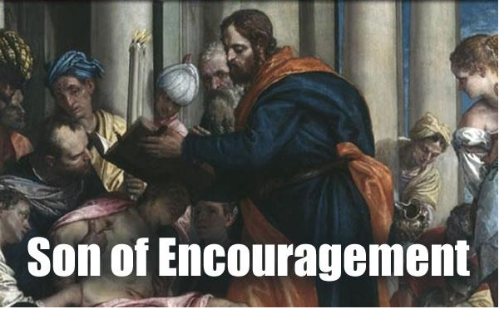

Slide 23
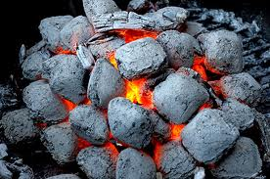

Slide 24
Witnessing
For I am not ashamed of the gospel, because it is the power of God that brings salvation to everyone who believes: first to the Jew, then to the Gentile.
Romans 1:16

Slide 25
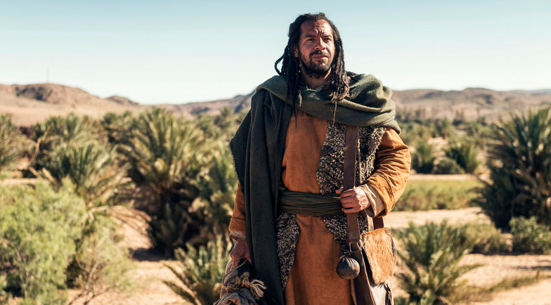

Slide 26
⁴³ The next day Jesus decided to leave for Galilee. Finding Philip, he said to him, “Follow me.”
⁴⁴ Philip, like Andrew and Peter, was from the town of Bethsaida. ⁴⁵ Philip found Nathanael and told him, “We have found the one Moses wrote about in the Law, and about whom the prophets also wrote—Jesus of Nazareth, the son of Joseph.”
John 1

Slide 27
⁴ Those who had been scattered preached the word wherever they went. ⁵ Philip went down to a city in Samaria and proclaimed the Messiah there. ⁶ When the crowds heard Philip and saw the signs he performed, they all paid close attention to what he said. . . .
Acts 8:4-6

Slide 28
