Slide 1
Disciple
Responding to Christ

Slide 2
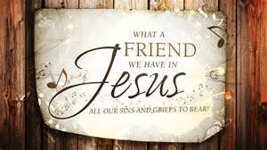

Slide 3
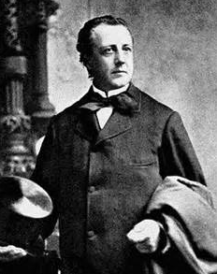
He devoted his life to tutoring, preaching and helping others.
Joseph Scriven (1819 – 1886)

Slide 4
⁹ “As the Father has loved me, so have I loved you. Now remain in my love. ¹⁰ If you keep my commands, you will remain in my love, just as I have kept my Father’s commands and remain in his love. ¹¹ I have told you this so that my joy may be in you and that your joy may be complete. ¹² My command is this: Love each other as I have loved you. ¹³ Greater love has no one than this: to lay down one’s life for one’s friends. ¹⁴ You are my friends if you do what I command.

Slide 5
¹⁵ I no longer call you servants, because a servant does not know his master’s business. Instead, I have called you friends, for everything that I learned from my Father I have made known to you. ¹⁶ You did not choose me, but I chose you and appointed you so that you might go and bear fruit—fruit that will last—and so that whatever you ask in my name the Father will give you. ¹⁷ This is my command: Love each other.
John 15:9-17 NIV

Slide 6
Jesus. . .

Slide 7
⁹ “As the Father has loved me, so have I loved you. Now remain in my love.

Slide 8
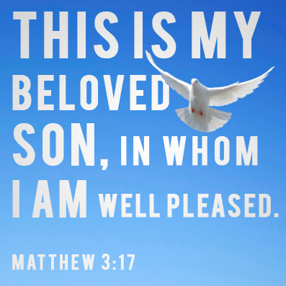

Slide 9
¹¹ I have told you this so that my joy may be in you and that your joy may be complete.

Slide 10
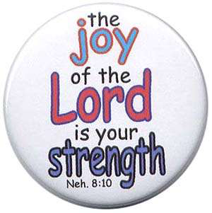

Slide 11
¹³ Greater love has no one than this: to lay down one’s life for one’s friends. ¹⁴ You are my friends if you do what I command. ¹⁵ I no longer call you servants, because a servant does not know his master’s business. Instead, I have called you friends, for everything that I learned from my Father I have made known to you.

Slide 13
¹⁶ You did not choose me, but I chose you and appointed you so that you might go and bear fruit—fruit that will last—and so that whatever you ask in my name the Father will give you.

Slide 14
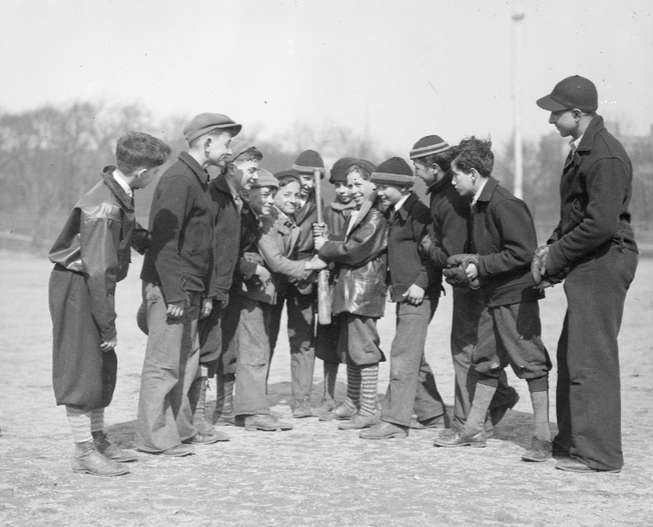
Leslie Jones (1934)

Slide 15
Disciples. . .

Slide 16
⁹ “As the Father has loved me, so have I loved you. Now remain in my love. ¹⁰ If you keep my commands, you will remain in my love, just as I have kept my Father’s commands and remain in his love.

Slide 17
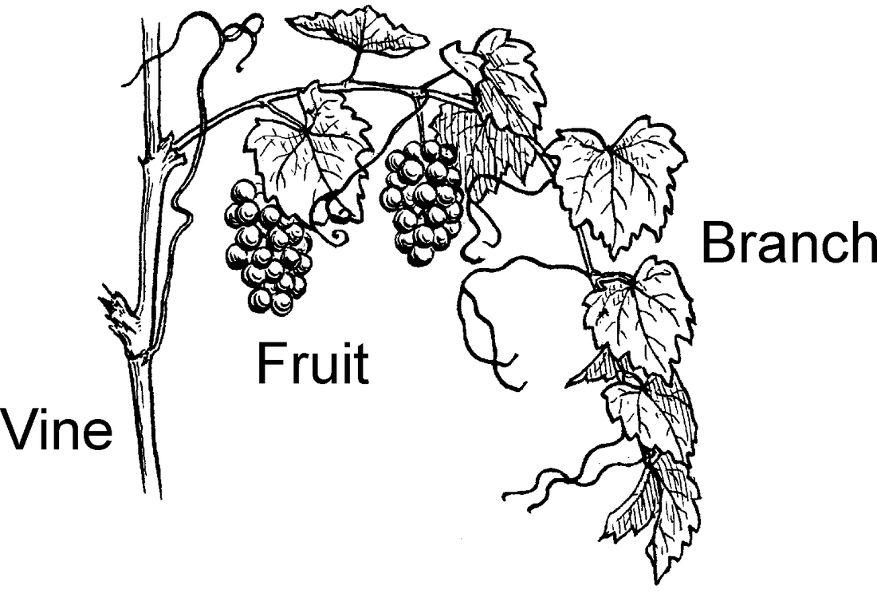

Slide 18
⁹ “As the Father has loved me, so have I loved you. Now remain in my love. ¹⁰ If you keep my commands, you will remain in my love, just as I have kept my Father’s commands and remain in his love. . .
¹⁴ You are my friends if you do what I command.

Slide 20
¹² My command is this: Love each other as I have loved you. ¹³ Greater love has no one than this: to lay down one’s life for one’s friends.

Slide 21
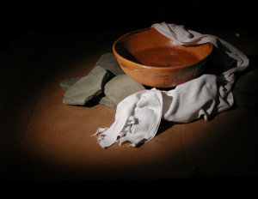

Slide 22
Bearing fruit. . .

Slide 23
¹⁶ You did not choose me, but I chose you and appointed you so that you might go and bear fruit—fruit that will last—and so that whatever you ask in my name the Father will give you. ¹⁷ This is my command: Love each other.

Slide 24
Fruit is people coming to Jesus
I chose you and appointed you. . .
Fruit leads to a transformed life
. . .that your joy may be complete.
Fruit is exemplified in loving one another
. . .to lay down one’s life for one’s friends.

Slide 25
