Slide 1
Romans
Our Love

Slide 4
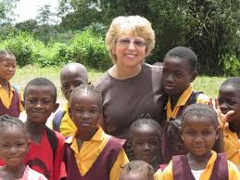

Slide 5
Romans 12:9-13
Love must be sincere. Hate what is evil; cling to what is good. Be devoted to one another in love. Honor one another above yourselves.

Slide 6
Never be lacking in zeal, but keep your spiritual fervor, serving the Lord. Be joyful in hope, patient in affliction, faithful in prayer. Share with the Lord’s people who are in need. Practice hospitality.

Slide 7
Live a life of love: toward God, toward others.

Slide 8
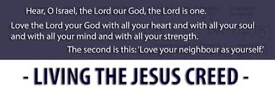
Preamble

Slide 9
Love must be sincere.
sin·cer·i·ty
noun
the quality of being free from pretense, deceit, or hypocrisy.
Synonyms: honesty, genuineness, truthfulness, integrity; candor

Slide 11
Love God
Hate what is evil; cling to what is good
Never be lacking in zeal, but keep your spiritual fervor, serving the Lord.
Be joyful in hope, patient in affliction, faithful in prayer.

Slide 14
Love People
Be devoted to one another in love.
Honor one another above yourselves.
Share with the Lord’s people who are in need.
Practice hospitality.

Slide 15
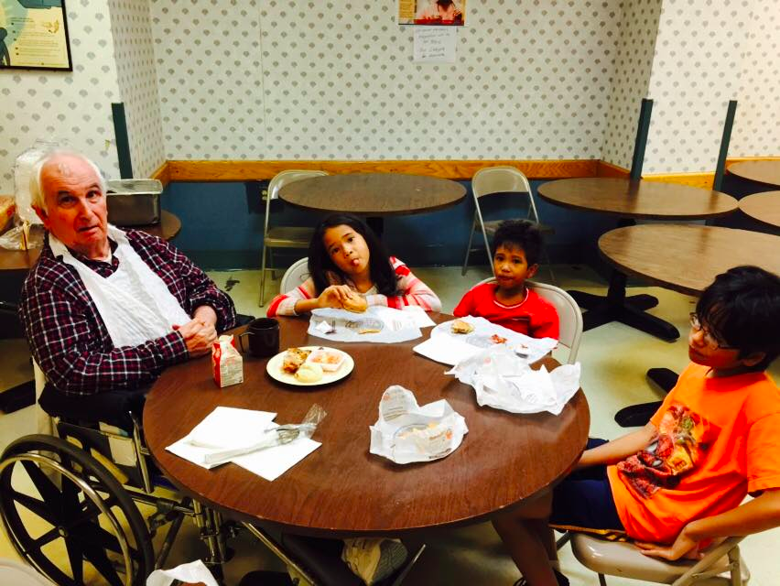

Slide 16
Live a life of love: toward God, toward others.

Slide 17
