Slide 1
Romans
His Time

Slide 2
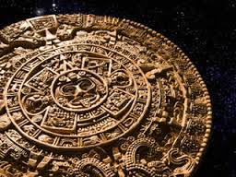

Slide 4
Live in Light of Christ’s Return

Slide 5
Romans 13:11-14
¹¹ And do this, understanding the present time: The hour has already come for you to wake up from your slumber, because our salvation is nearer now than when we first believed. ¹² The night is nearly over; the day is almost here. So let us put aside the deeds of darkness and put on the armor of light.

Slide 6
¹³ Let us behave decently, as in the daytime, not in carousing and drunkenness, not in sexual immorality and debauchery, not in dissension and jealousy. ¹⁴ Rather, clothe yourselves with the Lord Jesus Christ, and do not think about how to gratify the desires of the flesh.

Slide 7
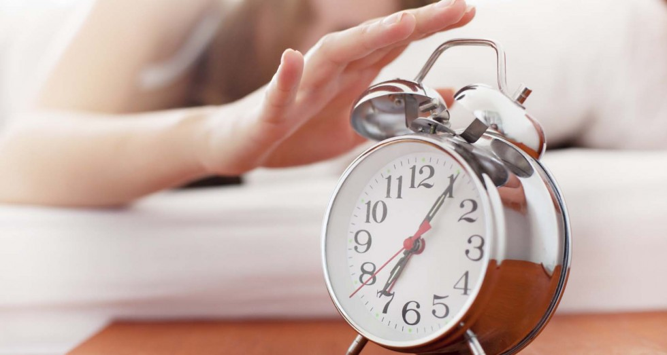
Wake Up!

Slide 8
“Understanding this present time . . . The hour has already come for you to wake up from your slumber, because our salvation is nearer now than when we first believed.”
Romans 13:11

Slide 10
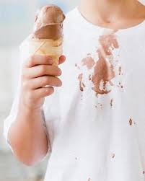
Put Off

Slide 11
deeds of darkness (v. 12)
carousing, drunkenness, sexual immorality debauchery, dissension and jealousy (v. 13)
thinking about how to gratify the desires of the flesh (v. 14)

Slide 12
Put On

Slide 13
the armor of light. (v. 12)
decent behavior, as in the daytime (v. 13)
the Lord Jesus Christ, clothing ourselves with Him (v. 14)

Slide 14
“We who are in Christ must envelop ourselves with him in such a way that he directs all our thinking and conduct.”
Douglas J. Moo

Slide 15
Live in light of Christ’s return by:
Putting off sin and sinful desires
Putting on Christ and the armor of light

Slide 16
