Slide 1
Romans
His Body

Slide 3
Romans 12:3-8
For by the grace given me I say to every one of you: Do not think of yourself more highly than you ought, but rather think of yourself with sober judgment, in accordance with the faith God has distributed to each of you.

Slide 4
For just as each of us has one body with many members, and these members do not all have the same function, so in Christ we, though many, form one body, and each member belongs to all the others. We have different gifts, according to the grace given to each of us.

Slide 5
If your gift is prophesying, then prophesy in accordance with your faith; if it is serving, then serve; if it is teaching, then teach; if it is to encourage, then give encouragement; if it is giving, then give generously; if it is to lead, do it diligently; if it is to show mercy, do it cheerfully.

Slide 6
What are some characteristics of a healthy church?

Slide 7
Humility
Do not think of yourself more highly than you ought, but rather think of yourself with sober judgment . . .
Romans 12:3

Slide 10
Appreciation
So in Christ we, though many, form one body, and each member belongs to all the others. Romans 12:5

Slide 11
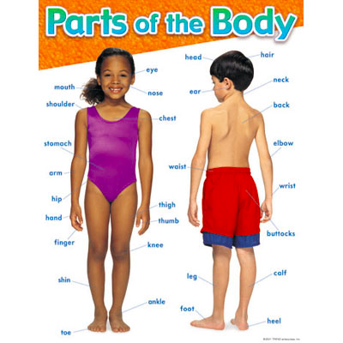

Slide 12
Employ
We have different gifts, according to the grace given to each of us. If your gift is . . .
Romans 12:6

Slide 13
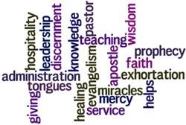

Slide 14
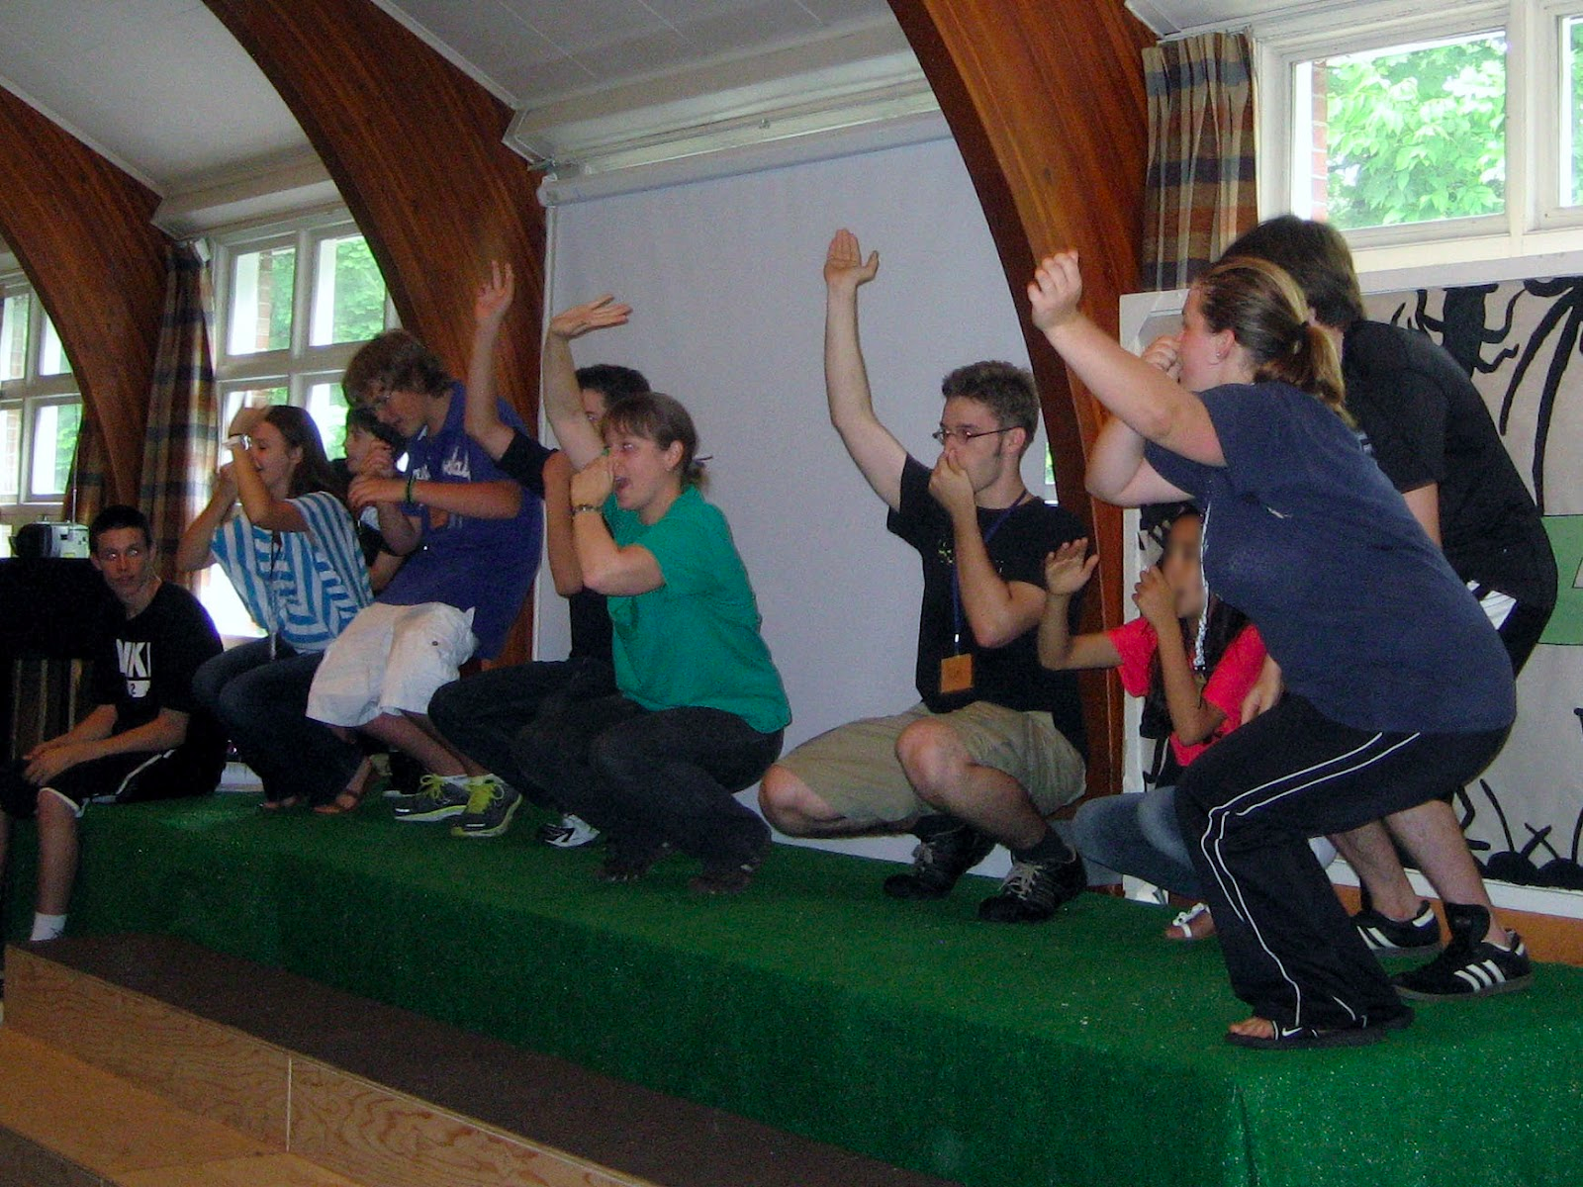

Slide 15
Be thankful
Be engaged

