Slide 1
Romans
Our Transformation

Slide 3
Romans 12:2
Do not conform to the pattern of this world, but be transformed by the renewing of your mind. Then you will be able to test and approve what God’s will is—his good, pleasing and perfect will.

Slide 4
Seek transformation, not conformation

Slide 5
Do not conform . . .

Slide 6
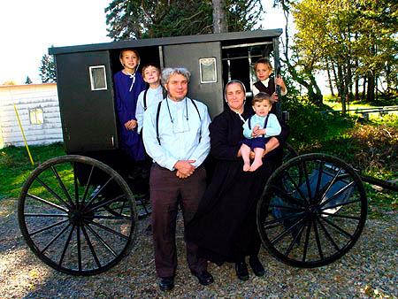

Slide 7
Lifestyle
Language
Values

Slide 8
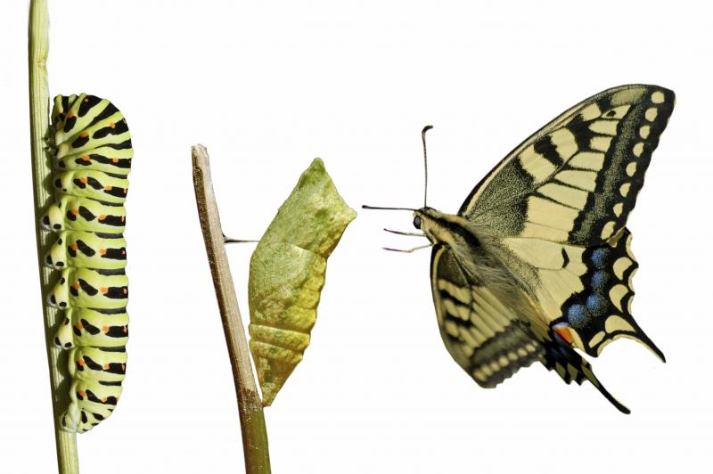
but be transformed . . .

Slide 9
Sanctification

Slide 10
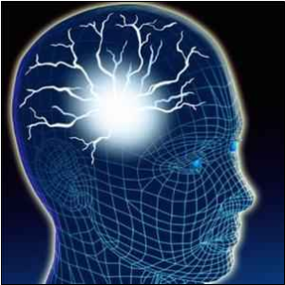
by the renewing of your mind . . .
Dr. Caroline Leaf

Slide 11
test and approve what God’s will is . . .

Slide 12
Reflect on your life
Feed on God’s Word
Dwell on the delightful

Slide 13
Seek transformation, not conformation

