Slide 1
Romans
Our Life & Ministry

Slide 4
Romans 15:14-16
¹⁴ I myself am convinced, my brothers and sisters, that you yourselves are full of goodness, filled with knowledge and competent to instruct one another.

Slide 5
¹⁵ Yet I have written you quite boldly on some points to remind you of them again, because of the grace God gave me ¹⁶ to be a minister of Christ Jesus to the Gentiles. He gave me the priestly duty of proclaiming the gospel of God, so that the Gentiles might become an offering acceptable to God, sanctified by the Holy Spirit.

Slide 7
Paul’s Assessment
¹⁴ I myself am convinced, my brothers and sisters, that you yourselves are full of goodness, filled with knowledge and competent to instruct one another.

Slide 8
“full of goodness”

Slide 9
When Christians live like disciples, outsiders look at their communities with wonder: “Look at the way they love. Look how they honor women, children, the elderly, and the sick. Look how they respond to persecution—it’s like they don’t even fear death.” That kind of love has the power to change the world.
Andy Stanley, “Christian”

Slide 10
“filled with knowledge”

Slide 11
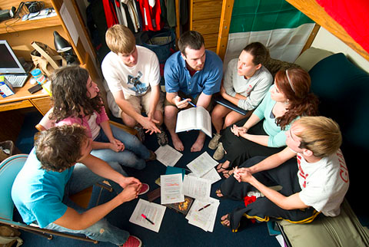
“competent to instruct one another”

Slide 12
Change needed
¹⁵ Yet I have written you quite boldly on some points to remind you of them again

Slide 13
Do not conform to the pattern of this world . . . (12:2)
Do not think of yourself more highly than you ought . . . (12:3)
Be joyful in hope, patient in affliction, faithful in prayer (12:12)
Live in harmony with one another (12:16)
Be subject to the governing authorities (13:1)
Accept the one whose faith is weak, without quarreling over disputable matters (14:1)

Slide 14
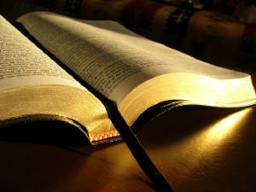

Slide 15
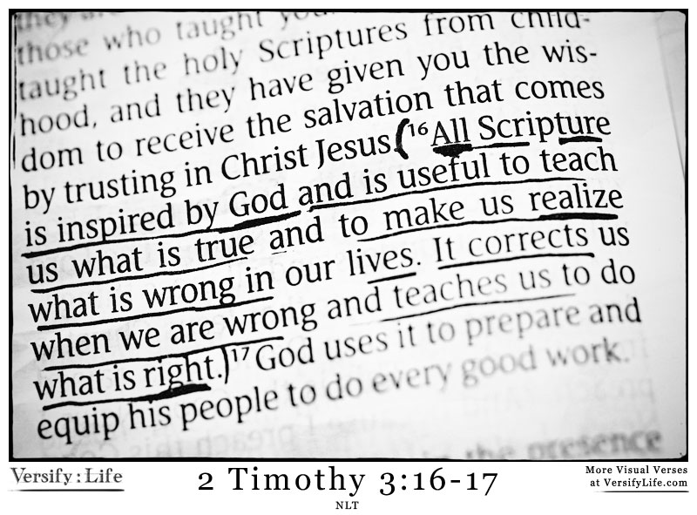

Slide 17
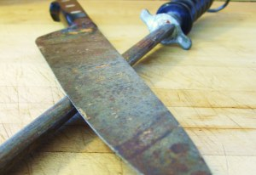

Slide 18
If a knife is blunt, it still continues to be a knife, although it is less effective, less useful in service. Let us therefore be encouraged to spend more time together, exhorting, encouraging, praying, admonishing, sharing God’s Word, praying over God’s Word and the needs of our local church, that we become sharper, more cutting in the ministry that the Lord has assigned to each of us.
GotQuestions.org

Slide 19
Service as a Sacrifice
¹⁶ He gave me the priestly duty of proclaiming the gospel of God, so that the Gentiles might become an offering acceptable to God, sanctified by the Holy Spirit.

Slide 20
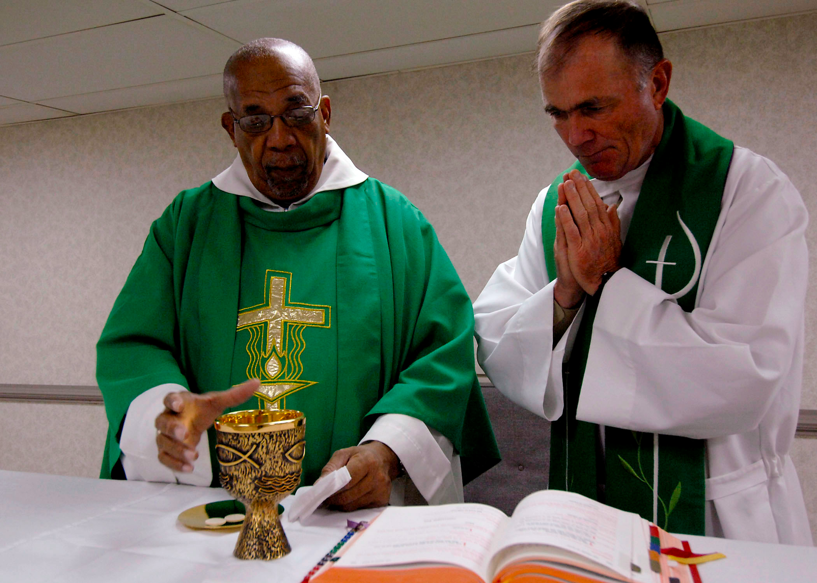

Slide 22
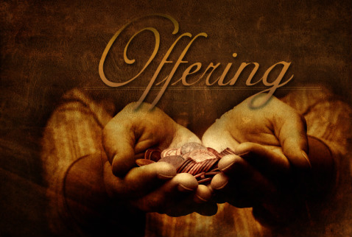

Slide 23
