Slide 1
Romans
Paul’s Encouragement

Slide 5
Romans 16
¹ I commend to you our sister Phoebe, a deacon of the church in Cenchreae. ² I ask you to receive her in the Lord in a way worthy of his people and to give her any help she may need from you, for she has been the benefactor of many people, including me.

Slide 7
³ Greet Priscilla and Aquila, my co-workers in Christ Jesus. ⁴ They risked their lives for me. Not only I but all the churches of the Gentiles are grateful to them.
⁵ Greet also the church that meets at their house.

Slide 8
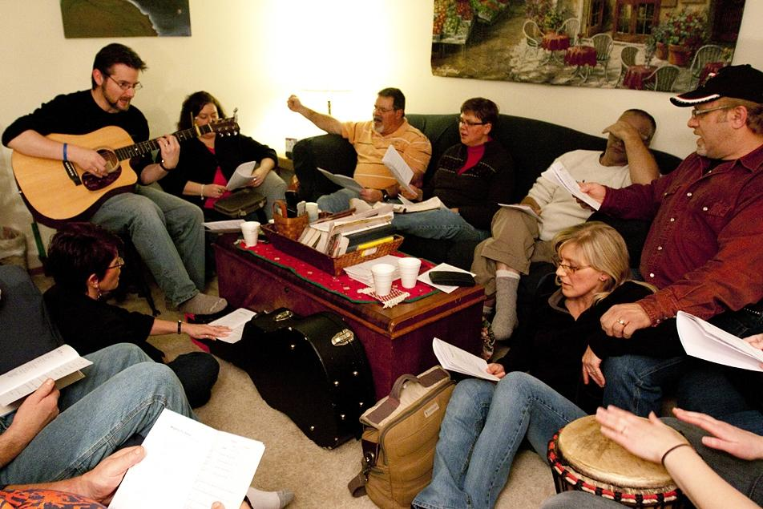

Slide 9
⁷ Greet Andronicus and Junia, my fellow Jews who have been in prison with me. They are outstanding among the apostles, and they were in Christ before I was.

Slide 11
¹² Greet my dear friend Persis, another woman who has worked very hard in the Lord.

Slide 12
What a tremendous pattern this is - it shows Paul's way of casting about uplifting words in a way meant to build up God's people. He was generous in paying compliments that were both sincere and wonderful.
David Guzik

Slide 13
¹⁷ I urge you, brothers and sisters, to watch out for those who cause divisions and put obstacles in your way that are contrary to the teaching you have learned. Keep away from them.

Slide 14
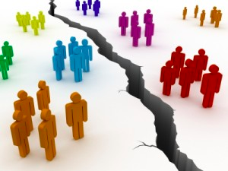

Slide 15
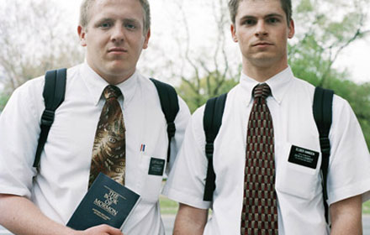

Slide 16
²⁵ Now to him who is able to establish you in accordance with my gospel, the message I proclaim about Jesus Christ . . . ²⁷ to the only wise God be glory forever through Jesus Christ! Amen.

Slide 19
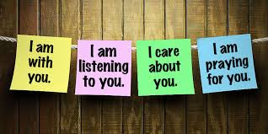
Encourage One Another

Slide 20
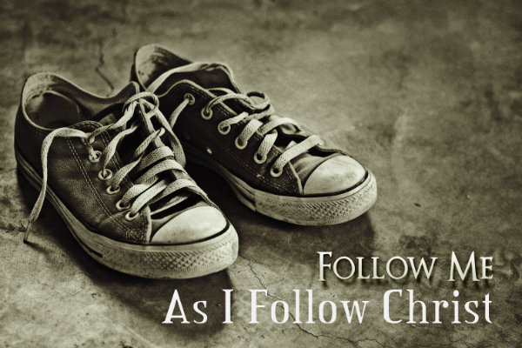
Emulate Godly Examples

Slide 21
Establish a Firm Foundation in Christ

