Slide 1
Conformed to Christ’s Image
Conformed & Transformed

Slide 3
2015 Theme:
Conformed to Christ’s Image

Slide 4
For those God foreknew he also predestined to be conformed to the image of his Son, that he might be the firstborn among many brothers and sisters.
Romans 8:29

Slide 5
God Initiates Salvation
“For those God foreknew he also predestined . . .”

Slide 7
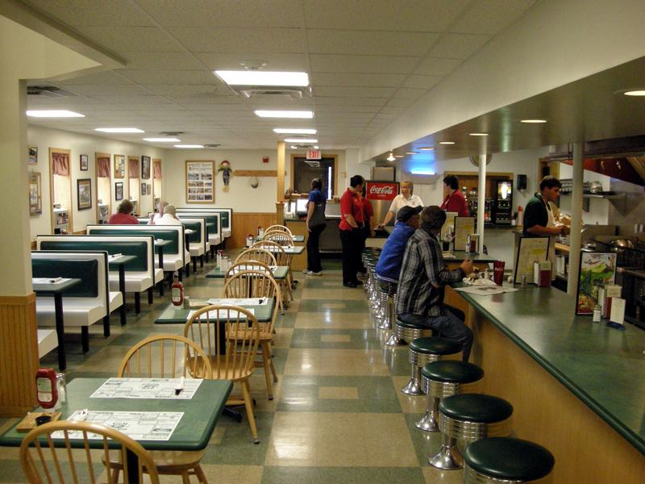

Slide 8
God Desires Change
“. . . to be conformed to the image of his Son”

Slide 9
Summorphos – having the same form as another

Slide 10
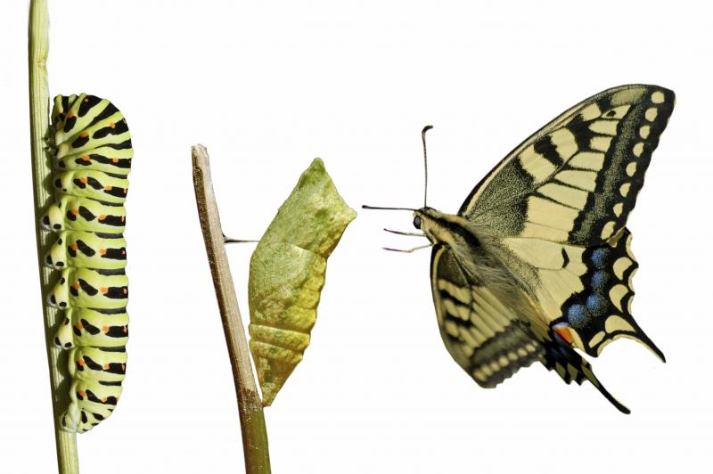

Slide 12
“What would it be like to live each hour of the day seeing your words, choices, reactions, prayers, temptations, thoughts, views and feelings from the perspective of heaven?”
T.W. Hunt and Melana Hunt Monroe, “From Heaven’s View”

Slide 13
In the way that we view sin
In the way we love God
In the way that we love others

Slide 14
God enables growth through community
“that he might be the firstborn among many brothers and sisters.”

Slide 16
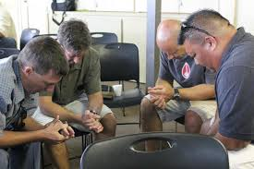

Slide 17
