Slide 1
Romans
Our Partnership

Slide 3
Romans 15:30-33
³⁰ I urge you, brothers and sisters, by our Lord Jesus Christ and by the love of the Spirit, to join me in my struggle by praying to God for me.

Slide 4
³¹ Pray that I may be kept safe from the unbelievers in Judea and that the contribution I take to Jerusalem may be favorably received by the Lord’s people there, ³² so that I may come to you with joy, by God’s will, and in your company be refreshed. ³³ The God of peace be with you all. Amen.

Slide 5
³⁰ I urge you, brothers and sisters, by our Lord Jesus Christ and by the love of the Spirit, to join me in my struggle by praying to God for me.

Slide 7
³⁰ I urge you, brothers and sisters, by our Lord Jesus Christ and by the love of the Spirit, to join me in my struggle by praying to God for me.

Slide 9
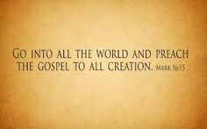

Slide 10
³⁰ I urge you, brothers and sisters, by our Lord Jesus Christ and by the love of the Spirit, to join me in my struggle by praying to God for me.

Slide 13
³¹ Pray that I may be kept safe from the unbelievers in Judea and that the contribution I take to Jerusalem may be favorably received by the Lord’s people there, ³² so that I may come to you with joy, by God’s will, and in your company be refreshed. ³³ The God of peace be with you all. Amen.

Slide 14
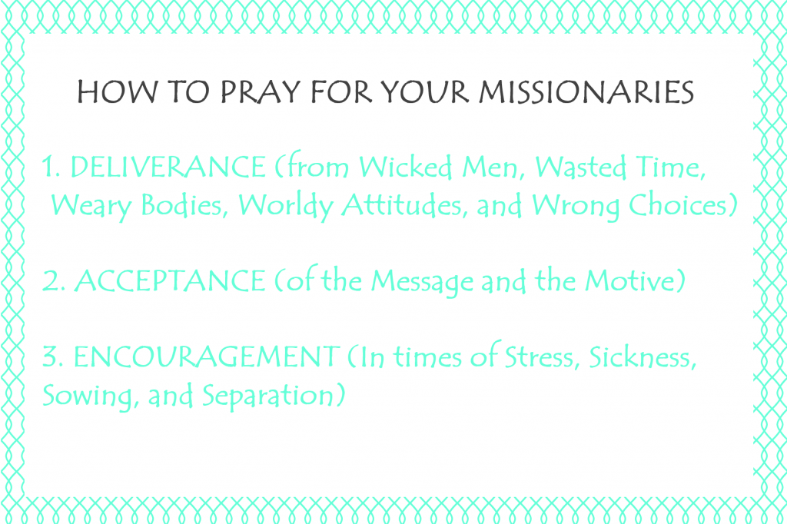
Brenson Jennings

Slide 15
³¹ Pray that I may be kept safe from the unbelievers in Judea and that the contribution I take to Jerusalem may be favorably received by the Lord’s people there, ³² so that I may come to you with joy, by God’s will, and in your company be refreshed. ³³ The God of peace be with you all. Amen.

Slide 25
