Slide 1
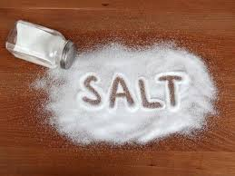

Slide 2
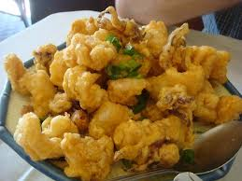
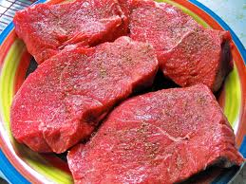
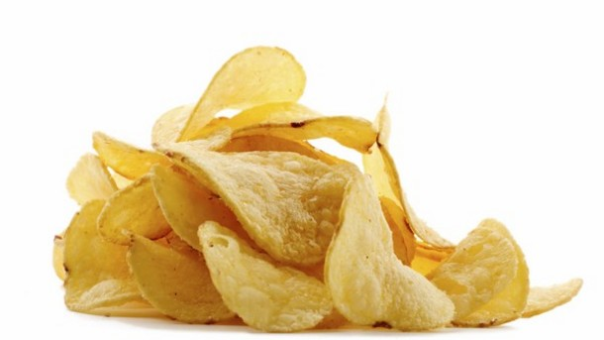

Slide 3
¹³ “You are the salt of the earth. But if the salt loses its saltiness, how can it be made salty again? . . .
¹⁴ “You are the light of the world. A town built on a hill cannot be hidden. ¹⁵ Neither do people light a lamp and put it under a bowl. Instead they put it on its stand, and it gives light to everyone in the house.

Slide 4
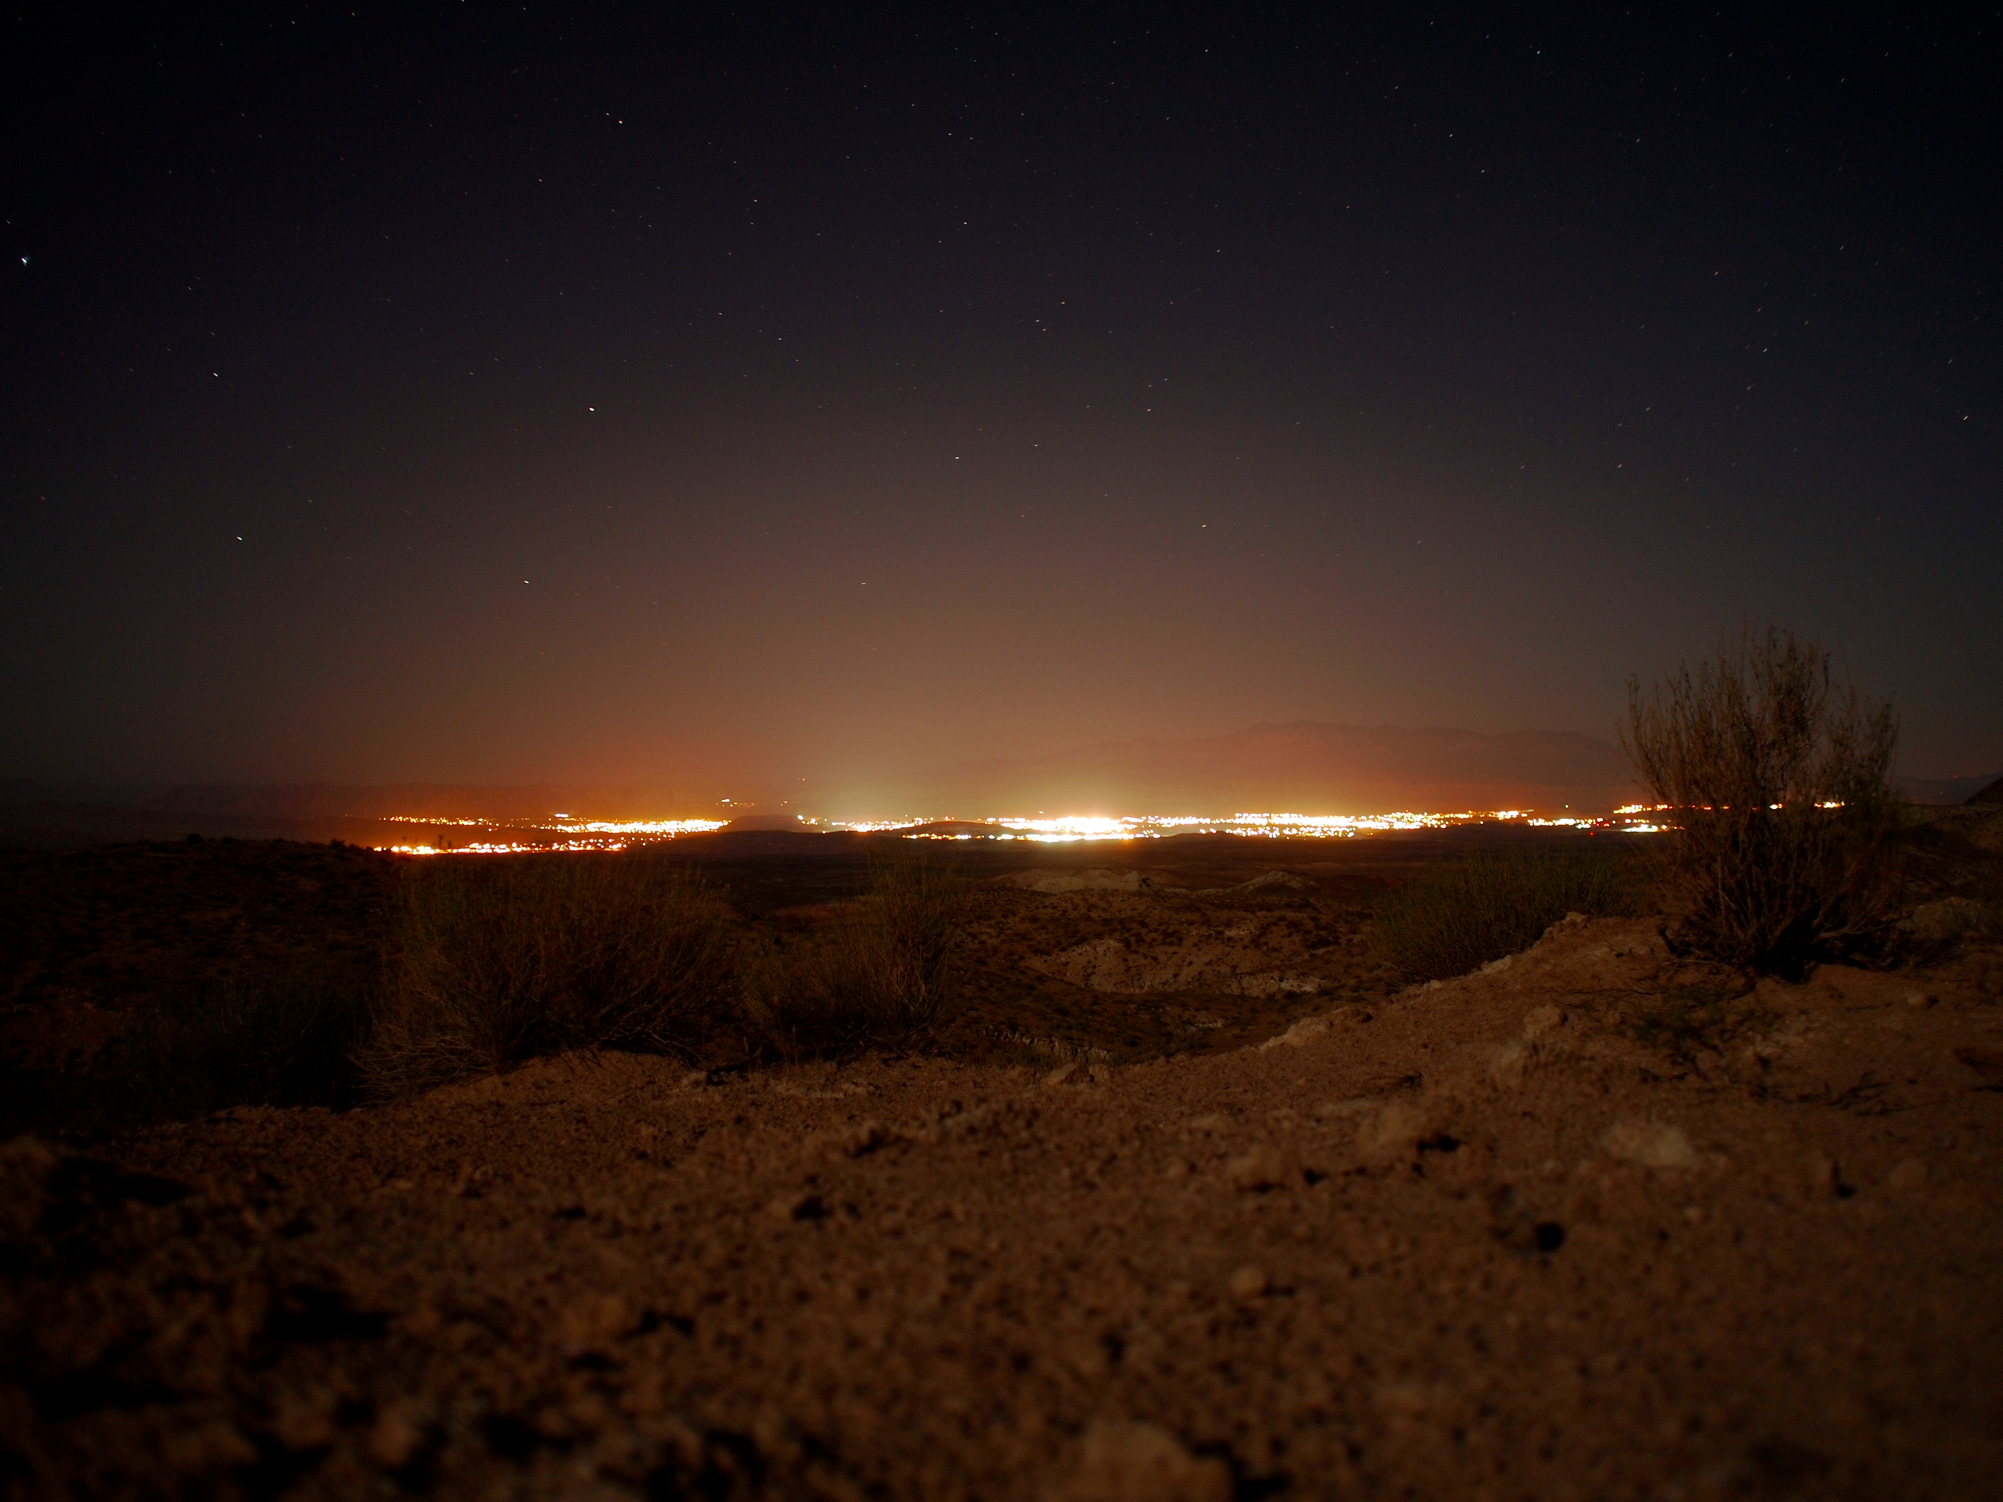

Slide 5
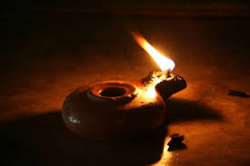

Slide 6
¹⁶ In the same way, let your light shine before others, that they may see your good deeds and glorify your Father in heaven.

