Slide 1
證道 Sermon
重生 Born Again
講員: 黄牧師
Speaker: Rev. Wong
（約翰福音 John 3:1-7）
Chinese Christian Church of Columbia Family Matters

Slide 2
約翰福音 3:1-7 (CUV)
1 有一个法利赛人，名叫尼哥底母，是犹太人的官。
2 这人夜里来见耶稣，说，拉比，我们知道你是由神那里来作师傅的。因为你所行的神迹，若没有神同在，无人能行。
Chinese Christian Church of Columbia Family Matters

Slide 3
3 耶稣回答说，我实实在在地告诉你，人
若不重生，就不能见神的国。
4 尼哥底母说，人已经老了，如何能重生
呢？岂能再进母腹生出来吗？
Chinese Christian Church of Columbia Family Matters

Slide 4
5 耶稣说，我实实在在地告诉你，人若不
是从水和圣灵生的，就不能进神的国。
6 从肉身生的，就是肉身。从灵生的，就是
灵。
7 我说，你们必须重生，你不要以为希奇。
Chinese Christian Church of Columbia Family Matters

Slide 5
John 3:1-7 (NIV)
1 Now there was a Pharisee, a man named Nicodemus who was a member of the Jewish ruling council.
2 He came to Jesus at night and said, “Rabbi, we know that you are a teacher who has come from God. For no one could perform the signs you are doing if God were not with him.”
Chinese Christian Church of Columbia Family Matters

Slide 6
3 Jesus replied, “Very truly I tell you, no one can see the kingdom of God unless they are born again.”
4 “How can someone be born when they are old?” Nicodemus asked. “Surely they cannot enter a second time into their mother’s womb to be born!”
Chinese Christian Church of Columbia Family Matters

Slide 7
5 Jesus answered, “Very truly I tell you, no one can enter the kingdom of God unless they are born of water and the Spirit.
6 Flesh gives birth to flesh, but the Spirit gives birth to spirit.
7 You should not be surprised at my saying, ‘You must be born again.’
Chinese Christian Church of Columbia Family Matters

Slide 8
Chinese Christian Church of Columbia Family Matters

Slide 9
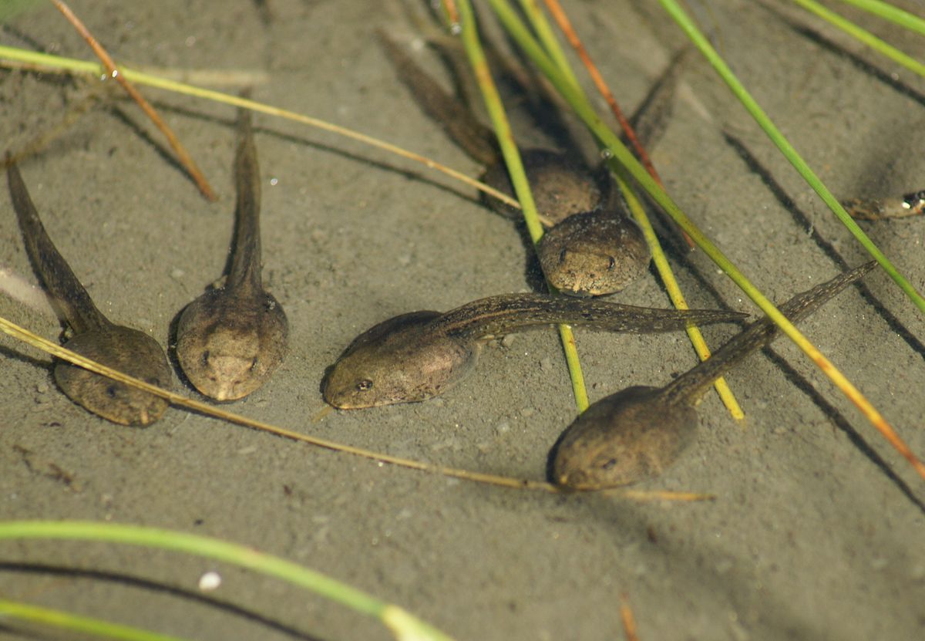
Chinese Christian Church of Columbia Family Matters

Slide 10
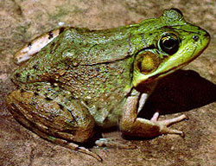
Chinese Christian Church of Columbia Family Matters

Slide 11
Chinese Christian Church of Columbia Family Matters

Slide 12
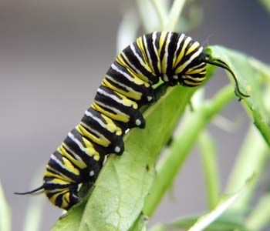
Chinese Christian Church of Columbia Family Matters

Slide 13

Chinese Christian Church of Columbia Family Matters

Slide 14
Chinese Christian Church of Columbia Family Matters

