Slide 1
Means of Spiritual Growth
Service

Slide 5
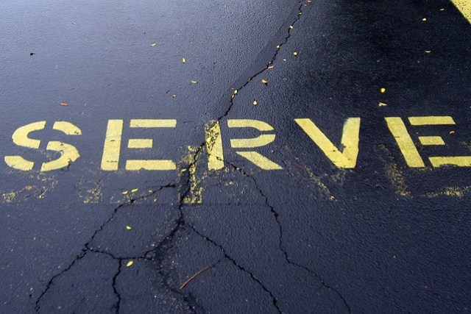

Slide 6
⁴² Jesus called them together and said, “You know that those who are regarded as rulers of the Gentiles lord it over them, and their high officials exercise authority over them. ⁴³ Not so with you. Instead, whoever wants to become great among you must be your servant,⁴⁴ and whoever wants to be first must be slave of all. ⁴⁵ For even the Son of Man did not come to be served, but to serve, and to give his life as a ransom for many.”
Mark 10:42-45

Slide 8
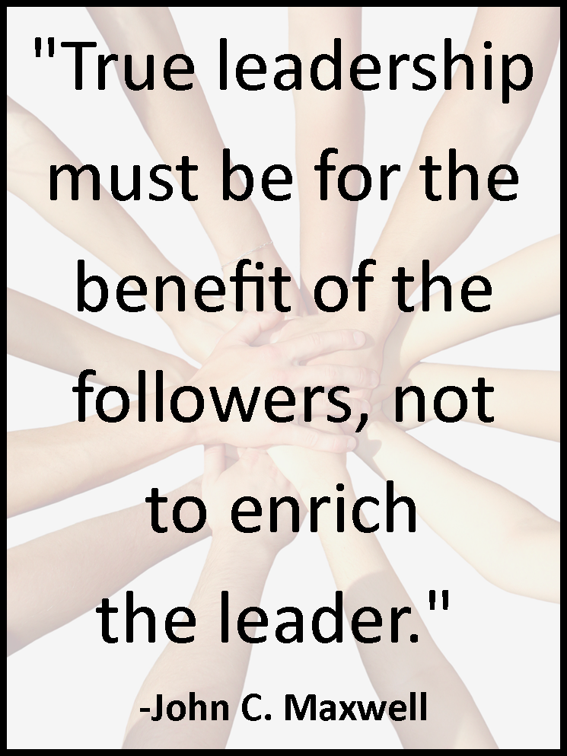

Slide 9
⁴² Jesus called them together and said, “You know that those who are regarded as rulers of the Gentiles lord it over them, and their high officials exercise authority over them. ⁴³ Not so with you. Instead, whoever wants to become great among you must be your servant,⁴⁴ and whoever wants to be first must be slave of all. ⁴⁵ For even the Son of Man did not come to be served, but to serve, and to give his life as a ransom for many.”
Mark 10:42-45

Slide 10
Serve Like Jesus

Slide 11
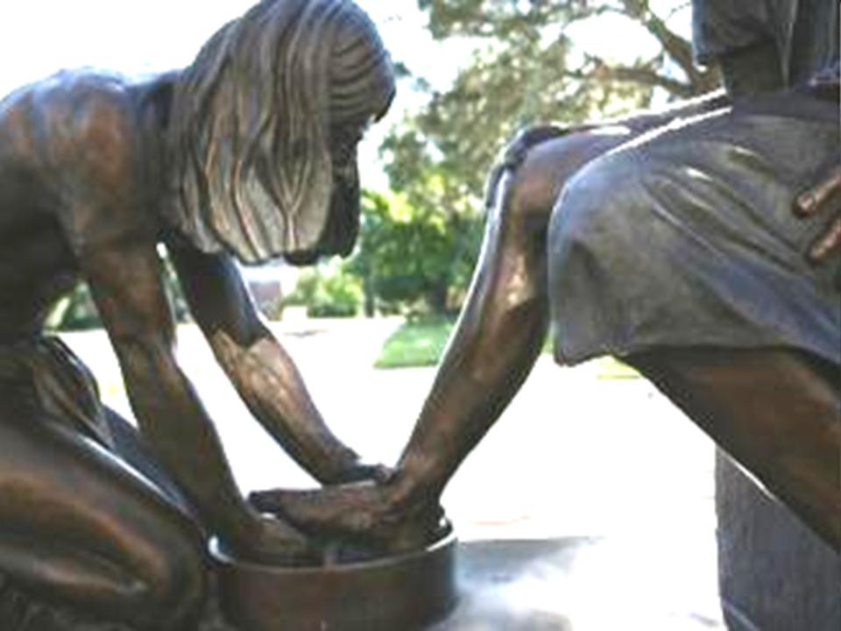

Slide 12
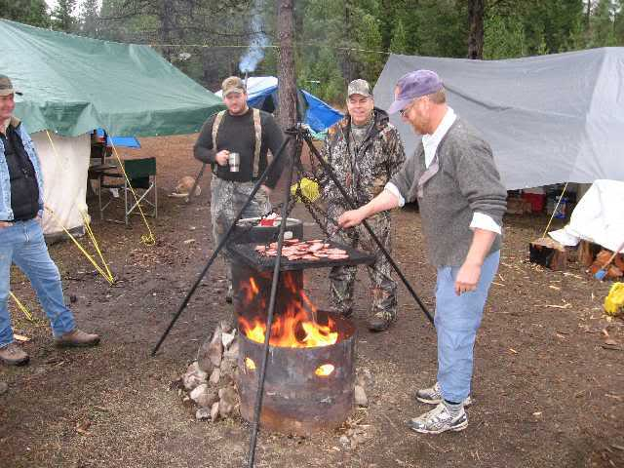

Slide 13
Serve According to Your Gifts

Slide 14
⁶ We have different gifts, according to the grace given to each of us. If your gift is prophesying, then prophesy in accordance with your faith; ⁷ if it is serving, then serve; if it is teaching, then teach; ⁸ if it is to encourage, then give encouragement; if it is giving, then give generously; if it is to lead, do it diligently; if it is to show mercy, do it cheerfully.
Romans 12

Slide 16
Serve the less fortunate

Slide 17
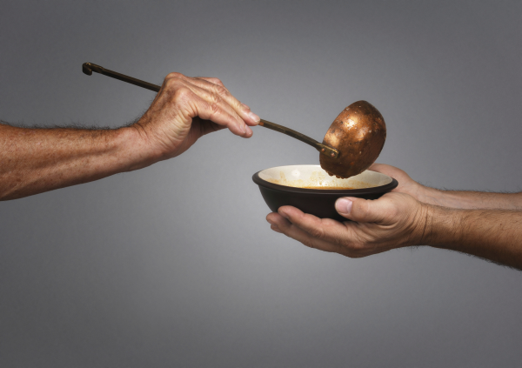

Slide 18
In Joppa there was a disciple named Tabitha (which, when translated, is Dorcas), who was always doing good and helping the poor.
Acts 9:36

Slide 20
Serve with a proper attitude

Slide 22
Recognition:
Self-righteous service – done so that others will notice, even with false modesty
True service – satisfied with simply being pleasing to God – He notices what is done in secret (Matt. 6:4)
Central Baptist Church

Slide 24
Rewards:
Self-righteous service – if I scratch his back, he’ll scratch mine
True service – serving for the sake of serving, no pay back needed

Slide 26
Recipients:
Self-righteous service – serving the powerful to gain an advantage
True service – serving anybody regardless of their circumstances

Slide 27
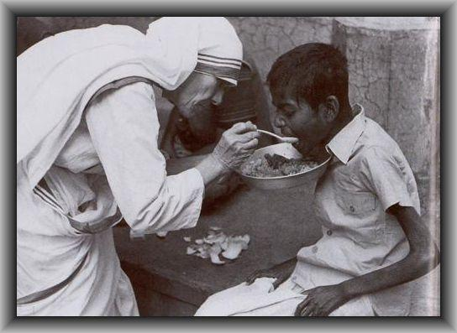

Slide 28
Feelings:
Self-righteous service – serving because you feel like it
True service – serving because there’s a need

Slide 29
