Slide 1
Fellowship
Serving Together

Slide 4
Serve Together

Slide 5
¹¹ So Christ himself gave the apostles, the prophets, the evangelists, the pastors and teachers, ¹² to equip his people for works of service, so that the body of Christ may be built up ¹³ until we all reach unity in the faith and in the knowledge of the Son of God and become mature, attaining to the whole measure of the fullness of Christ.
Ephesians 4:11-13

Slide 6
Context

Slide 7
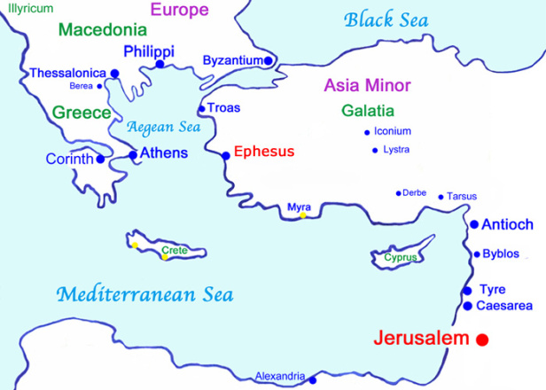

Slide 9
Serve. . .

Slide 10
¹¹ So Christ himself gave the apostles, the prophets, the evangelists, the pastors and teachers, ¹² to equip his people for works of service, so that the body of Christ may be built up. . .

Slide 11
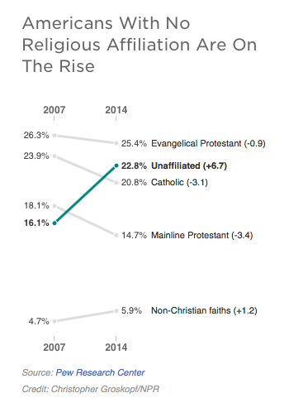

Slide 12
¹¹ So Christ himself gave the apostles, the prophets, the evangelists, the pastors and teachers, ¹² to equip his people for works of service, so that the body of Christ may be built up. . .

Slide 13
¹¹ So Christ himself gave the apostles, the prophets, the evangelists, the pastors and teachers, ¹² to equip his people for works of service, so that the body of Christ may be built up. . .

Slide 14
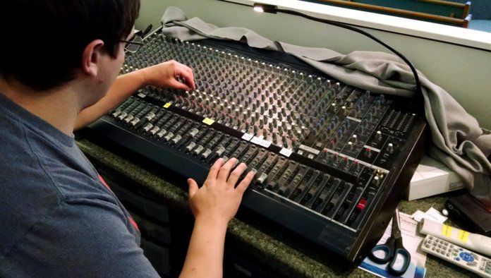

Slide 15
Unity. . .

Slide 16
until we all reach unity in the faith and in the knowledge of the Son of God and become mature, attaining to the whole measure of the fullness of Christ.

Slide 18
Knowledge. . .

Slide 19
until we all reach unity in the faith and in the knowledge of the Son of God and become mature, attaining to the whole measure of the fullness of Christ.

Slide 21
Maturity. . .

Slide 22
until we all reach unity in the faith and in the knowledge of the Son of God and become mature, attaining to the whole measure of the fullness of Christ.

Slide 23
5 Signs That You Lack Spiritual Maturity
Don’t show up
Pride in biblical knowledge
Truth without grace
Can’t get along well with others
Telling people you’re mature

Slide 24
Live it Out

Slide 26
Engage
Train
Teach

