Slide 1
Theme
Share Our Love

Slide 2
Share Our Faith, Share Our Hope, Share Our Love
But in your hearts revere Christ as Lord. Always be prepared to give an answer to everyone who asks you to give the reason for the hope that you have. But do this with gentleness and respect.
1 Peter 3:15

Slide 3
By this everyone will know that you are my disciples, if you love one another.”
John 13:35

Slide 5
Theological Differences
Interpersonal Conflict
Difference in Vision
Use and Misuse of Money
Gossip and slander
Self-serving church members
Lack of prayer
Power Groups

Slide 6
³⁴ “A new command I give you: Love one another. As I have loved you, so you must love one another. ³⁵ By this everyone will know that you are my disciples, if you love one another.”
John 13:34-35

Slide 8
³⁴ “A new command I give you: Love one another. As I have loved you, so you must love one another. ³⁵ By this everyone will know that you are my disciples, if you love one another.”
John 13:34-35

Slide 9
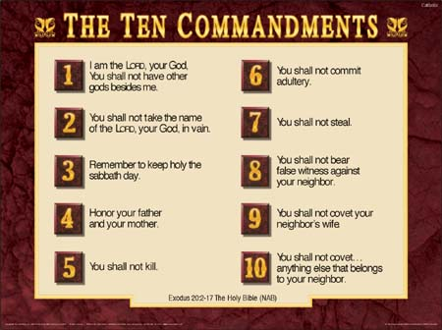

Slide 11
69. Men must not shave their beards with a razor — Lev. 19:27
85. To bless the Almighty after eating — Deut. 8:10
185. Not to eat non-kosher maggots — Lev. 11:44
191. Not to eat a limb torn off a living creature — Deut. 12:23
494. Make a guard rail around flat roofs — Deut. 22:8
495. Not to put a stumbling block before a blind man (nor give harmful advice) — Lev. 19:14

Slide 12
“‘Do not seek revenge or bear a grudge against anyone among your people, but love your neighbor as yourself. I am the Lord.
Leviticus 19:18

Slide 14
A new commandment – the ancient Greek word “new” here implies freshness, or the opposite of outworn, rather than recent or different. It isn't that this commandment was just invented, but it will be presented in a new, fresh way.

Slide 15
³⁴ “A new command I give you: Love one another. As I have loved you, so you must love one another. ³⁵ By this everyone will know that you are my disciples, if you love one another.”
John 13:34-35

Slide 18
Jesus Served
Jesus Interceded
Jesus had compassion
Jesus Preached
Jesus Sacrificed

Slide 20
³⁴ “A new command I give you: Love one another. As I have loved you, so you must love one another. ³⁵ By this everyone will know that you are my disciples, if you love one another.”
John 13:34-35

Slide 21
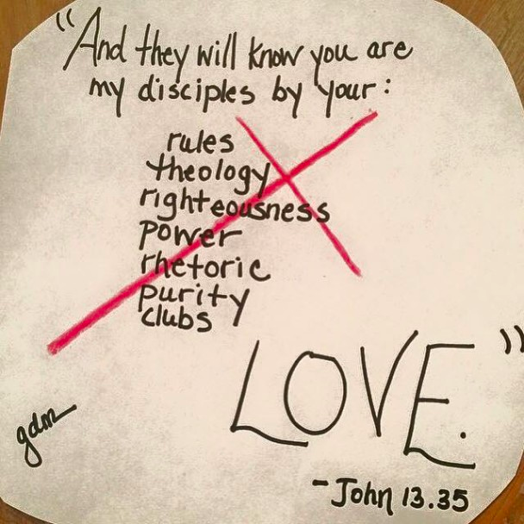

Slide 22
³⁴ “A new command I give you: Love one another. As I have loved you, so you must love one another. ³⁵ By this everyone will know that you are my disciples, if you love one another.”
John 13:34-35

