Slide 1
Theme
Share Our Faith, Share Our Hope

Slide 2
Conformed to Christ’s Image
For those God foreknew he also predestined to be conformed to the image of his Son . . .
Romans 8:29

Slide 3
Share Our Faith, Share Our Hope, Share Our Love
But in your hearts revere Christ as Lord. Always be prepared to give an answer to everyone who asks you to give the reason for the hope that you have. But do this with gentleness and respect.
1 Peter 3:15

Slide 4
By this everyone will know that you are my disciples, if you love one another.”
John 13:35

Slide 5
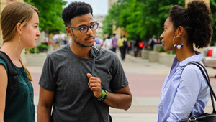

Slide 7
But in your hearts revere Christ as Lord. Always be prepared to give an answer to everyone who asks you to give the reason for the hope that you have. But do this with gentleness and respect.
1 Peter 3:15

Slide 8
But in your hearts revere Christ as Lord. Always be prepared to give an answer to everyone who asks you to give the reason for the hope that you have. But do this with gentleness and respect.
1 Peter 3:15

Slide 9
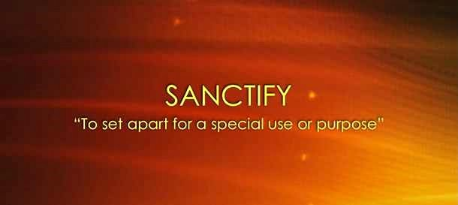

Slide 10
“Other lords are permitted to invade the sanctuary of the heart, and to exercise dominion over us. Our own selfish desires, the opinion of others, worldly wisdom, the pressure of circumstances, these and many other lords command us, and we turn away our simple and complete allegiance to our one Lord."
G. Campbell Morgan

Slide 11
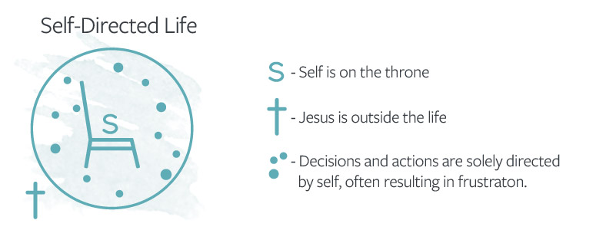

Slide 12
"The simple meaning of the injunction is that at the very centre of life there is to be one Lord, and that is Christ....”
G. Campbell Morgan

Slide 15
But in your hearts revere Christ as Lord. Always be prepared to give an answer to everyone who asks you to give the reason for the hope that you have. But do this with gentleness and respect.
1 Peter 3:15

Slide 21
But in your hearts revere Christ as Lord. Always be prepared to give an answer to everyone who asks you to give the reason for the hope that you have. But do this with gentleness and respect.
1 Peter 3:15

Slide 22
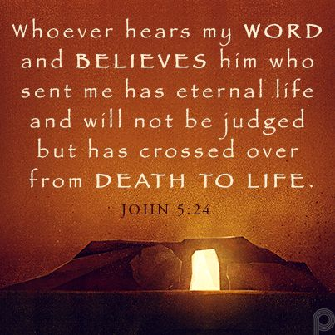

Slide 24
