Slide 1
Grace to You
Sufficiency of Grace

Slide 3
Birth of a child
Breakup of a relationship
End of a marriage
Moving to another country / city
Starting a new job
Starting a new year
Death of a loved one
Failure of a business
Loss of a home
Loss of a job
Starting a marriage
Dealing with major illness

Slide 4
Context

Slide 5
Super Apostles – skilled at speaking in a polished, sophisticated, and entertaining way
Corinthian Church – didn’t admire Paul’s apostolic credentials because they thought in a worldly way, not liking Paul’s apparent weakness and unimpressive appearance.

Slide 7
Visions & Revelations – a remarkable spiritual Christ-centered experience whereby one experiences spiritual realities such as heaven, angels, demons, etc., and receives truth from or about God.

Slide 8
Thorn in the Flesh

Slide 9
⁷ Therefore, in order to keep me from becoming conceited, I was given a thorn in my flesh, a messenger of Satan, to torment me.
2 Corinthians 12

Slide 10
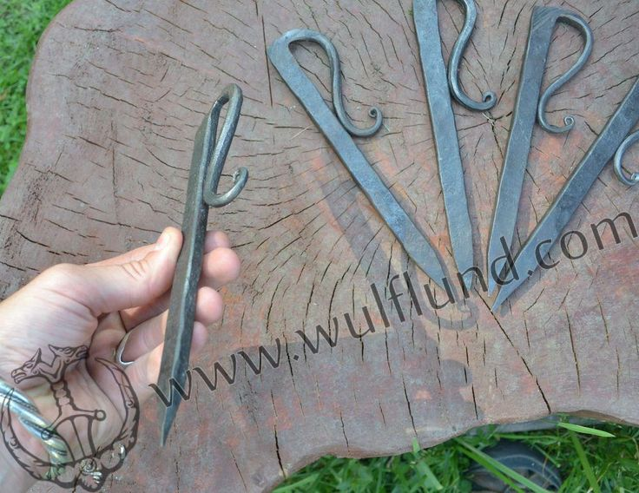

Slide 11
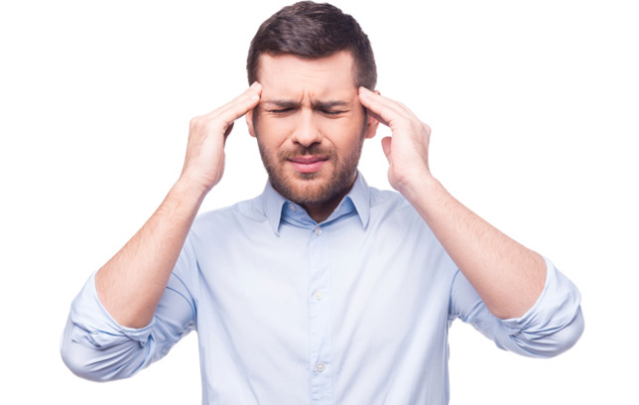

Slide 12
⁷ Therefore, in order to keep me from becoming conceited, I was given a thorn in my flesh, a messenger of Satan, to torment me.

Slide 14
Sufficient Grace

Slide 15
⁸ Three times I pleaded with the Lord to take it away from me. ⁹ But he said to me, “My grace is sufficient for you, for my power is made perfect in weakness.”

Slide 18
Strength in Weakness

Slide 19
Therefore I will boast all the more gladly about my weaknesses, so that Christ’s power may rest on me. ¹⁰ That is why, for Christ’s sake, I delight in weaknesses, in insults, in hardships, in persecutions, in difficulties. For when I am weak, then I am strong.
2 Corinthians 12:7-10

Slide 20
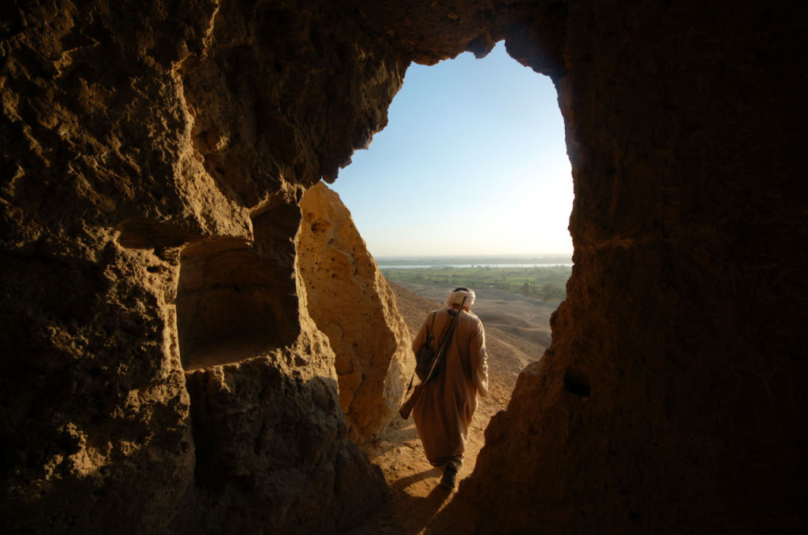

Slide 21
Many harbor a longing for the day when the Christian life will become “easy.” We hope for a time when the major struggles with sin are behind us, and now we go on to bigger and better things without much of a struggle. That day is an illusion. If the Apostle Paul himself constantly experienced weakness, who are we to think that we will surpass him?
Rev. David Guzik

Slide 22
Lessons for Disciples

