Slide 1
The Christian Life
The Lord’s Prayer

Slide 2
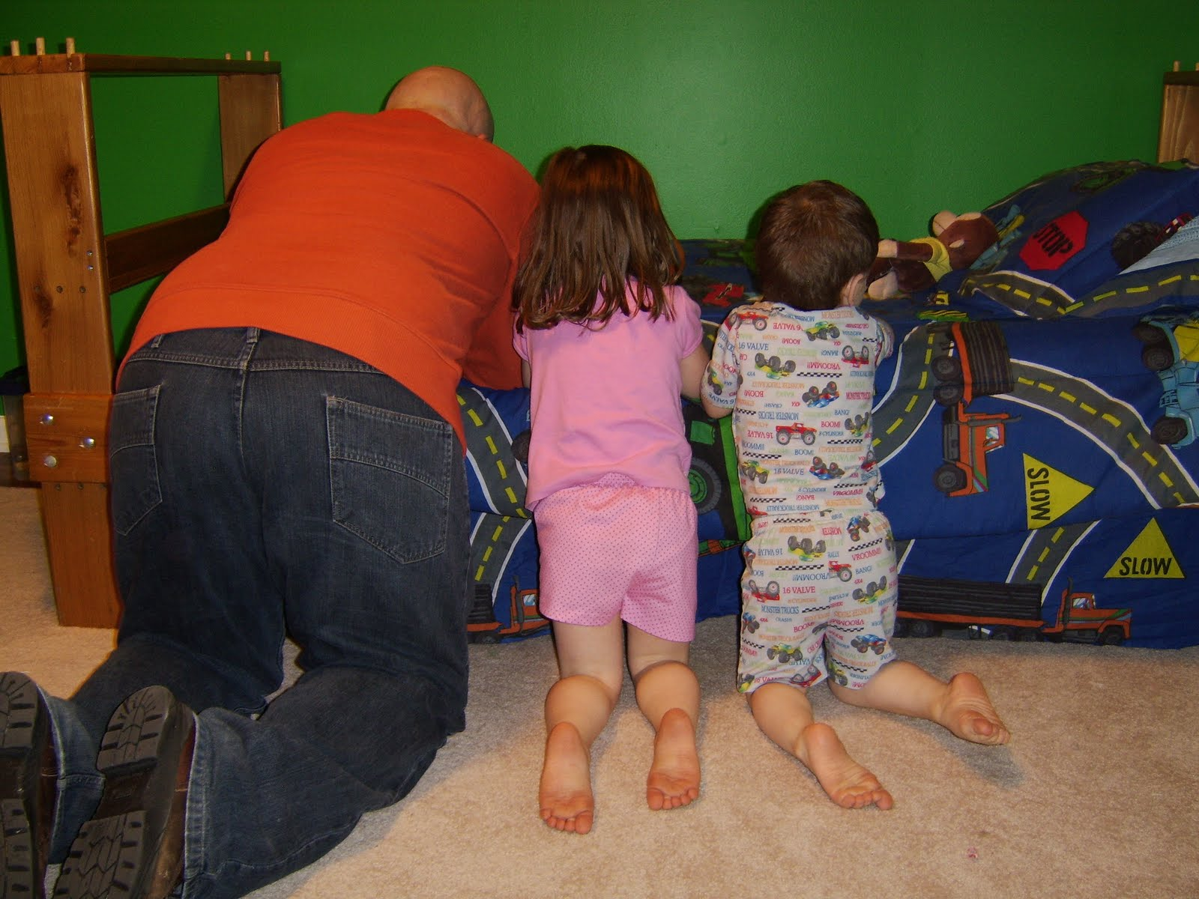

Slide 3
¹ One day Jesus was praying in a certain place. When he finished, one of his disciples said to him, “Lord, teach us to pray, just as John taught his disciples.”
² He said to them, “When you pray, say:

Slide 4
“‘Father,
hallowed be your name,
your kingdom come.
³ Give us each day our daily bread.
⁴ Forgive us our sins,
for we also forgive everyone who sins against us.
And lead us not into temptation.’”
Luke 11:1-4

Slide 5
Pray regularly in the manner that Jesus prayed.

Slide 6
An important request
The nature of God
Four petitions

Slide 7
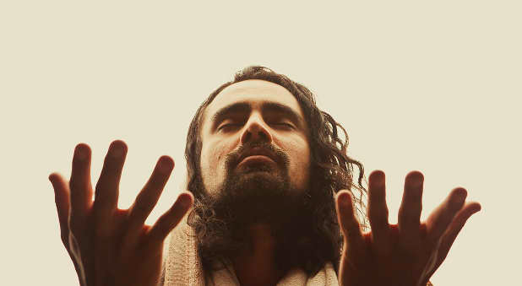

Slide 8
¹ One day Jesus was praying in a certain place. When he finished, one of his disciples said to him, “Lord, teach us to pray, just as John taught his disciples.

Slide 9
Jesus never taught His disciples how to preach, only how to pray. He did not speak much of what was needed to preach well, but much of praying well.
Andrew Murray

Slide 10
An important request
The nature of God
Four petitions

Slide 11
² He said to them, “When you pray, say:
“‘Father,
hallowed be your name,

Slide 12
Every recorded prayer we have from the lips of Jesus save one, he calls God "Father." It was for that reason that many of Jesus' enemies sought to destroy him; he assumed to have this intimate, personal relationship with the sovereign God of heaven and the creator of all things, and he dared to speak in such intimate terms with God. What's even more radical is that Jesus says to his people, "When you pray, you say, 'Our Father.'"
Dr. R.C. Sproul

Slide 13
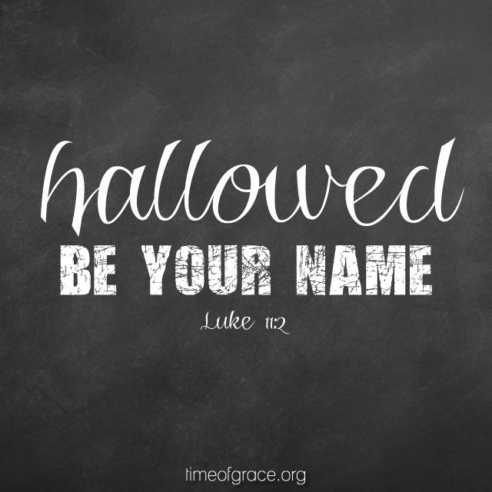

Slide 14
An important request
The nature of God
Four petitions

Slide 17
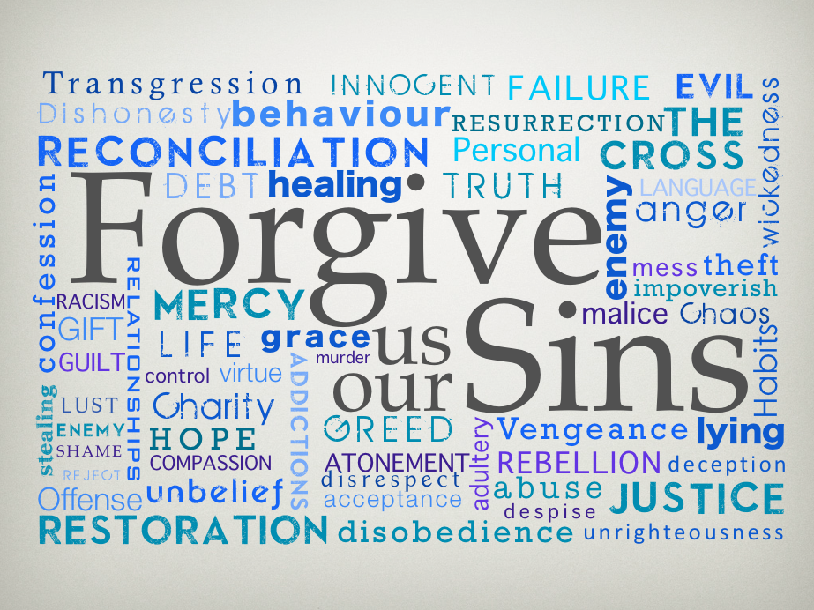

Slide 18
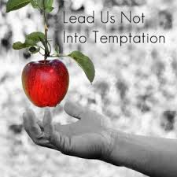

Slide 20
Lessons for Disciples

Slide 21
Pray regularly in the manner that Jesus prayed.

Slide 22
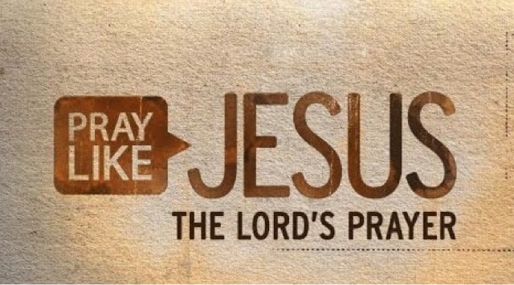

Slide 23
He said to them, “When you pray, say:
Luke 11:2
Pray then like this:
Matthew 6:9

Slide 24
“Our Father in heaven,
hallowed be your name.
Your kingdom come,
your will be done,
on earth as it is in heaven.
Give us this day our daily bread,
and forgive us our debts,
as we also have forgiven our debtors.
And lead us not into temptation,
but deliver us from evil.
For yours is the kingdom and the power and the glory, forever. Amen
Matthew 6:9-13

