Slide 1
Forgive
The Practice of Forgiveness

Slide 5
¹⁴ Bless those who persecute you; bless and do not curse. ¹⁵ Rejoice with those who rejoice; mourn with those who mourn. ¹⁶ Live in harmony with one another. Do not be proud, but be willing to associate with people of low position. Do not be conceited.
Romans 12:14-16

Slide 6
Bless adversaries

Slide 7
¹⁴ Bless those who persecute you; bless and do not curse.

Slide 8
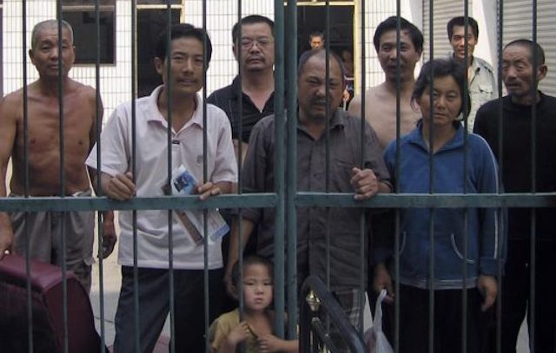

Slide 10
Share empathy

Slide 11
¹⁴ Bless those who persecute you; bless and do not curse. ¹⁵ Rejoice with those who rejoice; mourn with those who mourn.

Slide 12
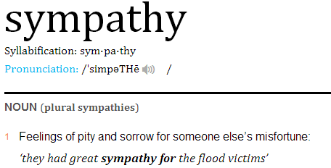

Slide 14
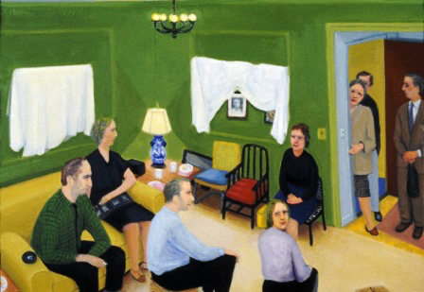

Slide 15
Live harmoniously

Slide 16
¹⁴ Bless those who persecute you; bless and do not curse. ¹⁵ Rejoice with those who rejoice; mourn with those who mourn. ¹⁶ Live in harmony with one another.

Slide 18
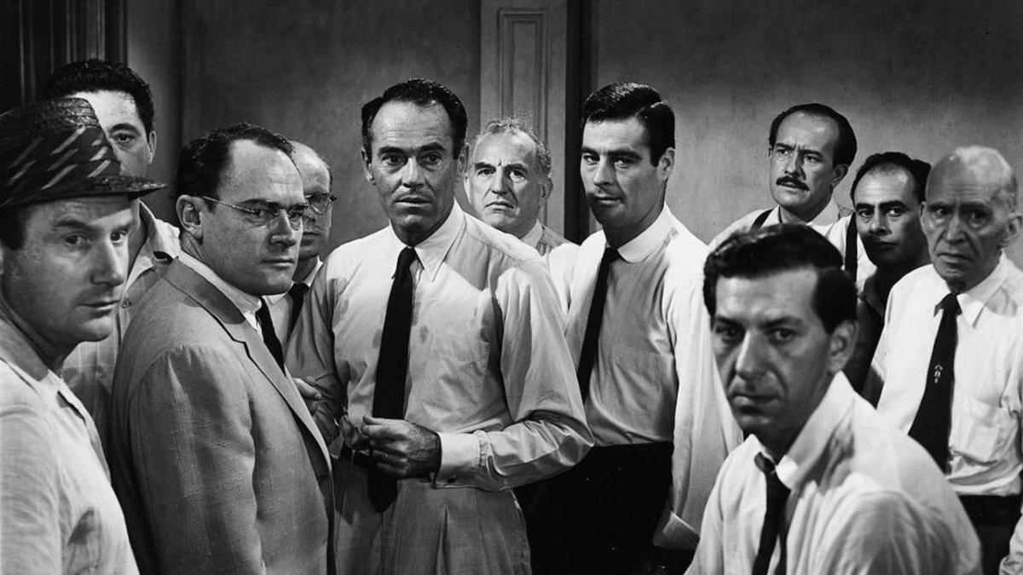

Slide 19
Walk humbly

Slide 20
¹⁶ Live in harmony with one another. Do not be proud, but be willing to associate with people of low position. Do not be conceited.

Slide 23
Lessons for disciples

Slide 24
Is there someone you need to forgive, and bless?
Is there someone hurting, whom you can come along side?
Are you living in harmony with others?
Can you help someone made in God’s image?

