Slide 1
Resolutions
The Prize

Slide 2
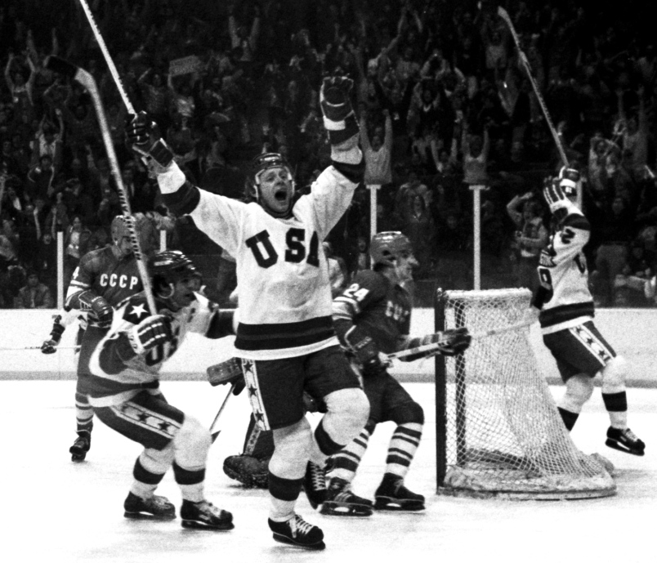

Slide 3
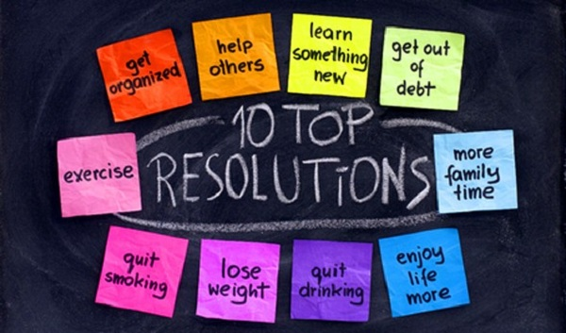

Slide 4
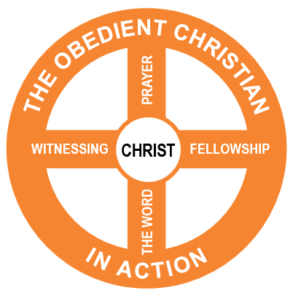

Slide 6
²⁴ Do you not know that in a race all the runners run, but only one receives the prize? So run that you may obtain it. ²⁵ Every athlete exercises self-control in all things. They do it to receive a perishable wreath, but we an imperishable. ²⁶ So I do not run aimlessly; I do not box as one beating the air. ²⁷ But I discipline my body and keep it under control, lest after preaching to others I myself should be disqualified.
1 Corinthians 9:24-27

Slide 7
Order your life in a way to win the prize.

Slide 8
Goal: The Prize
Training: Self control and discipline
Beware: Disqualification

Slide 9
²⁴ Do you not know that in a race all the runners run, but only one receives the prize? So run that you may obtain it. ²⁵ Every athlete exercises self-control in all things. They do it to receive a perishable wreath, but we an imperishable. ²⁶ So I do not run aimlessly; I do not box as one beating the air. ²⁷ But I discipline my body and keep it under control, lest after preaching to others I myself should be disqualified.
1 Corinthians 9:24-27

Slide 10
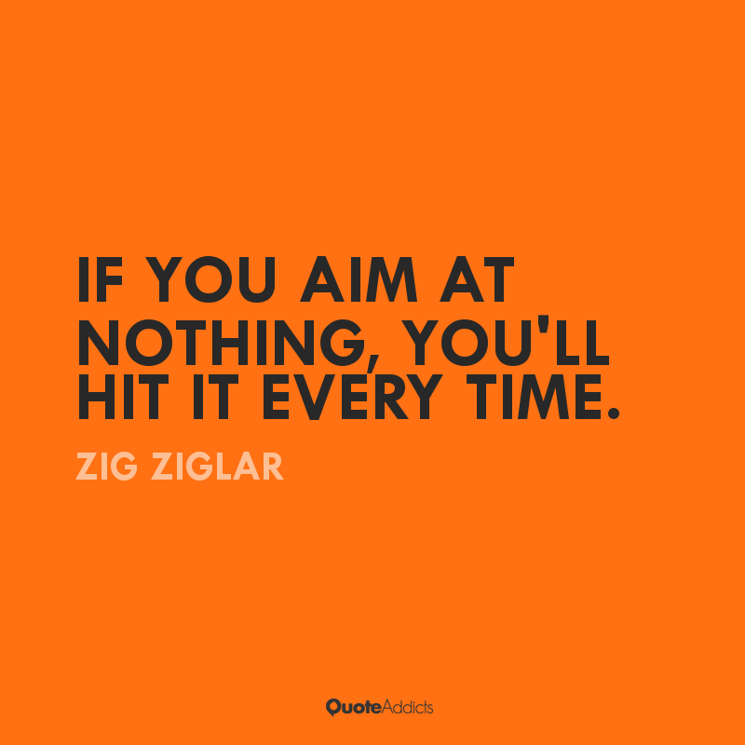

Slide 11
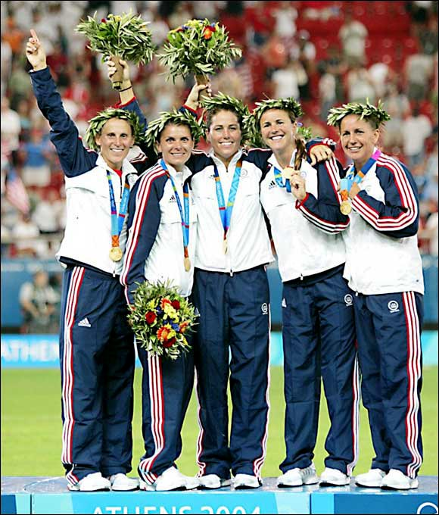

Slide 12
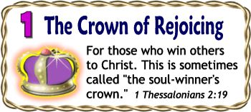
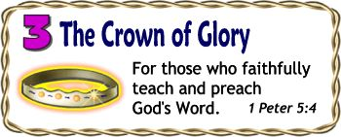
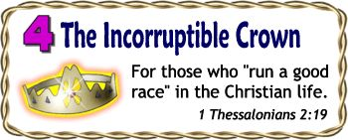

Slide 13
Goal: The Prize
Training: Self control and discipline
Beware: Disqualification

Slide 14
²⁴ Do you not know that in a race all the runners run, but only one receives the prize? So run that you may obtain it. ²⁵ Every athlete exercises self-control in all things. They do it to receive a perishable wreath, but we an imperishable. ²⁶ So I do not run aimlessly; I do not box as one beating the air. ²⁷ But I discipline my body and keep it under control, lest after preaching to others I myself should be disqualified.
1 Corinthians 9:24-27

Slide 15
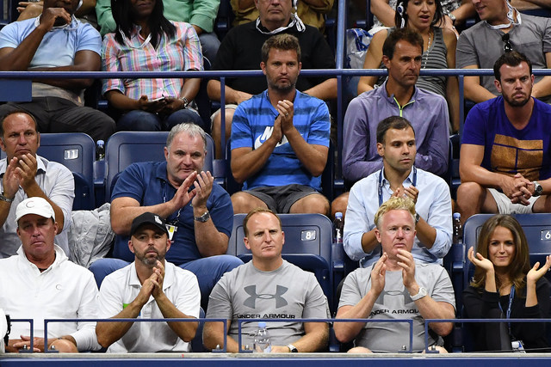

Slide 16
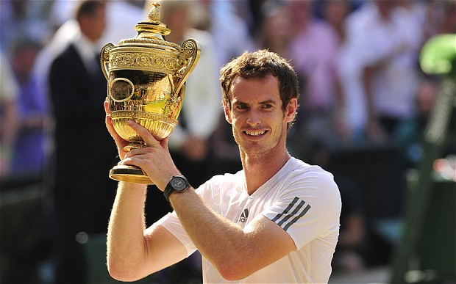

Slide 17
Goal: The Prize
Training: Self control and discipline
Beware: Disqualification

Slide 18
²⁴ Do you not know that in a race all the runners run, but only one receives the prize? So run that you may obtain it. ²⁵ Every athlete exercises self-control in all things. They do it to receive a perishable wreath, but we an imperishable. ²⁶ So I do not run aimlessly; I do not box as one beating the air. ²⁷ But I discipline my body and keep it under control, lest after preaching to others I myself should be disqualified.
1 Corinthians 9:24-27

Slide 19
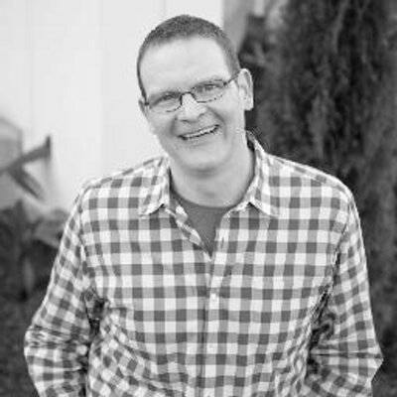
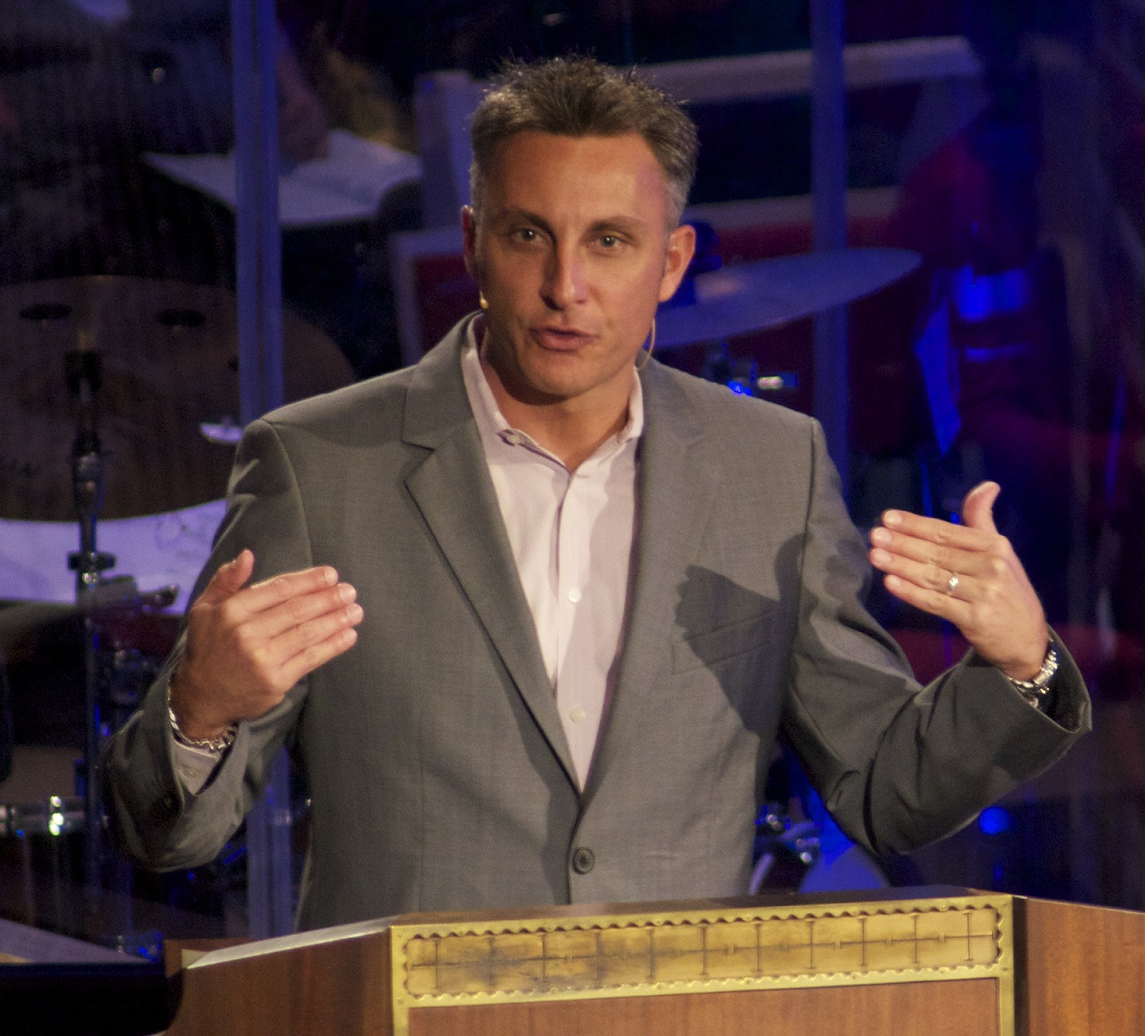
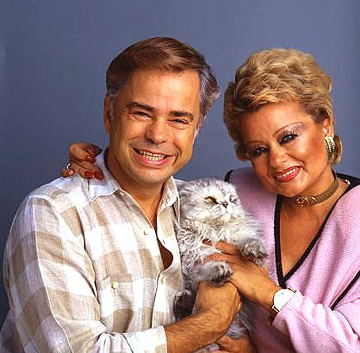
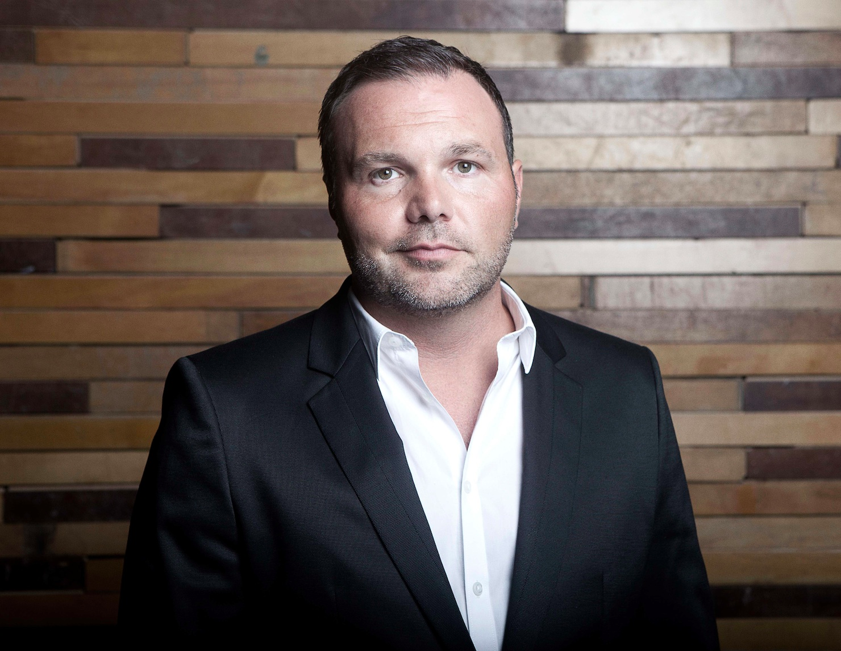

Slide 21
Lessons for Disciples

Slide 22
Order your life in a way to win the prize.

Slide 23
Pick
Sunday Worship
Saying Grace
Fellowship Groups
Daily Devotions
Tithes & Offerings

Slide 24
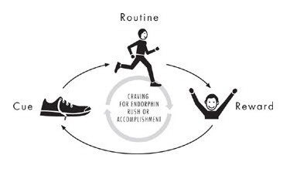
Plan

Slide 25
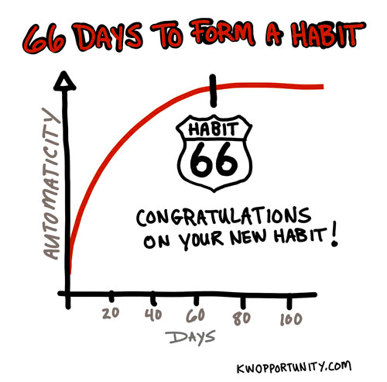
Persevere

Slide 26
