Slide 1
Transformed
Luke the Disciple

Slide 4
For those God foreknew he also predestined to be conformed to the image of his Son . . .
Romans 8:29

Slide 5
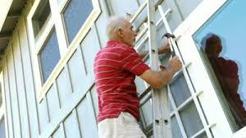

Slide 6
Epaphras, my fellow prisoner in Christ Jesus, sends you greetings. And so do Mark, Aristarchus, Demas and Luke, my fellow workers.
Philemon 1:23-24

Slide 7
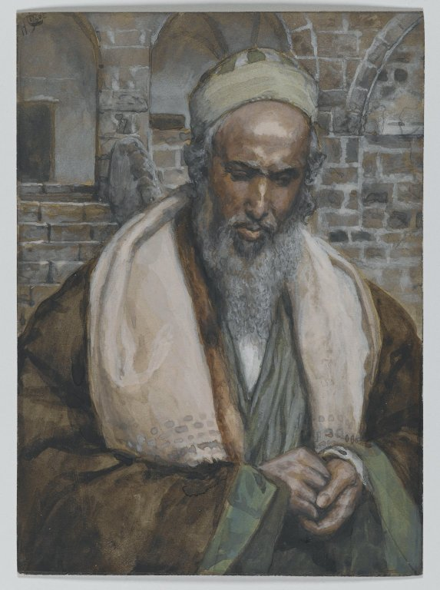

Slide 8
Blessed the church through his ministry

Slide 9
¹ Many have undertaken to draw up an account of the things that have been fulfilled among us, ² just as they were handed down to us by those who from the first were eyewitnesses and servants of the word. ³ With this in mind, since I myself have carefully investigated everything from the beginning, I too decided to write an orderly account for you, most excellent Theophilus, ⁴ so that you may know the certainty of the things you have been taught.
Luke 1:1-4

Slide 11
Now it is required that those who have been given a trust must prove faithful.
1 Corinthians 4:2

Slide 13
"Luke is a historian of the first rank; not merely are his statements of fact trustworthy... [he] should be placed along with the very greatest of historians.”
Sir William Ramsay
Archeologist

Slide 14
You are a manager of the gifts God has given to you. They may be great or small in your eyes, but they matter to God.
Rick Warren

Slide 15
Edified the body through his vocation

Slide 16
Our dear friend Luke, the doctor, and Demas send greetings.
Colossians 4:14

Slide 17
Roman doctors had a knowledge of hundreds of herbal and other medicines, and utilized a variety of surgical procedures, which were carried out using a variety of instruments including forceps, scalpels and catheters.

Slide 19
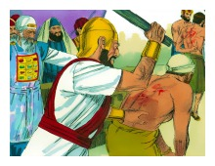

Slide 21
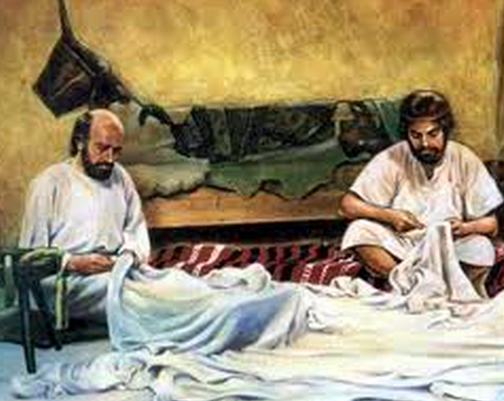

Slide 23
Encouraged coworkers through his presence

Slide 24
Demas, because he loved this world, has deserted me and has gone to Thessalonica. Crescens has gone to Galatia, and Titus to Dalmatia. Only Luke is with me.
2 Timothy 4:10-11

Slide 25
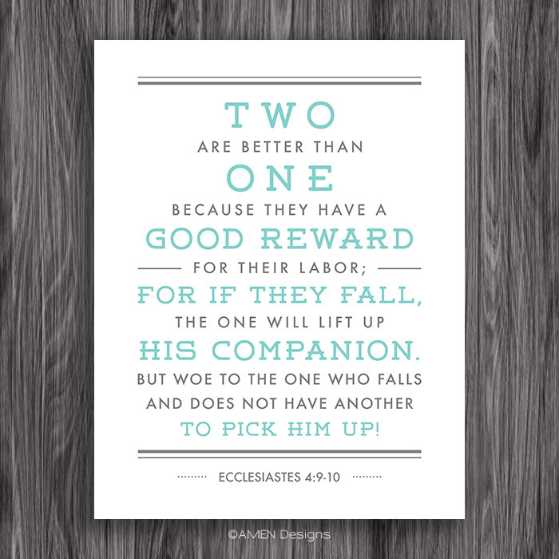

Slide 26
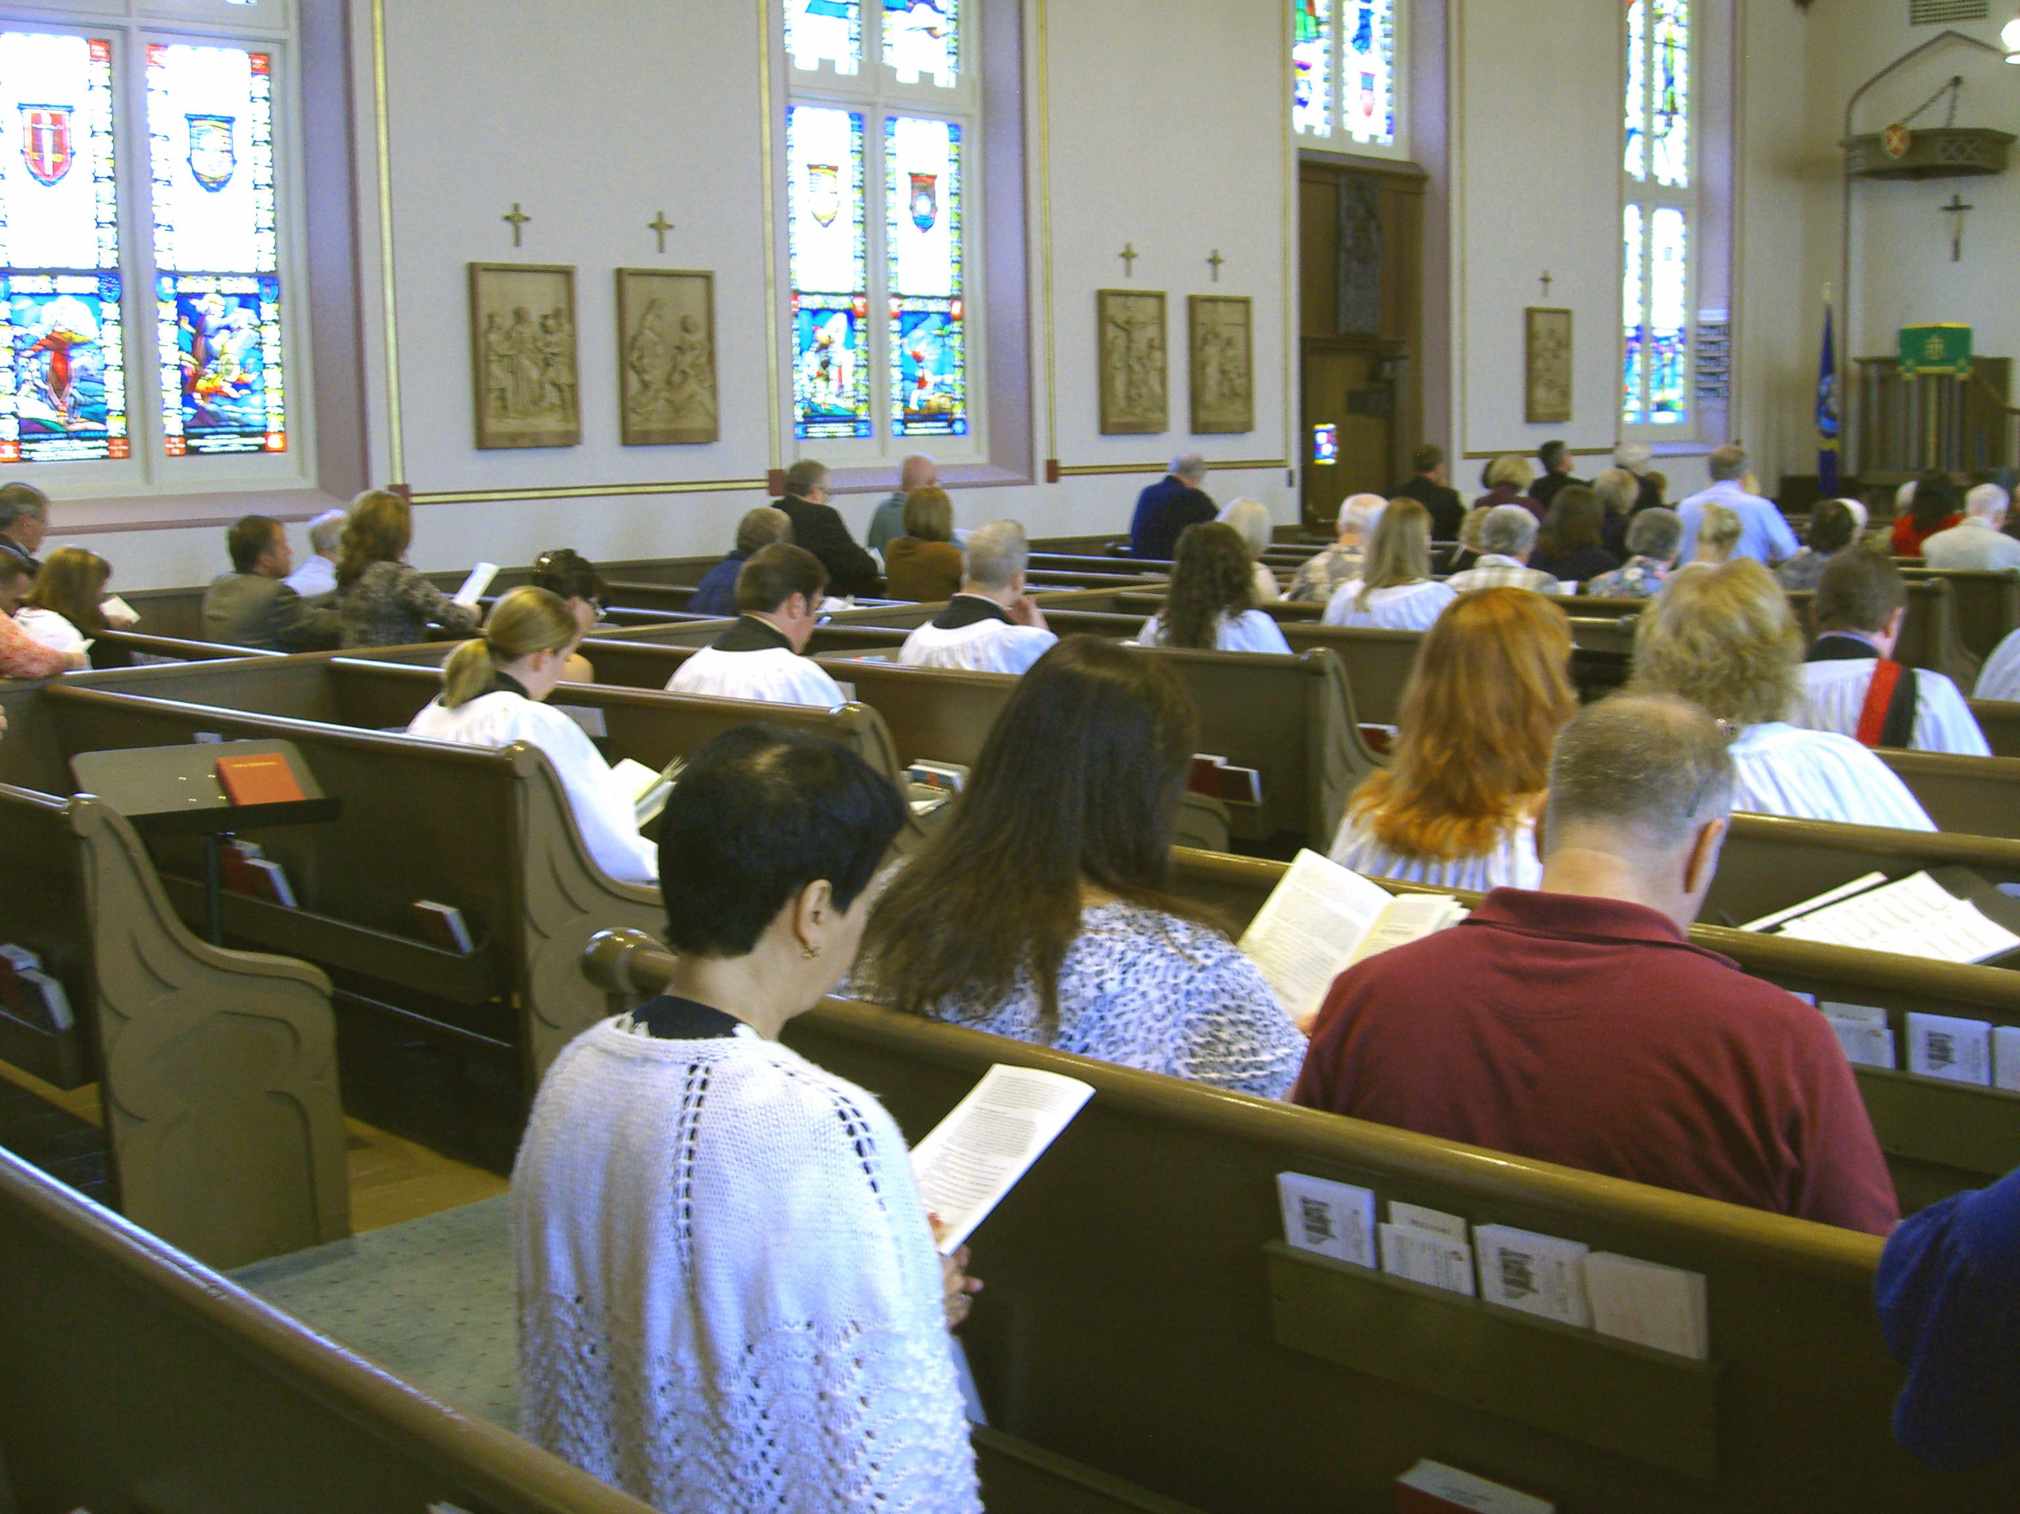

Slide 27
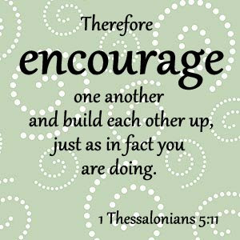

Slide 28
Faithfully serve the Lord through your ministry, your work and by encouraging each other.

