Slide 1
Transformed
The Apostle Paul

Slide 2
For those God foreknew he also predestined to be conformed to the image of his Son . . .
Romans 8:29

Slide 3
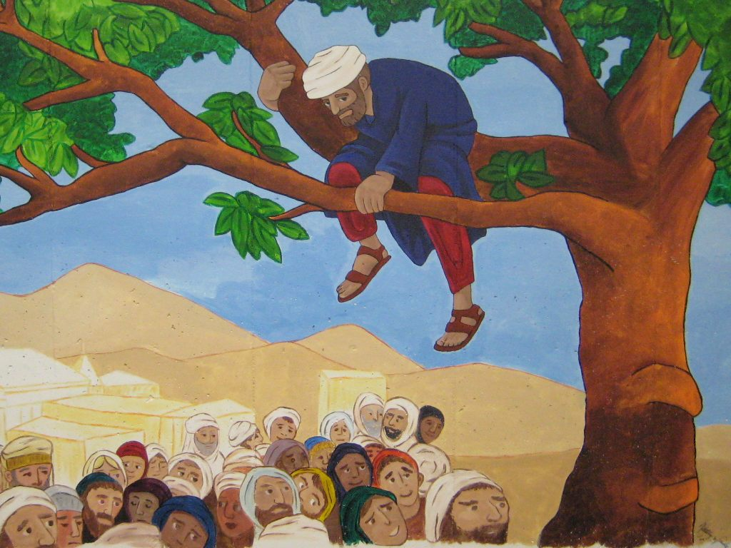

Slide 5
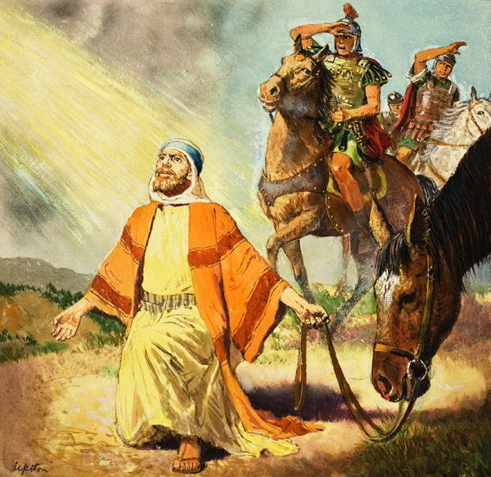

Slide 6
But whatever were gains to me I now consider loss for the sake of Christ. What is more, I consider everything a loss because of the surpassing worth of knowing Christ Jesus my Lord, for whose sake I have lost all things. I consider them garbage, that I may gain Christ.
Philippians 3:7-8

Slide 7
Change in Values

Slide 8
But whatever were gains to me I now consider loss for the sake of Christ. What is more, I consider everything a loss because of the surpassing worth of knowing Christ Jesus my Lord, for whose sake I have lost all things. I consider them garbage, that I may gain Christ.
Philippians 3:7-8

Slide 9
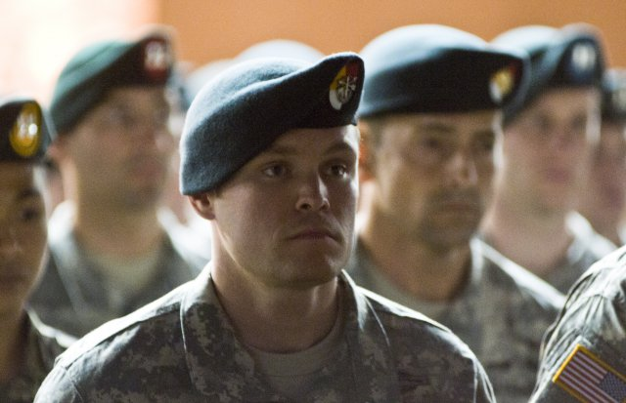

Slide 10
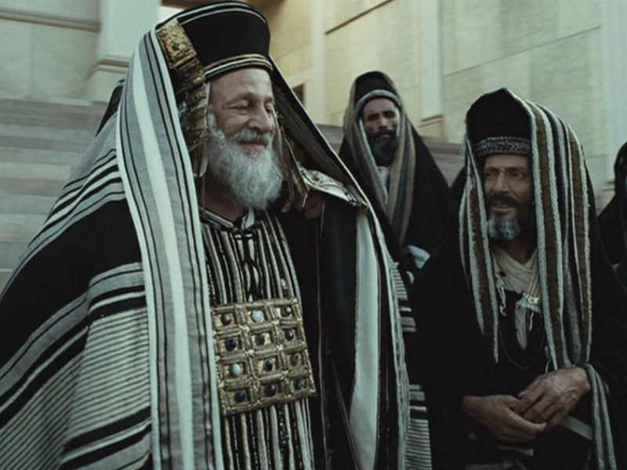

Slide 11
Circumcised on the eighth day, of the
people of Israel, of the
tribe of Benjamin,
a Hebrew of Hebrews;
in regard to the law, a Pharisee; as for
zeal, persecuting the church; as for
righteousness based on the law, faultless.
Philippians 3:5-6

Slide 13
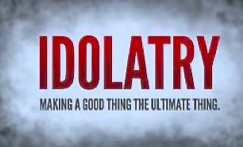

Slide 14
Person
Possession
Career
Job
Decision

Slide 15
Change in Circumstances

Slide 16
But whatever were gains to me I now consider loss for the sake of Christ. What is more, I consider everything a loss because of the surpassing worth of knowing Christ Jesus my Lord, for whose sake I have lost all things. I consider them garbage, that I may gain Christ.
Philippians 3:7-8

Slide 17
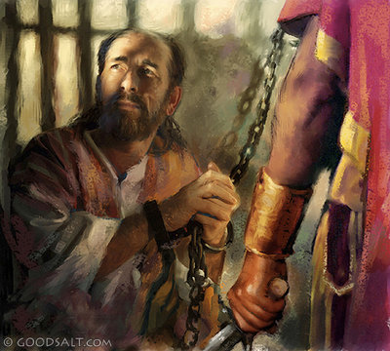

Slide 18
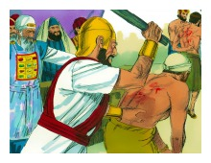

Slide 19
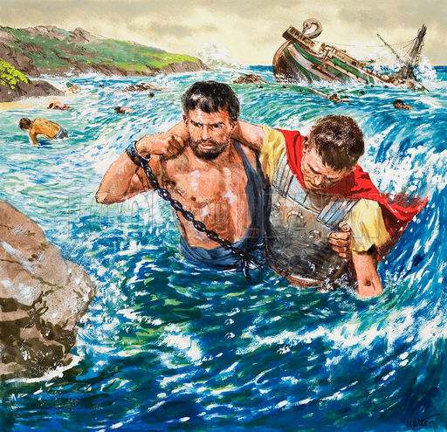

Slide 20
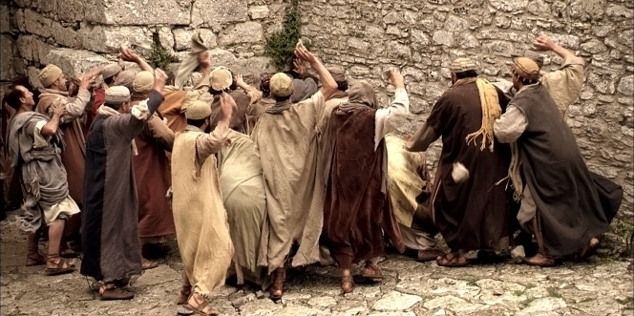

Slide 21
Will anti-gay Christians be politically and socially ostracized? I sure hope so. . . . To those who remain in the fringe minority stubbornly mired in hatred and the dark rationalizations of the past, please try to lose gracefully. You are not being exiled. The world is simply moving on without you.
Sally Kohn

Slide 23
Change in Priorities

Slide 24
But whatever were gains to me I now consider loss for the sake of Christ. What is more, I consider everything a loss because of the surpassing worth of knowing Christ Jesus my Lord, for whose sake I have lost all things. I consider them garbage, that I may gain Christ.
Philippians 3:7-8

Slide 25
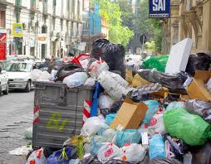

Slide 28
“How can we turn our knowledge about God into knowledge of God? The rule for doing this is simple but demanding. It is that we turn each Truth that we learn about God into
matter for meditation before God, leading to prayer and praise to God.”
J.I. Packer, Knowing God

