Slide 1
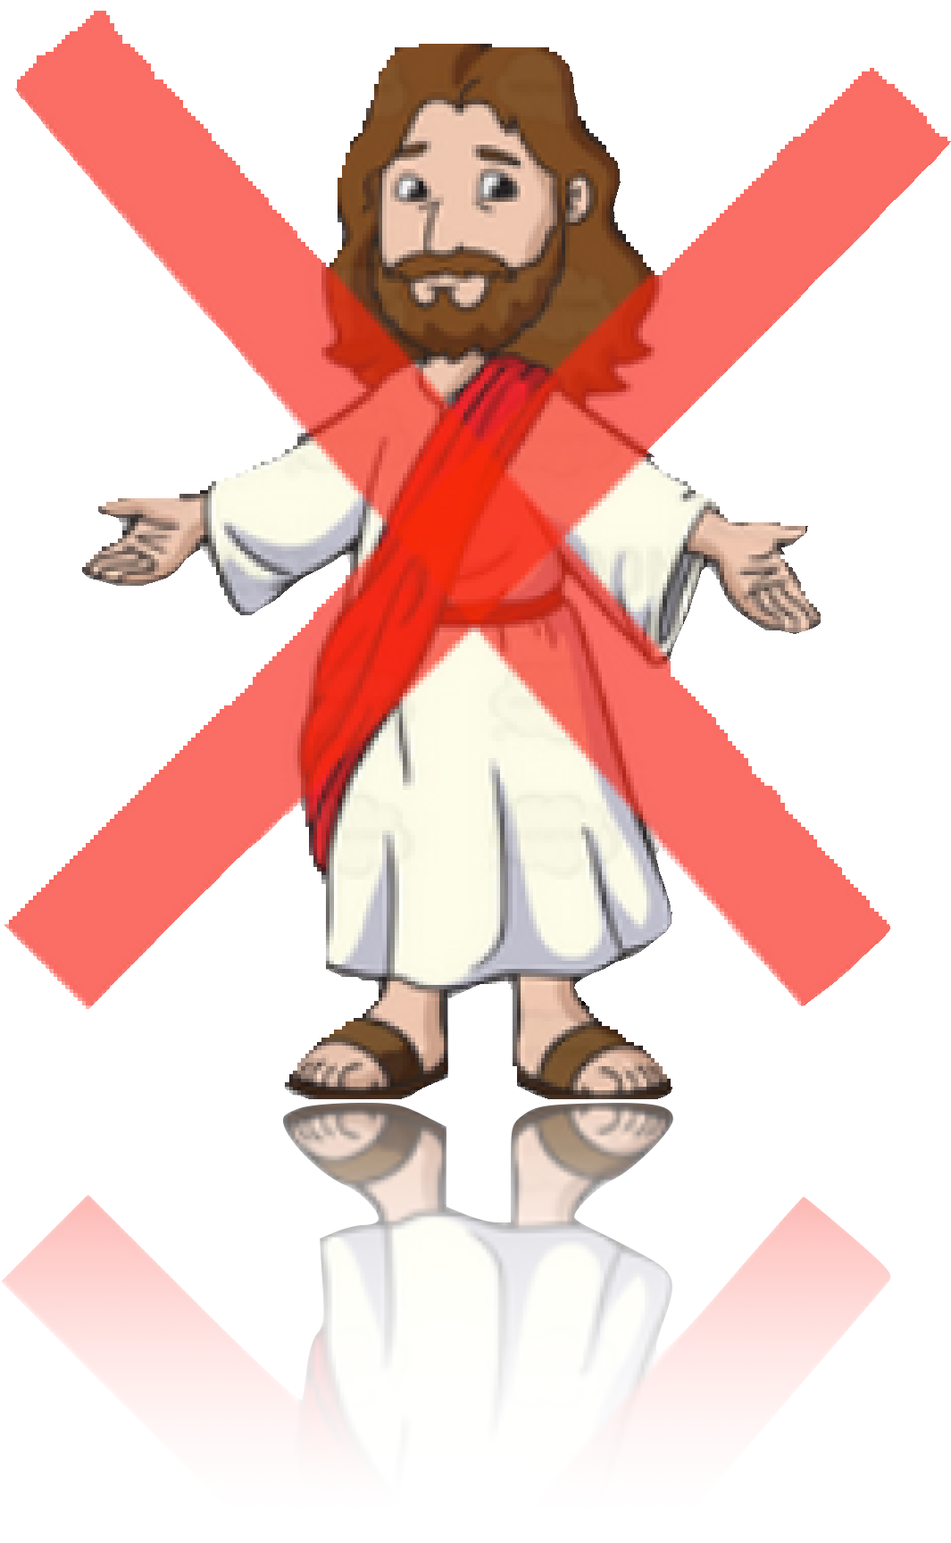
UNLIKE JESUS!
One Area Where Jesus-Followers Excel

Slide 2

UNLIKE JESUS!
One Area Where Jesus-Followers Excel
“To what can I compare this generation? They are like children sitting in the market- places and calling out to others:
“‘We played the pipe for you, and you did not dance;
we sang a dirge,
and you did not mourn.’
For John came neither eating nor drinking, and they say, ‘He has a demon.’ 19 The Son of Man came eating and drinking, and they say, ‘Here is a glutton and a drunkard, a friend of tax collectors and sinners.’ But wisdom is proved right by her deeds.” (Mt. 11)

Slide 3
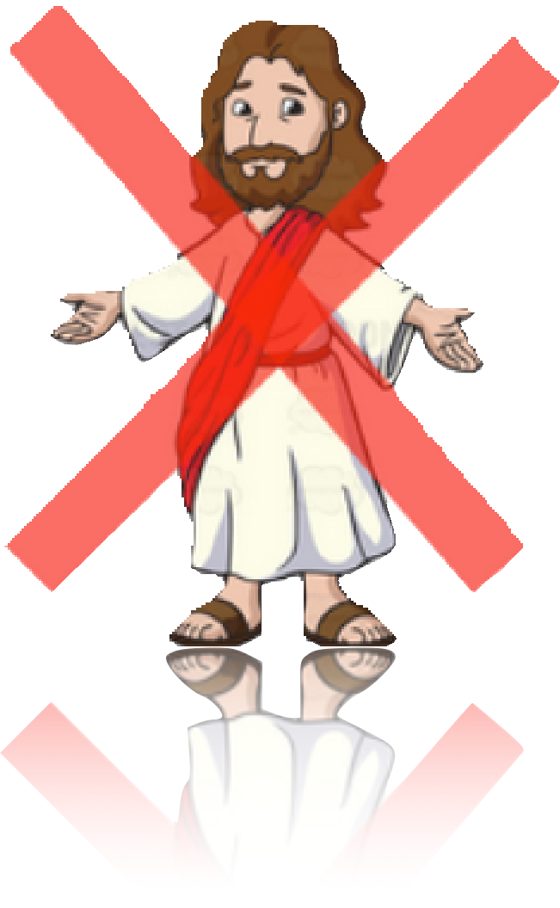
UNLIKE JESUS!
One Area Where Jesus-Followers Excel
“To what can I compare this generation?
They are like children sitting in the marketplaces and calling out to others:
“‘We played the pipe for you, and you did not dance;
we sang a dirge,
and you did not mourn.’
I. Jesus’ Criticism of His Culture (vv. 16-17)

Slide 4
UNLIKE JESUS!
One Area Where Jesus-Followers Excel
“To what can I compare this generation?
They are like children sitting in the marketplaces and calling out to others:
“‘We played the pipe for you, and you did not dance;
we sang a dirge,
and you did not mourn.’
II. The Culture’s Criticism of John the Baptist and Jesus (vv. 16-17)
A. In General
these are plural!

Slide 5
UNLIKE JESUS!
One Area Where Jesus-Followers
Excel
18 For John came neither eating nor drinking, and they say, ‘He has a demon.’ 19 The Son of Man came eating and drinking, and they say, ‘Here is a glutton and a drunkard, a friend of tax collectors and sinners.’ But wisdom is proved right by her deeds.” (Mt. 11)
II. The Culture’s Criticism of John the Baptist and Jesus (vv. 16-17)
B. Specifically
1. JTB’s
frugality

Slide 6

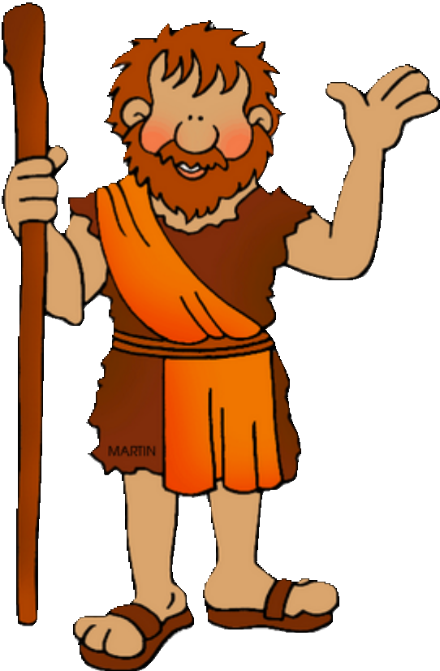


UNLIKE JESUS!
One Area Where Jesus-Followers
Excel
II. The Culture’s Criticism of John the Baptist and Jesus (vv. 16-17)
B. Specifically
Brooks Brothers Two-Button Camel Hair
Sport Coat
$698.00
1. JTB’s
frugality

Slide 7
UNLIKE JESUS!
One Area Where Jesus-Followers
Excel
18 For John came neither eating nor drinking, and they say, ‘He has a demon.’ 19 The Son of Man came eating and drinking, and they say, ‘Here is a glutton and a drunkard, a friend of tax collectors and sinners.’ But wisdom is proved right by her deeds.” (Mt. 11)
II. The Culture’s Criticism of John the Baptist and Jesus (vv. 16-17)
B. Specifically
2. Jesus’
“indulgence”

Slide 8
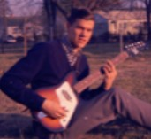
UNLIKE JESUS!
One Area Where Jesus-Followers
Excel
“Avoid all appearance of evil!” (I Thes. 5:22 KVJ)
“Reject every KIND of evil!” (I Thes. 5:22 NIV)
Did the Lord Jesus avoid all APPEARANCE
of evil?
Apparently not! Otherwise, why is Jesus accused of gluttony and drunkenness?

Slide 9
UNLIKE JESUS!
One Area Where Jesus-Followers
Excel
18 For John came neither eating nor drinking, and they say, ‘He has a demon.’ 19 The Son of Man came eating and drinking, and they say, ‘Here is a glutton and a drunkard, a friend of tax collectors and sinners.’ But wisdom is proved right by her deeds.” (Mt. 11)
III. Jesus’ Response to the Culture’s Criticism
(vv. 18-19)
A. Gluttony
B. Drunkenness
C. Friend of Sinners

Slide 10
UNLIKE JESUS!
One Area Where Jesus-Followers
Excel
18 For John came neither eating nor drinking, and they say, ‘He has a demon.’ 19 The Son of Man came eating and drinking, and they say, ‘Here is a glutton and a drunkard, a friend of tax collectors and sinners.’ But wisdom is proved right by her deeds.” (Mt. 11)
III. Jesus’ Response to the Culture’s Criticism
(vv. 18-19)
A. Gluttony
The Word of God on gluttony!

Slide 11
UNLIKE JESUS!
One Area Where Jesus-Followers Excel
The Word of God on gluttony!
“Do not join those who drink too much wine or gorge themselves on meat, for drunkards and gluttons become poor, and drowsiness clothes them in rags.” (Prov. 23:20-21).
Proverbs 28:7 says, “He who keeps the law is a discerning son, but a companion of gluttons disgraces his father.”
Proverbs 23 says, “When you sit to dine with a ruler, note well what is before you, and put a knife to your throat if you are given to gluttony.” (v. 2).

Slide 12

UNLIKE JESUS!
One Area Where Jesus-Followers
Excel
18 For John came neither eating nor drinking, and they say, ‘He has a demon.’ 19 The Son of Man came eating and drinking, and they say, ‘Here is a glutton and a drunkard, a friend of tax collectors and sinners.’ But wisdom is proved right by her deeds.” (Mt. 11)
III. Jesus’ Response to the Culture’s Criticism
(vv. 18-19)
A. Gluttony
The Word of God on gluttony!

Slide 13
UNLIKE JESUS!
One Area Where Jesus-Followers
Excel
18 For John came neither eating nor drinking, and they say, ‘He has a demon.’ 19 The Son of Man came eating and drinking, and they say, ‘Here is a glutton and a drunkard, a friend of tax collectors and sinners.’ But wisdom is proved right by her deeds.” (Mt. 11)
III. Jesus’ Response to the Culture’s Criticism
(vv. 18-19)
B. Drunkenness
The Word of God on drunkenness!

Slide 14
UNLIKE JESUS!
One Area Where Jesus-Followers
Excel
The Word of God on drunkenness!
“Wine is a mocker and beer a brawler; whoever is led astray by them is not wise” (Prov. 20:1).
“It is not for kings to drink wine, not for rulers to crave beer, lest they drink and forget what has been decreed, and deprive all the oppressed of their rights.” (Prov. 31:4-5)
Jesus was certainly not one who lingered over wine or asked, “When will I wake up so I can find another
drink?” (see Prov. 23:29-33).
The Holy Spirit would lead Paul to write: “Do not get drunk on wine, which leads to debauchery. Instead, be filled with the Spirit” (Eph. 5:18)

Slide 15
UNLIKE JESUS!
One Area Where Jesus-Followers
Excel
18 For John came neither eating nor drinking, and they say, ‘He has a demon.’ 19 The Son of Man came eating and drinking, and they say, ‘Here is a glutton and a drunkard, a friend of tax collectors and sinners.’ But wisdom is proved right by her deeds.” (Mt. 11)
III. Jesus’ Response to the Culture’s Criticism
(vv. 18-19)
B. Drunkenness
The Word of God on drunkenness!

Slide 16

UNLIKE JESUS!
One Area Where Jesus-Followers
Excel
18 For John came neither eating nor drinking, and they say, ‘He has a demon.’ 19 The Son of Man came eating and drinking, and they say, ‘Here is a glutton and a drunkard, a friend of tax collectors and sinners.’ But wisdom is proved right by her deeds.” (Mt. 11)
III. Jesus’ Response to the Culture’s Criticism
(vv. 18-19)
C. Friend of Sinners

Slide 17
UNLIKE JESUS!
One Area Where Jesus-Followers Excel
Proof that Jesus was a friend of tax collectors and sinners …..
He chooses a tax collector as one of His disciples! (Mt. 9:9-13)

Slide 18
UNLIKE JESUS!
As Jesus went on from there, he saw a man named Matthew sitting at the tax collector’s booth. “Follow me,” he told him, and Matthew got up and followed him.
While Jesus was having dinner at Matthew’s house, many tax collectors and sinners came and ate with him and his disciples. 11 When the Pharisees saw this, they asked his disciples, “Why does your teacher eat with tax collectors and sinners?”
12 On hearing this, Jesus said, “It is not the healthy who need a doctor, but the sick. 13 But go and learn what this means: ‘I desire mercy, not sacrifice.’ For I have not come to call the righteous, but sinners.” (Mt. 9)

Slide 19
UNLIKE JESUS!
One Area Where Jesus-Followers Excel
Proof that Jesus was a friend of tax collectors and sinners …..
He chooses a tax collector as one of His disciples! (Mt. 9:9-13)
He describes His mission as coming for such people. (Luke 5, Luke 19, Matthew 18)

Slide 20
UNLIKE JESUS!
29 Then Levi held a great banquet for Jesus at his house, and a large crowd of tax collectors and others were eating with them. 30 But the Pharisees and the teachers of the
law who belonged to their sect complained to his disciples, “Why do you eat and drink with tax collectors and sinners?”
31 Jesus answered them, “It is not the healthy who need a doctor, but the sick. 32 I have not come to call the righteous, but sinners to repentance.” (Luke 5)

Slide 21
UNLIKE JESUS!
Jesus entered Jericho and was passing through. 2 A man was there by the name of Zacchaeus; he was a chief tax collector
and was wealthy. 3 He wanted to see who Jesus was, but because he was short he could not see over the crowd. 4 So he ran ahead and climbed a sycamore-fig tree to see him, since Jesus was coming that way.
5 When Jesus reached the spot, he looked up and said to him, “Zacchaeus, come down immediately. I must stay at your house today.” 6 So he came down at once and welcomed him gladly.

Slide 22
UNLIKE JESUS!
All the people saw this and began to mutter, “He has gone to be the guest of a sinner.”
But Zacchaeus stood up and said to the Lord, “Look, Lord! Here and now I give half of my possessions to the poor, and if I have cheated anybody out of anything, I will pay back four times the amount.”
Jesus said to him, “Today salvation has come to this house, because this man, too, is a son of Abraham.
For the Son of Man came to seek and to save the lost.” (Luke 19)

Slide 23
UNLIKE JESUS!
15 “If your brother or sister sins, go and point out their fault, just between the two of you. If they listen to you, you have won them over. 16 But if they will not listen,
take one or two others along, so that ‘every matter may be established by the testimony of two or three witnesses.’
17 If they still refuse to listen, tell it to the church; and if they refuse to listen even to the church, treat them as you would a pagan or a tax collector.” (Matthew 18)

Slide 24
UNLIKE JESUS!
One Area Where Jesus-Followers Excel
Proof that Jesus was a friend of tax collectors and sinners …..
He chooses a tax collector as one of His disciples! (Mt. 9:9-13)
He describes His mission as coming for such people. (Luke 5, Luke 19, Matthew 18)
The famous story of the Prodigal Son is told specifically because He welcomed sinners!

Slide 25
UNLIKE JESUS!
Now the tax collectors and sinners were all gathering around to hear Jesus. 2 But the Pharisees and the teachers of the law muttered,
“This man welcomes sinners and eats with them.”
[The story of the lost sheep- vv. 3-7] “I tell you that in the same way there will be more rejoicing in heaven over one sinner who repents than over ninety-nine righteous persons who do not need to repent.”
[The story of the lost coin- vv. 8-10] “ In the same way, I tell you, there is rejoicing in the presence of the angels of God over one sinner who repents.”
[The story of the prodigal son- vv. 11-32] “‘My son,’ the father said, ‘you are always with me, and everything I have is yours. 32 But we had to celebrate and be glad, because this brother of yours was dead and is alive again; he was lost and is found.’”

Slide 26
UNLIKE JESUS!
One Area Where Jesus-Followers Excel
So, now what? Where do we go from here?
1. We repent for not being like the Lord Jesus!
Some have confused James 4 and Matthew 11!
4 You adulterous people, don’t you know that friendship with the world means enmity against God? Therefore, anyone who chooses to be a friend of the world becomes an enemy of God.” (James 4)
19 The Son of Man came eating and drinking, and they say, ‘Here is a glutton and a drunkard, a friend of tax collectors and sinners.’ (Mt. 19)

Slide 27
UNLIKE JESUS!
One Area Where Jesus-Followers Excel
So, now what? Where do we go from here?
2. We look for opportunities to spend time with those who need the Lord! What did the Lord Jesus do?
HE FED THEM!
Is it possible that we spend all our time with the healthy, the righteous, etc?
HE ATE WITH THEM!
HE SPENT TIME WITH THEM!
HE SOUGHT THEM OUT! (Mt. 18)

Slide 28
UNLIKE JESUS!
One Area Where Jesus-Followers Excel
So, now what? Where do we go from here?
2. We look for opportunities to spend time with those who need the Lord! What did the
Lord Jesus do?
We are not talking about
spiritual relationships!
HE SPENT TIME, FED & ATE WITH THEM!
AND SOUGHT THEM OUT!
“Do not be yoked together with unbelievers. For what do righteous- ness and wickedness have in common? Or what fellowship can light have with darkness?” (2 Cor.

Slide 29
UNLIKE JESUS!
One Area Where Jesus-Followers Excel
So, now what? Where do we go from here?
3. We become aware of our excuses to spend time only with believers and not be a friend of sinners lMikyecJheildsruens!?w?a?sM. ake your
home the fun center!!!
“I
simply don’t have the time!”
“I don’t want to be criticized by Christians!”
“I’m afraid I’ll fall into compromise!”

Slide 30
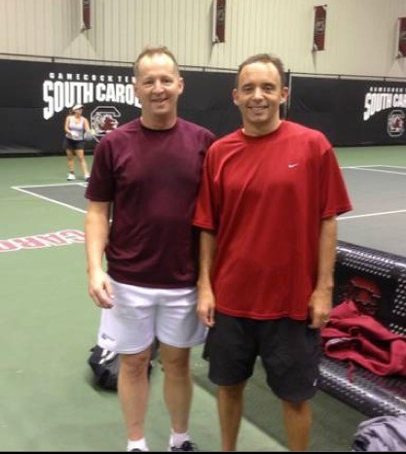









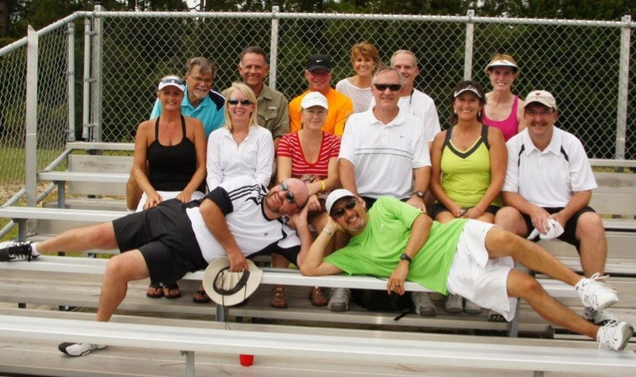
UNLIKE JESUS!
One Area Where Jesus-Followers Excel
Some suggestions:
1. Conversations, not conversions!
2. Learn to listen to their story!
NOW BEFOR
ETERNI
E?
3. Pursue your hobby or sport with unbelievers!

Slide 31











FRIENDSHIP CONTINUUM:
“a friend of tax collectors and sinners”
DEVELOPING
CLOSE
STRANGERS
ACQUAINTANCES
FRIENDS
FRIENDS
no contact with unbelievers
being a friend of sinners
Our friendships are not conditional!
becoming more like the Lord Jesus!
we should have no fellowship with the children of darkness!
We are not seeking spiritual fellowship with those who don’t know Christ.
Our spirituality ought to make us better friends & neighbors!

Slide 32
UNLIKE JESUS!
One Area Where Jesus-Followers Excel
“To what can I compare this generation? They are like children sitting in the market- places and calling out to others:
“‘We played the pipe for you, and you did not dance;
we sang a dirge,
and you did not mourn.’
For John came neither eating nor drinking, and they say, ‘He has a demon.’ 19 The Son of Man came eating and drinking, and they say, ‘Here is a glutton and a drunkard, a friend of tax collectors and sinners.’ But wisdom is proved right by her deeds.” (Mt. 11)

