Slide 1
Conformed to Christ’s Image
A View from the Tree

Slide 2
For those God foreknew he also predestined to be conformed to the image of his Son . . .
Romans 8:29

Slide 4
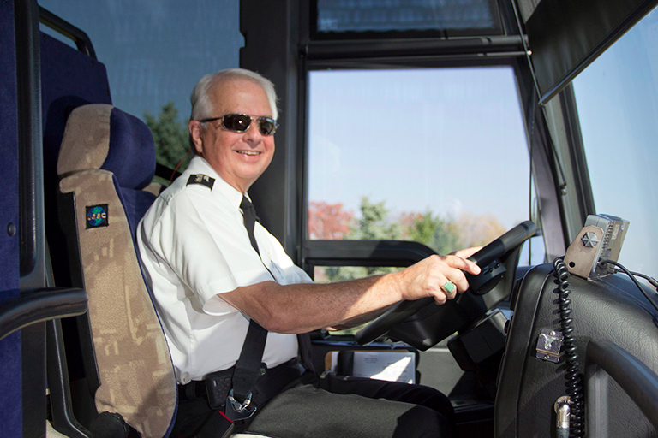

Slide 6
¹Jesus entered Jericho and was passing through. ² A man was there by the name of Zacchaeus; he was a chief tax collector and was wealthy. ³ He wanted to see who Jesus was, but because he was short he could not see over the crowd. ⁴ So he ran ahead and climbed a sycamore-fig tree to see him, since Jesus was coming that way.

Slide 7
⁵ When Jesus reached the spot, he looked up and said to him, “Zacchaeus, come down immediately. I must stay at your house today.” ⁶ So he came down at once and welcomed him gladly. ⁷ All the people saw this and began to mutter, “He has gone to be the guest of a sinner.”

Slide 8
⁸ But Zacchaeus stood up and said to the Lord, “Look, Lord! Here and now I give half of my possessions to the poor, and if I have cheated anybody out of anything, I will pay back four times the amount.”

Slide 9
⁹ Jesus said to him, “Today salvation has come to this house, because this man, too, is a son of Abraham. ¹⁰ For the Son of Man came to seek and to save the lost.”

Slide 10
God Loves Everyone

Slide 11
¹Jesus entered Jericho and was passing through. ² A man was there by the name of Zacchaeus; he was a chief tax collector and was wealthy. ³ He wanted to see who Jesus was, but because he was short he could not see over the crowd. ⁴ So he ran ahead and climbed a sycamore-fig tree to see him, since Jesus was coming that way.

Slide 12
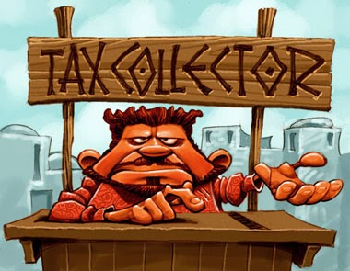

Slide 13
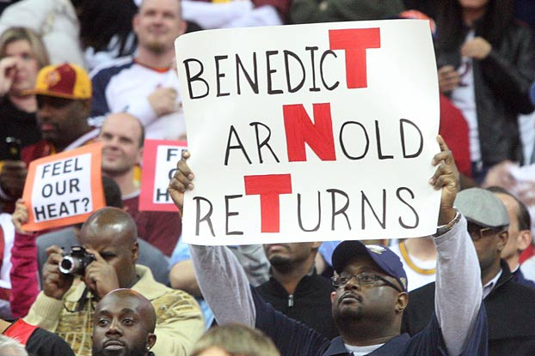

Slide 14
⁵ When Jesus reached the spot, he looked up and said to him, “Zacchaeus, come down immediately. I must stay at your house today.” ⁶ So he came down at once and welcomed him gladly. ⁷ All the people saw this and began to mutter, “He has gone to be the guest of a sinner.”

Slide 16
God Seeks Us Out

Slide 18
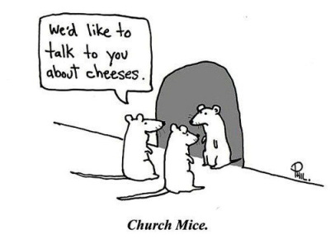

Slide 19
⁵ When Jesus reached the spot, he looked up and said to him, “Zacchaeus, come down immediately. I must stay at your house today.” ⁶ So he came down at once and welcomed him gladly.

Slide 22
God Brings Change

Slide 23
⁸ But Zacchaeus stood up and said to the Lord, “Look, Lord! Here and now I give half of my possessions to the poor, and if I have cheated anybody out of anything, I will pay back four times the amount.”

Slide 24
⁸ But Zacchaeus stood up and said to the Lord, “Look, Lord! Here and now I give half of my possessions to the poor, and if I have cheated anybody out of anything, I will pay back four times the amount.”

Slide 25
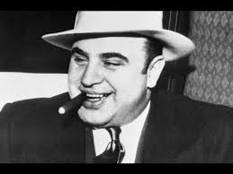

Slide 26
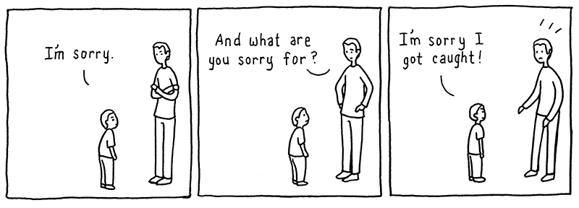

Slide 27
Seek

Slide 29
Receive

Slide 30
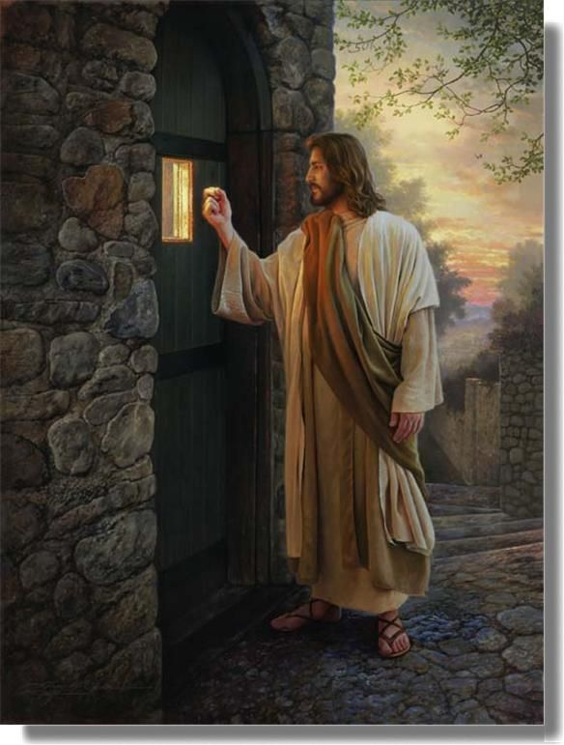

Slide 31
Repent

Slide 32
“Repentance is not merely behavior reform.
But because true repentance involves a
change of heart and purpose, it inevitably
results in a change of behavior.”
Dr. John McArthur

