Slide 1
Advent
Preparing for Jesus

Slide 3
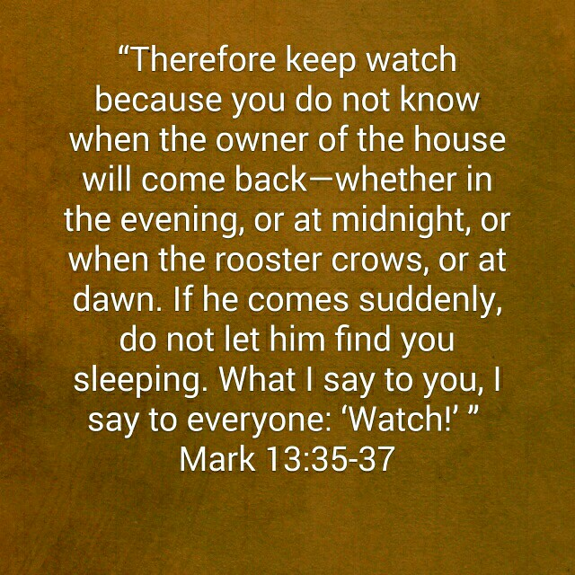

Slide 5
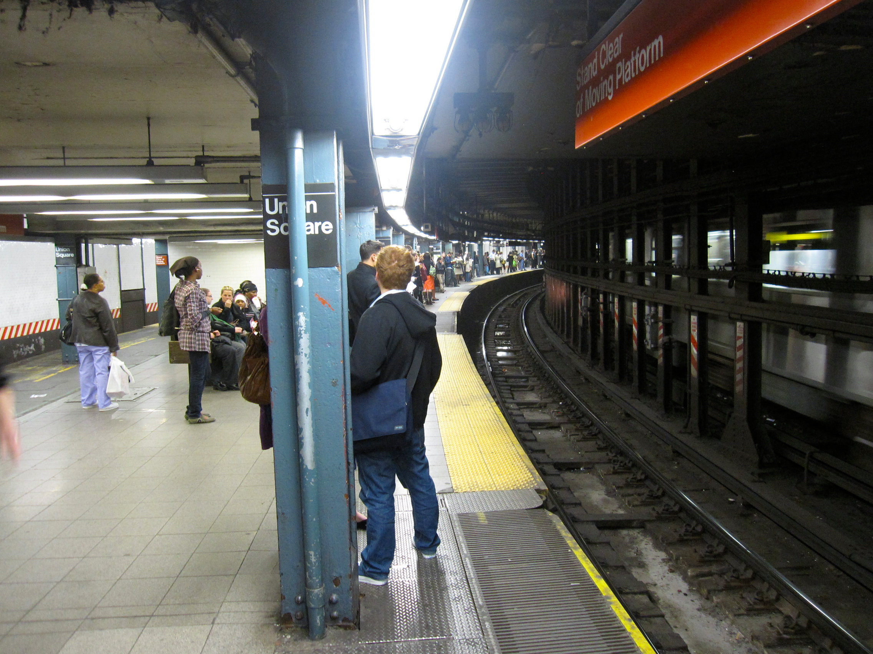

Slide 6
¹⁶ Rejoice always, ¹⁷ pray continually, ¹⁸ give thanks in all circumstances; for this is God’s will for you in Christ Jesus.
¹⁹ Do not quench the Spirit. ²⁰ Do not treat prophecies with contempt ²¹ but test them all; hold on to what is good, ²² reject every kind of evil.

Slide 7
²³ May God himself, the God of peace, sanctify you through and through. May your whole spirit, soul and body be kept blameless at the coming of our Lord Jesus Christ. ²⁴ The one who calls you is faithful, and he will do it.
1 Thessalonians 5:16-24

Slide 8
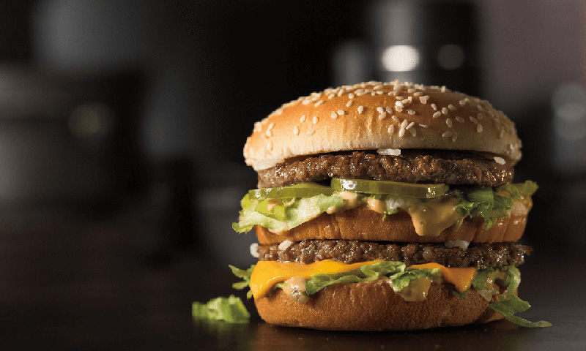

Slide 9
Personal response toward God

Slide 10
¹⁶ Rejoice always, ¹⁷ pray continually, ¹⁸ give thanks in all circumstances; for this is God’s will for you in Christ Jesus.

Slide 12
¹⁶ Rejoice always, ¹⁷ pray continually, ¹⁸ give thanks in all circumstances; for this is God’s will for you in Christ Jesus.

Slide 13
Implications:
The use of the voice is not an essential element in prayer.
The posture of prayer is not of primary importance.
The place of prayer is not of great importance.
The particular time of prayer is not important.
A Christian should never be in a place where he could not pray.

Slide 14
¹⁶ Rejoice always, ¹⁷ pray continually, ¹⁸ give thanks in all circumstances; for this is God’s will for you in Christ Jesus.

Slide 15
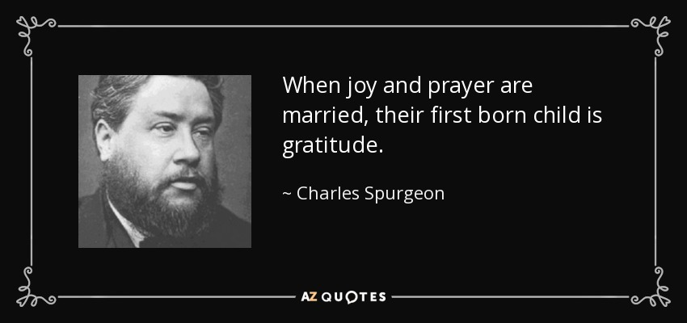

Slide 16
Community response toward God

Slide 17
¹⁹ Do not quench the Spirit. ²⁰ Do not treat prophecies with contempt ²¹ but test them all; hold on to what is good, ²² reject every kind of evil.

Slide 19
¹⁹ Do not quench the Spirit. ²⁰ Do not treat prophecies with contempt ²¹ but test them all; hold on to what is good, ²² reject every kind of evil.

Slide 21
¹⁹ Do not quench the Spirit. ²⁰ Do not treat prophecies with contempt ²¹ but test them all; hold on to what is good, ²² reject every kind of evil.

Slide 23
Apply

Slide 24
As we await Christ’s coming, seek sanctification through God’s power.

Slide 25
