Slide 1
Journey to the Cross
Wilderness Experience

Slide 3
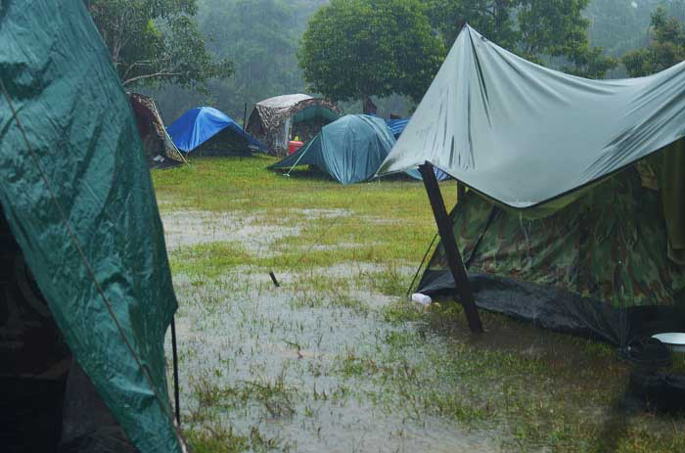

Slide 5
Renew our walk with God through various spiritual practices

Slide 6
¹ Jesus, full of the Holy Spirit, left the Jordan and was led by the Spirit into the wilderness, ² where for forty days he was tempted by the devil. He ate nothing during those days, and at the end of them he was hungry.
³ The devil said to him, “If you are the Son of God, tell this stone to become bread.”
⁴ Jesus answered, “It is written: ‘Man shall not live on bread alone.’”

Slide 7
⁵ The devil led him up to a high place and showed him in an instant all the kingdoms of the world. ⁶ And he said to him, “I will give you all their authority and splendor; it has been given to me, and I can give it to anyone I want to. ⁷ If you worship me, it will all be yours.”
⁸ Jesus answered, “It is written: ‘Worship the Lord your God and serve him only.’”

Slide 8
⁹ The devil led him to Jerusalem and had him stand on the highest point of the temple. “If you are the Son of God,” he said, “throw yourself down from here. ¹⁰ For it is written:
“‘He will command his angels concerning you
to guard you carefully;
¹¹ they will lift you up in their hands,
so that you will not strike your foot against a stone.’”
¹² Jesus answered, “It is said: ‘Do not put the Lord your God to the test.’”
¹³ When the devil had finished all this tempting, he left him until an opportune time.
Luke 4:1-13

Slide 9
¹ Jesus, full of the Holy Spirit, left the Jordan and was led by the Spirit into the wilderness, ² where for forty days he was tempted by the devil. He ate nothing during those days, and at the end of them he was hungry.

Slide 11
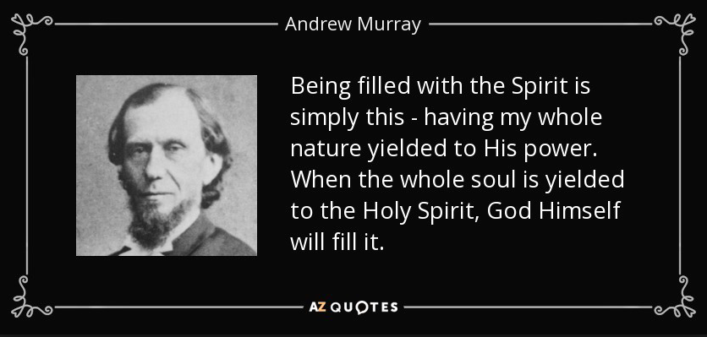

Slide 12
¹ Jesus, full of the Holy Spirit, left the Jordan and was led by the Spirit into the wilderness, ² where for forty days he was tempted by the devil. He ate nothing during those days, and at the end of them he was hungry.

Slide 13
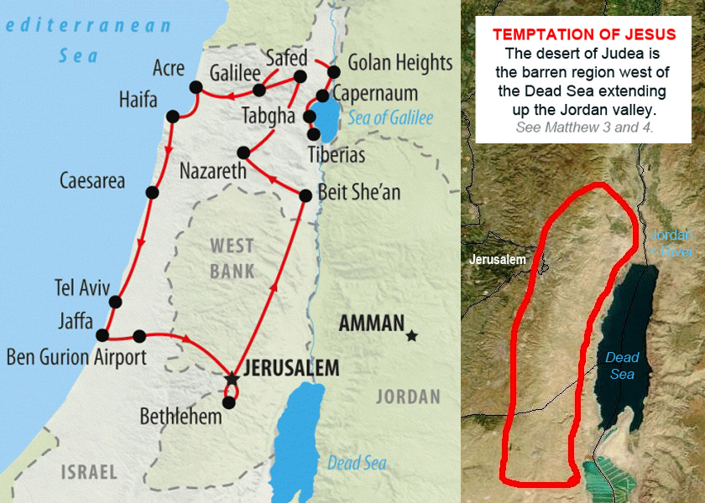

Slide 15
¹ Jesus, full of the Holy Spirit, left the Jordan and was led by the Spirit into the wilderness, ² where for forty days he was tempted by the devil. He ate nothing during those days, and at the end of them he was hungry.

Slide 16
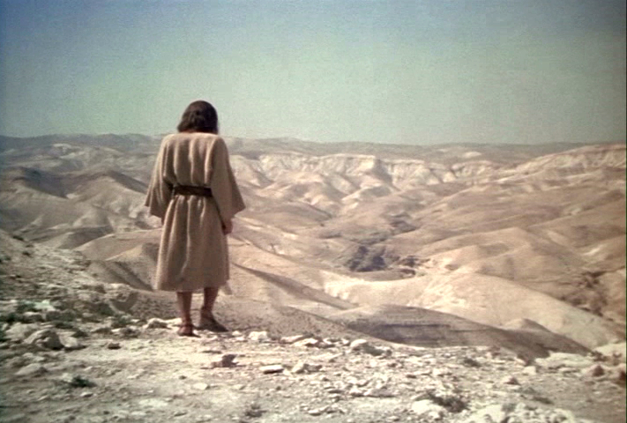

Slide 17
Solitude
Fasting
Prayer
Meditation

Slide 18
¹ Jesus, full of the Holy Spirit, left the Jordan and was led by the Spirit into the wilderness, ² where for forty days he was tempted by the devil. He ate nothing during those days, and at the end of them he was hungry.

Slide 19
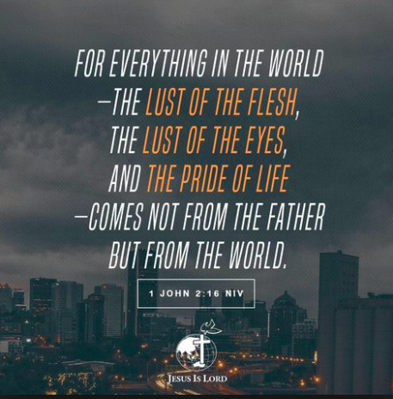

Slide 20
Lust of the Flesh
³ The devil said to him, “If you are the Son of God, tell this stone to become bread.”
⁴ Jesus answered, “It is written: ‘Man shall not live on bread alone.’” (Deuteronomy 8:3)

Slide 21
Lust of the Eyes
⁵ The devil led him up to a high place and showed him in an instant all the kingdoms of the world. ⁶ And he said to him, “I will give you all their authority and splendor; it has been given to me, and I can give it to anyone I want to. ⁷ If you worship me, it will all be yours.”
⁸ Jesus answered, “It is written: ‘Worship the Lord your God and serve him only.’” (Deuteronomy 6:13)

Slide 22
Pride of Life
⁹ The devil led him to Jerusalem and had him stand on the highest point of the temple. “If you are the Son of God,” he said, “throw yourself down from here. ¹⁰ For it is written:
“‘He will command his angels concerning you
to guard you carefully;
¹¹ they will lift you up in their hands,
so that you will not strike your foot against a stone.’”
¹² Jesus answered, “It is said: ‘Do not put the Lord your God to the test.’” (Deuteronomy 6:16)

Slide 23
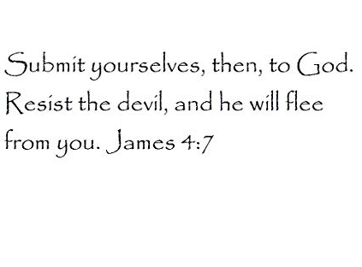

Slide 24
Lesson for disciples

Slide 25
Renew our walk with God through various spiritual practices

