Slide 1
Into the Word 紮根聖經
Word Inspired 神所默示的聖經

Slide 2
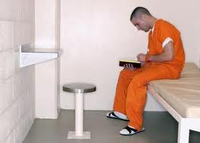

Slide 3
¹⁶ All Scripture is God-breathed and is useful for teaching, rebuking, correcting and training in righteousness, ¹⁷ so that the servant of God may be thoroughly equipped for every good work.
2 Timothy 3:16-17
¹⁶ 聖經都是神所默示的, 於教訓、督責、使人歸正、教導人學義都是有益的， ¹⁷ 叫屬神的人得以完全，豫備行各樣的善事。
提後：3:16-17

Slide 4
Challenge:
Be inspired by the inspired Word of God that you experience transformation.
願神所默示的聖經啓迪我，願我的生命被神的話語更新。

Slide 5
Inspired （神所默示的）

Slide 6
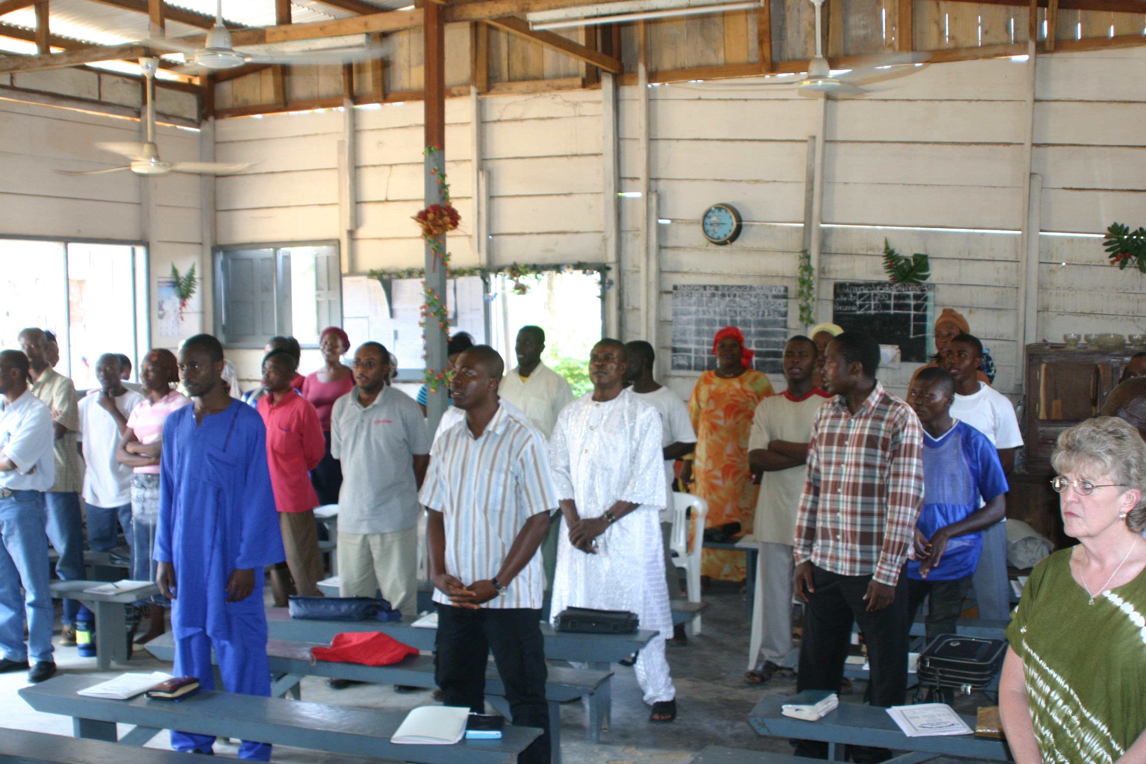
Teaching （教訓）

Slide 7
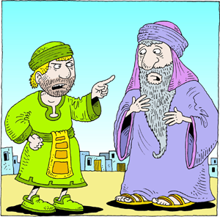
Rebuking （督責）
ChristArt.com

Slide 8
Correcting （使人歸正）

Slide 9
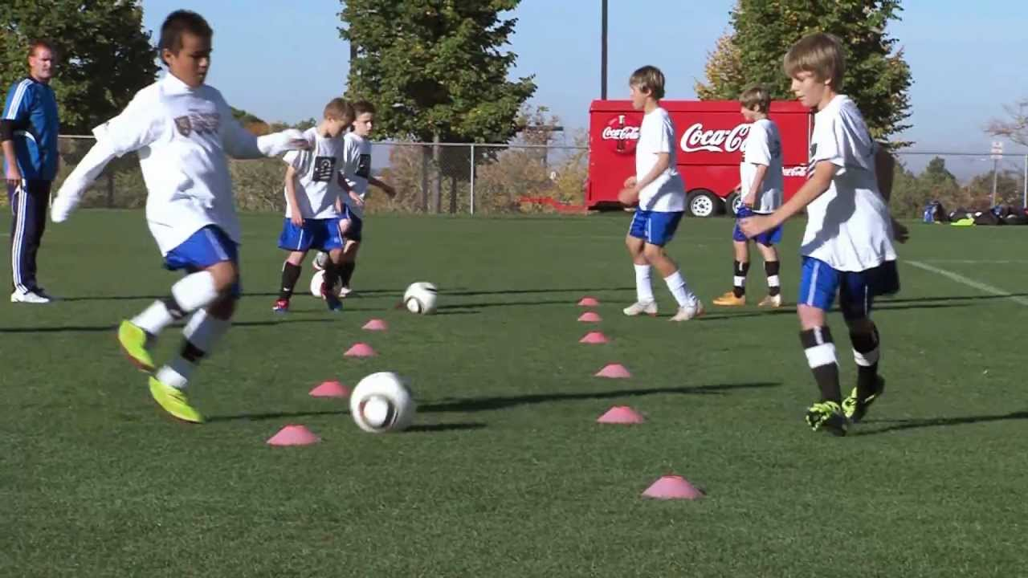
Training in Righteousness （教導人學義）

Slide 10
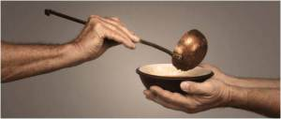
Result: Good Works
（行善事）

Slide 11
Our Response 我們的回應
Study the Word 學習聖經
Reflect on the Word 思考聖經
Apply the Word 應用聖經

Slide 12
Be inspired by the inspired Word of God that you may experience transformation and be an agent of transformation.
願神所默示的聖經啓迪我，願我的生命被神的話語更新。

